Slide 1

BECK TECH AHEAD
INNOVATION FOR THE FUTURE
Beck-Technology.com
Because Estimators Rock

Slide 2

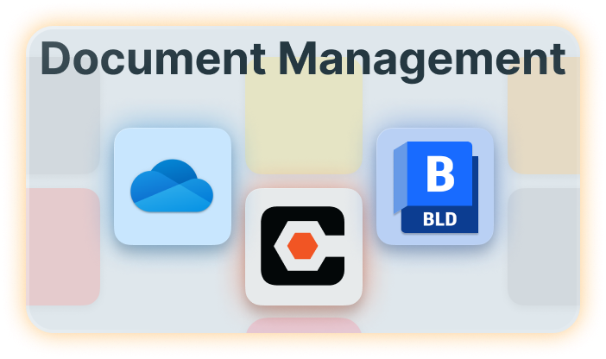
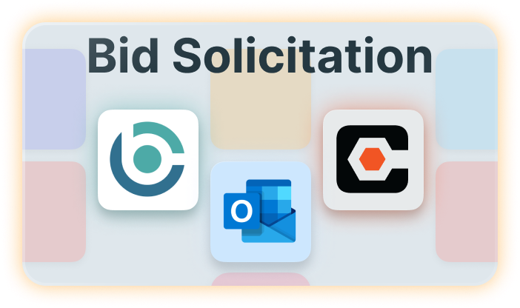
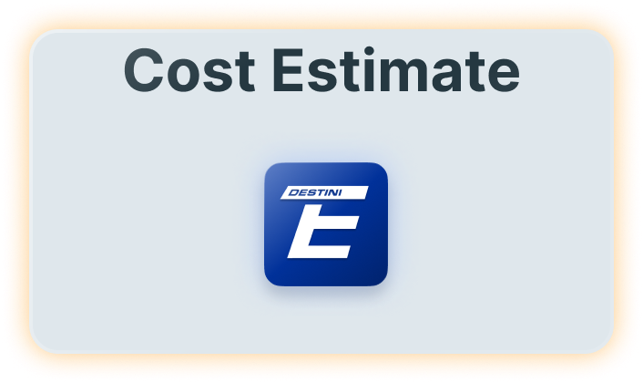

Notes:
Document Management -> Bid Solictation

Slide 3

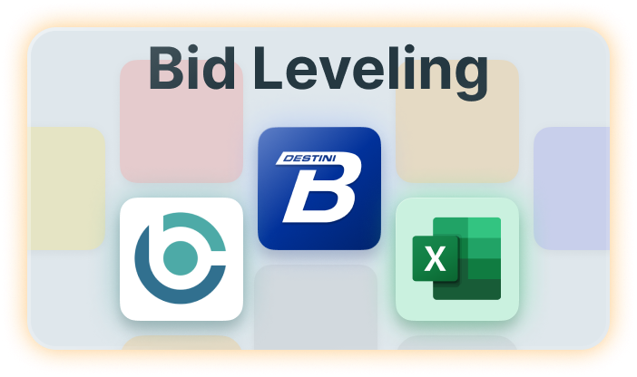
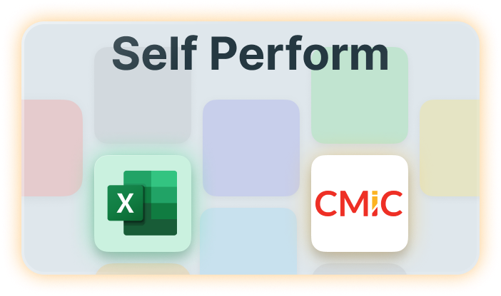
Notes:
Self Perform -> Cost Estimate

Slide 4


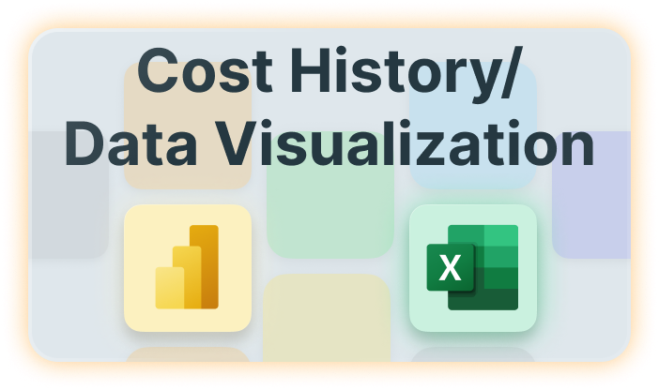

Slide 5
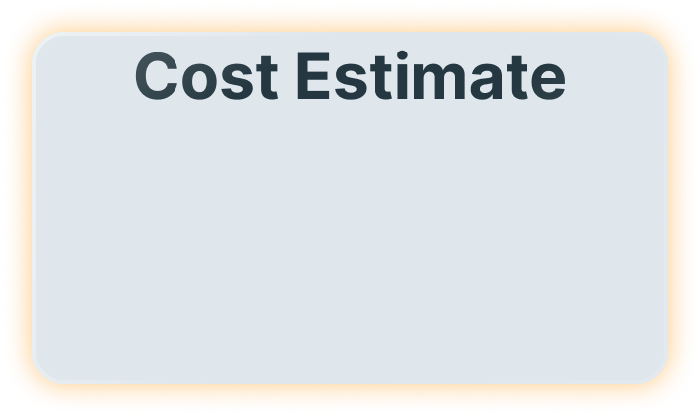

Notes:
Cost History / Data Visualization -> Bid Solicitation
Over the next 12 to 24 months we plan to clean up this spider web focusing on making estimator a bigger part of your team

Slide 6
Notes:
Over the next 12 to 24 months we plan to clean up this spider web focusing on making estimator a bigger part of your team

Slide 7



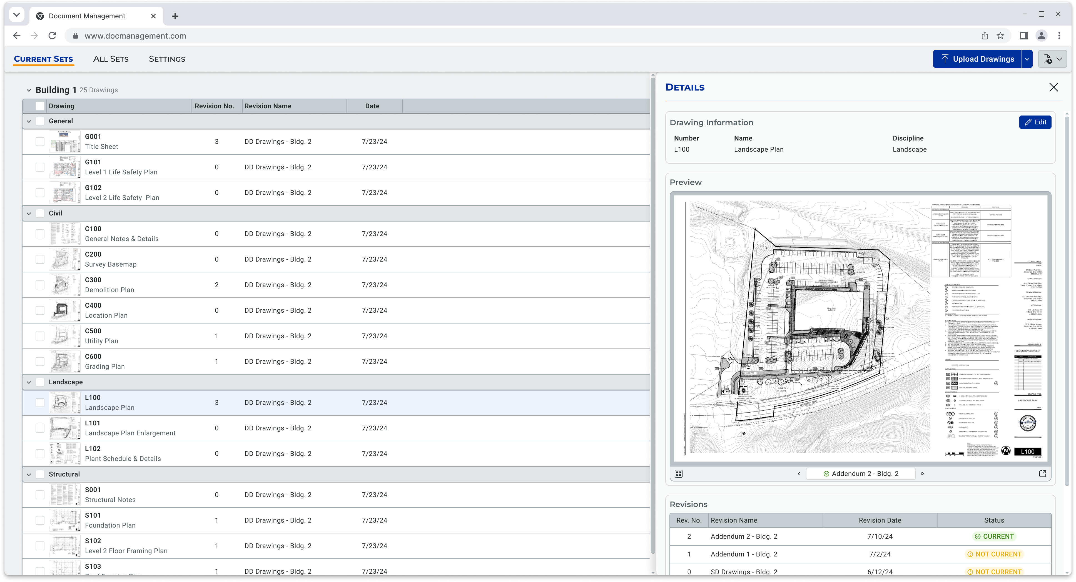

Notes:
We will begin by relentlessly focusing on integrating document management and augmenting our integrated takeoff capabilities.

Slide 8
Notes:
PDF -> organized docs for estimating
Track document history
Keep everyone on the correct version of a drawing

Slide 9
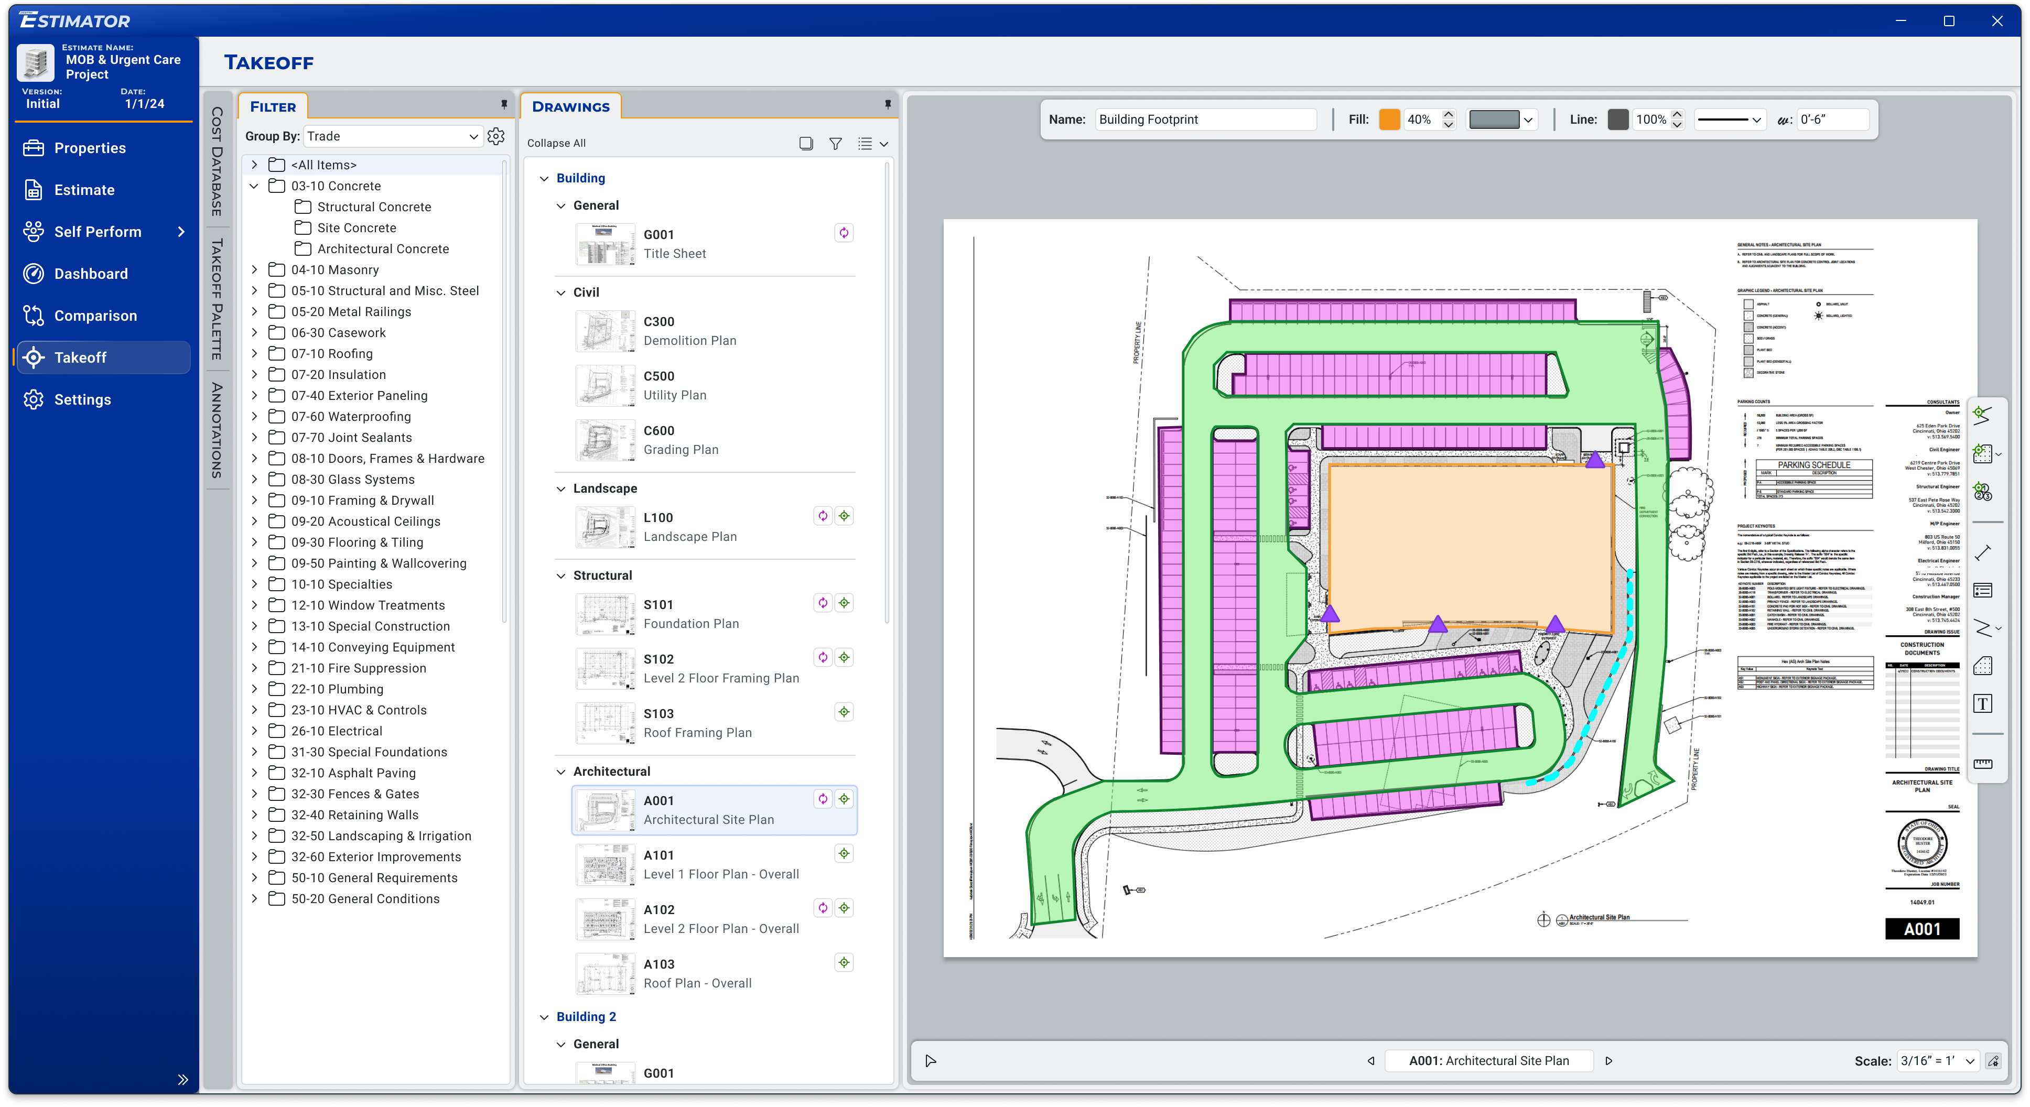
Notes:
Enable estimators to decide how and when to handle changes to the drawings
Providing path to adoption - align workflows with OST

Slide 10
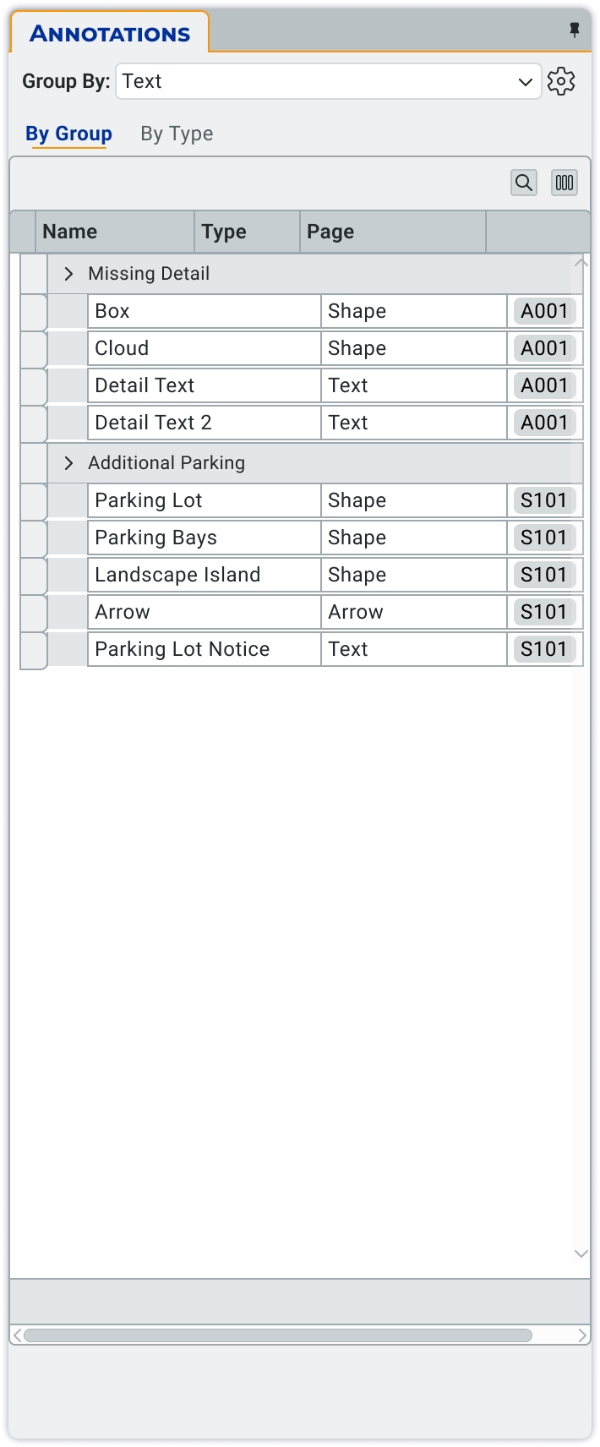
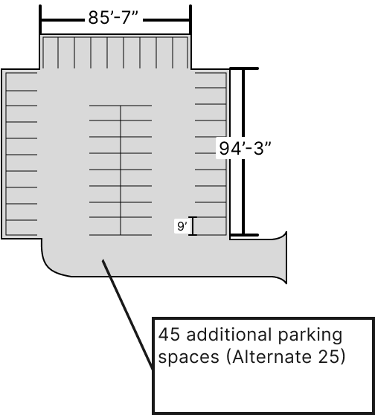
Notes:
Annotate drawings

Slide 11
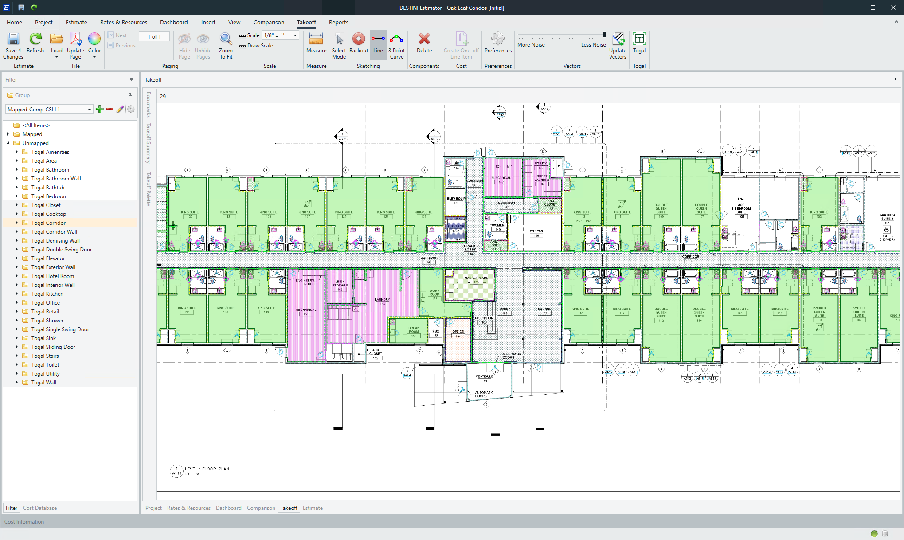
Notes:
Intuitively leverage AI generated takeoff.

Slide 12
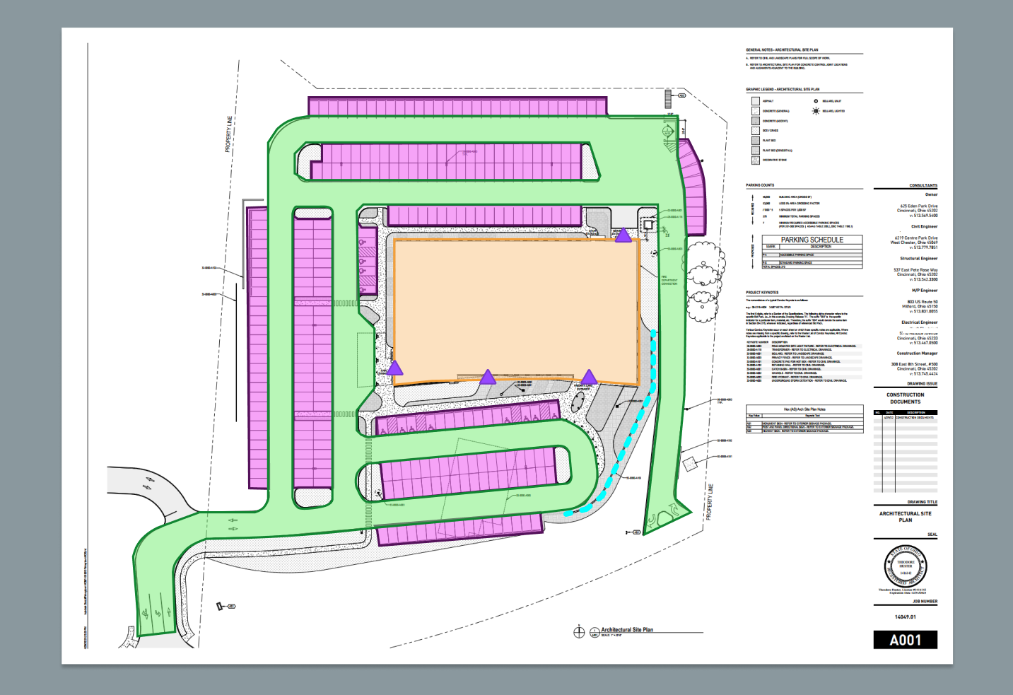
Notes:
Create high quality reports on your takeoff
Communicate to stakeholders what changed, why it changed, and the impact on project cost

Slide 13




Slide 14
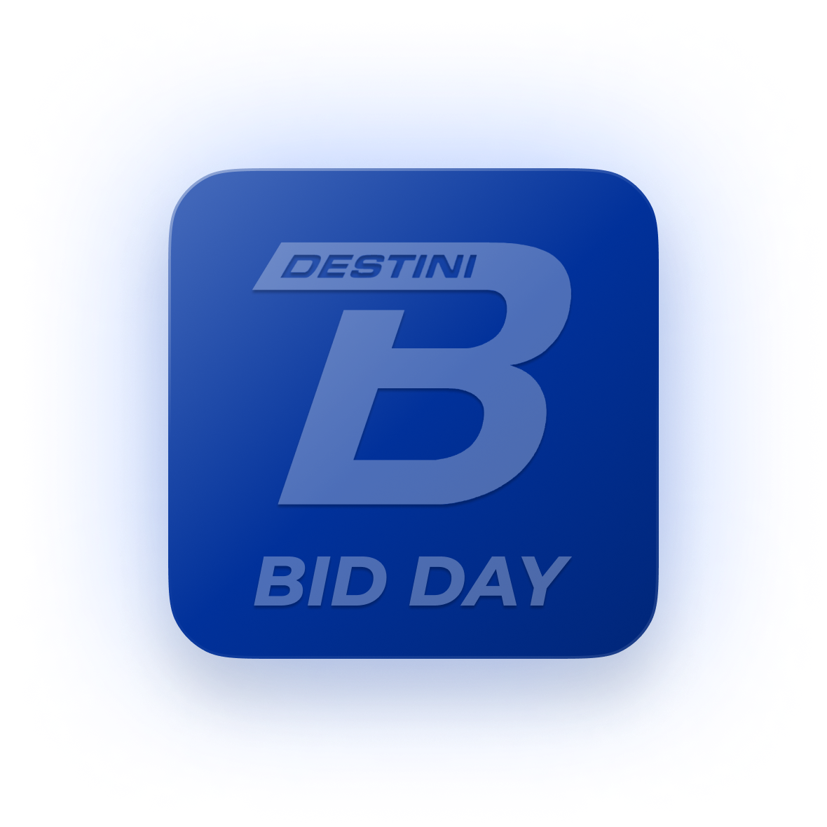

Notes:
Like Estimator, Bid Day has a ton of potential to grow the value it brings to your team

Slide 15


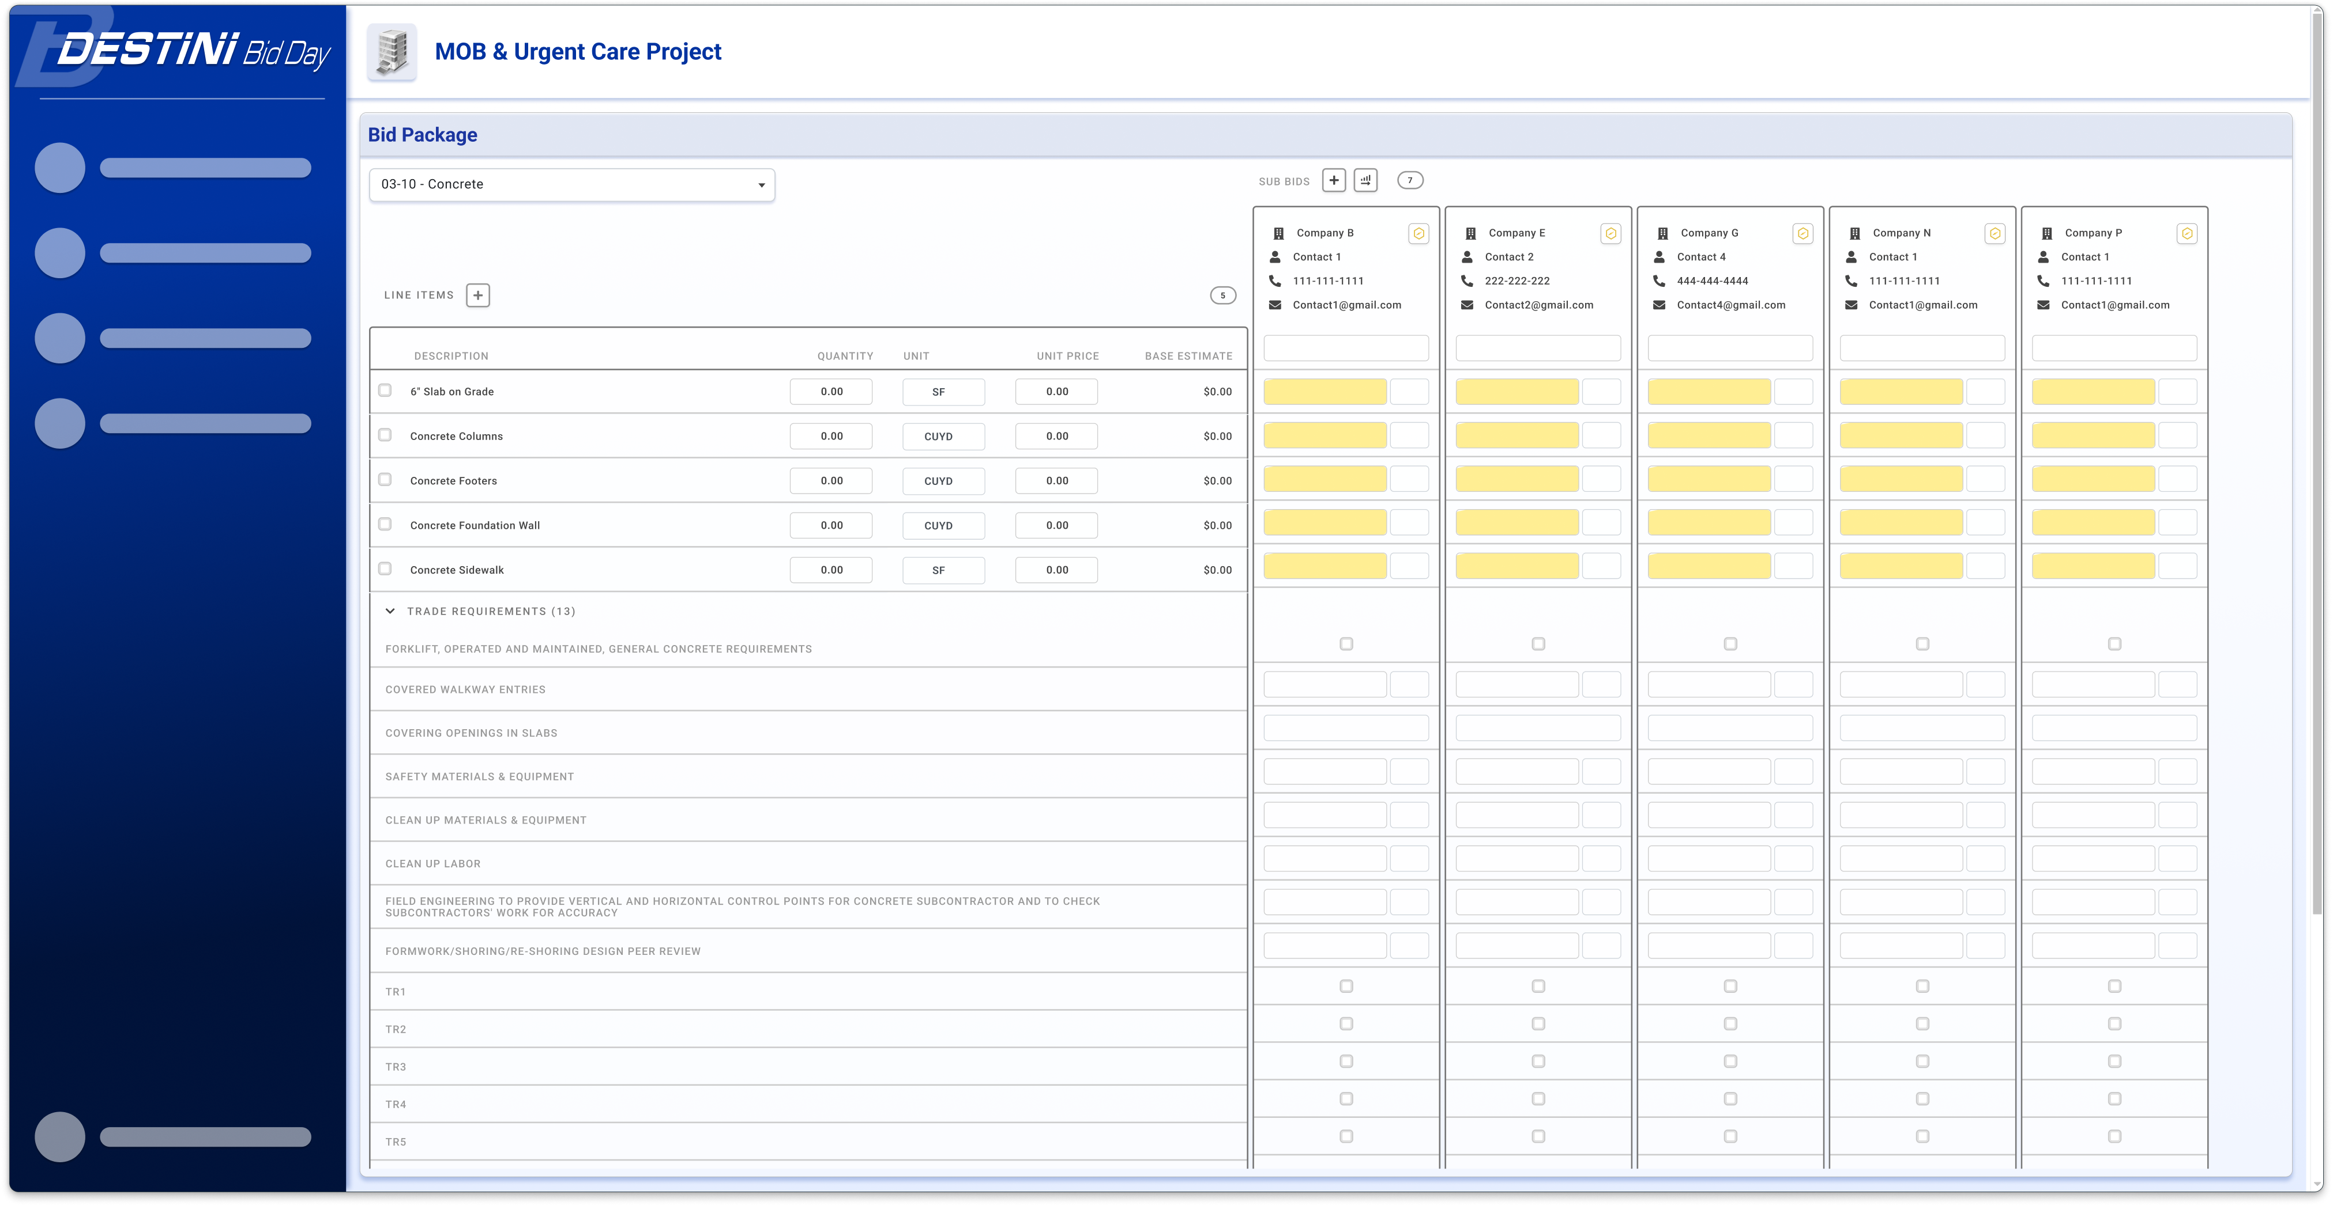



Slide 16
Notes:
From estimate to organized bid leveling

Slide 17
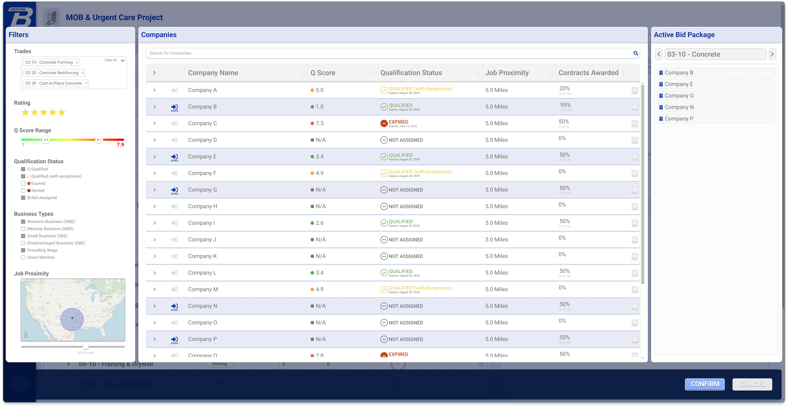
Notes:
Leverage a hybrid subcontractor rolodex
Inform sub selection by combining your sub qualification data with 3rd party databases

Slide 18
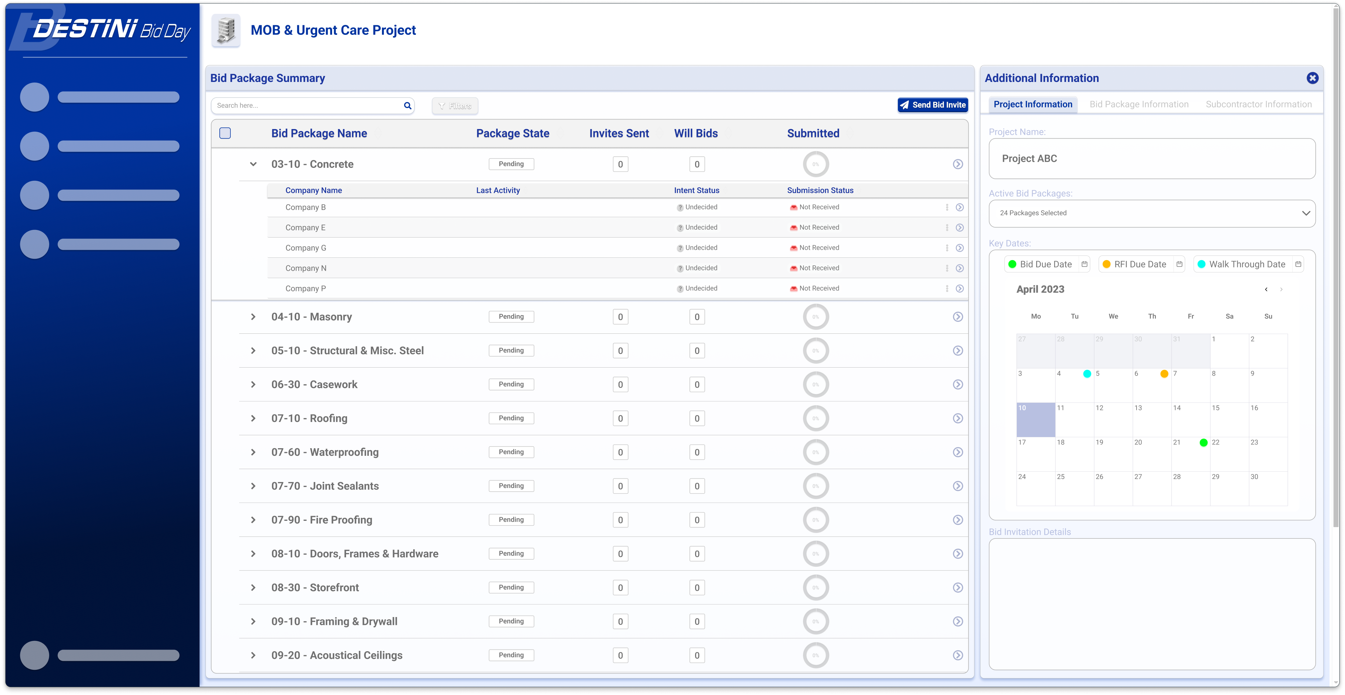
Notes:
Solicit bids to those subs…

Slide 19
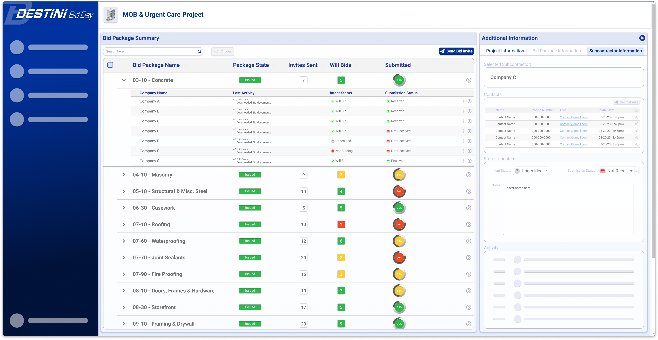
Notes:
… and track the responses and communication through the bidding process
Track information on how those subs have bid across projects

Slide 21
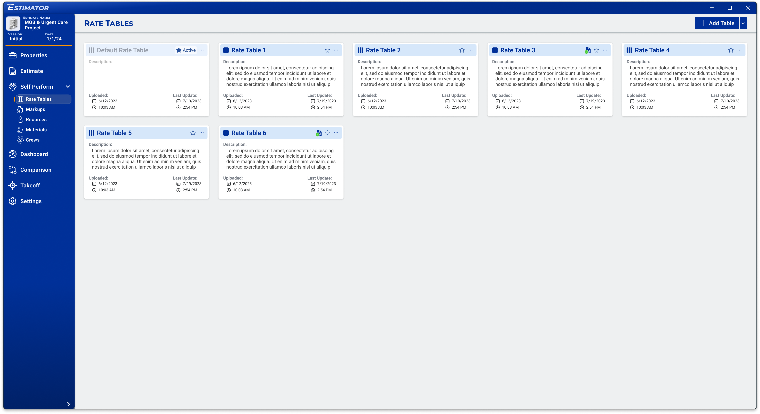

Notes:
While some teams have been able to estimate self-perform projects in Estimator there is still a need by others to use tools better suited to their process or augment the process using Excel.

Slide 22
Notes:
Drive consistency, shared learning, resource sharing, along with expanding your preconstruction data across teams

Slide 23
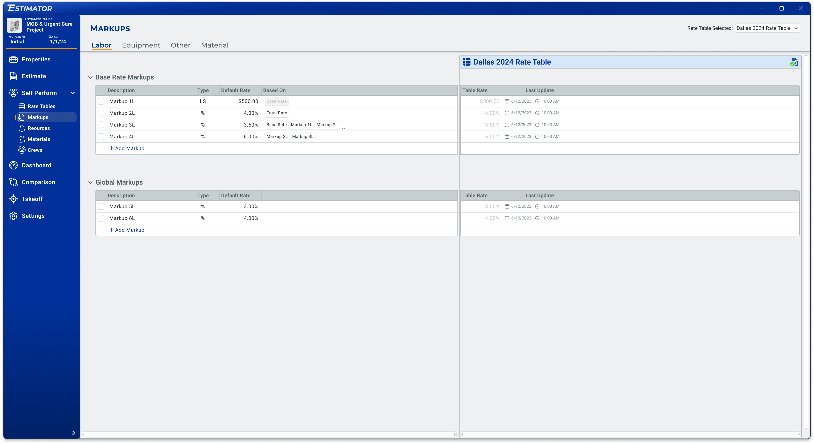
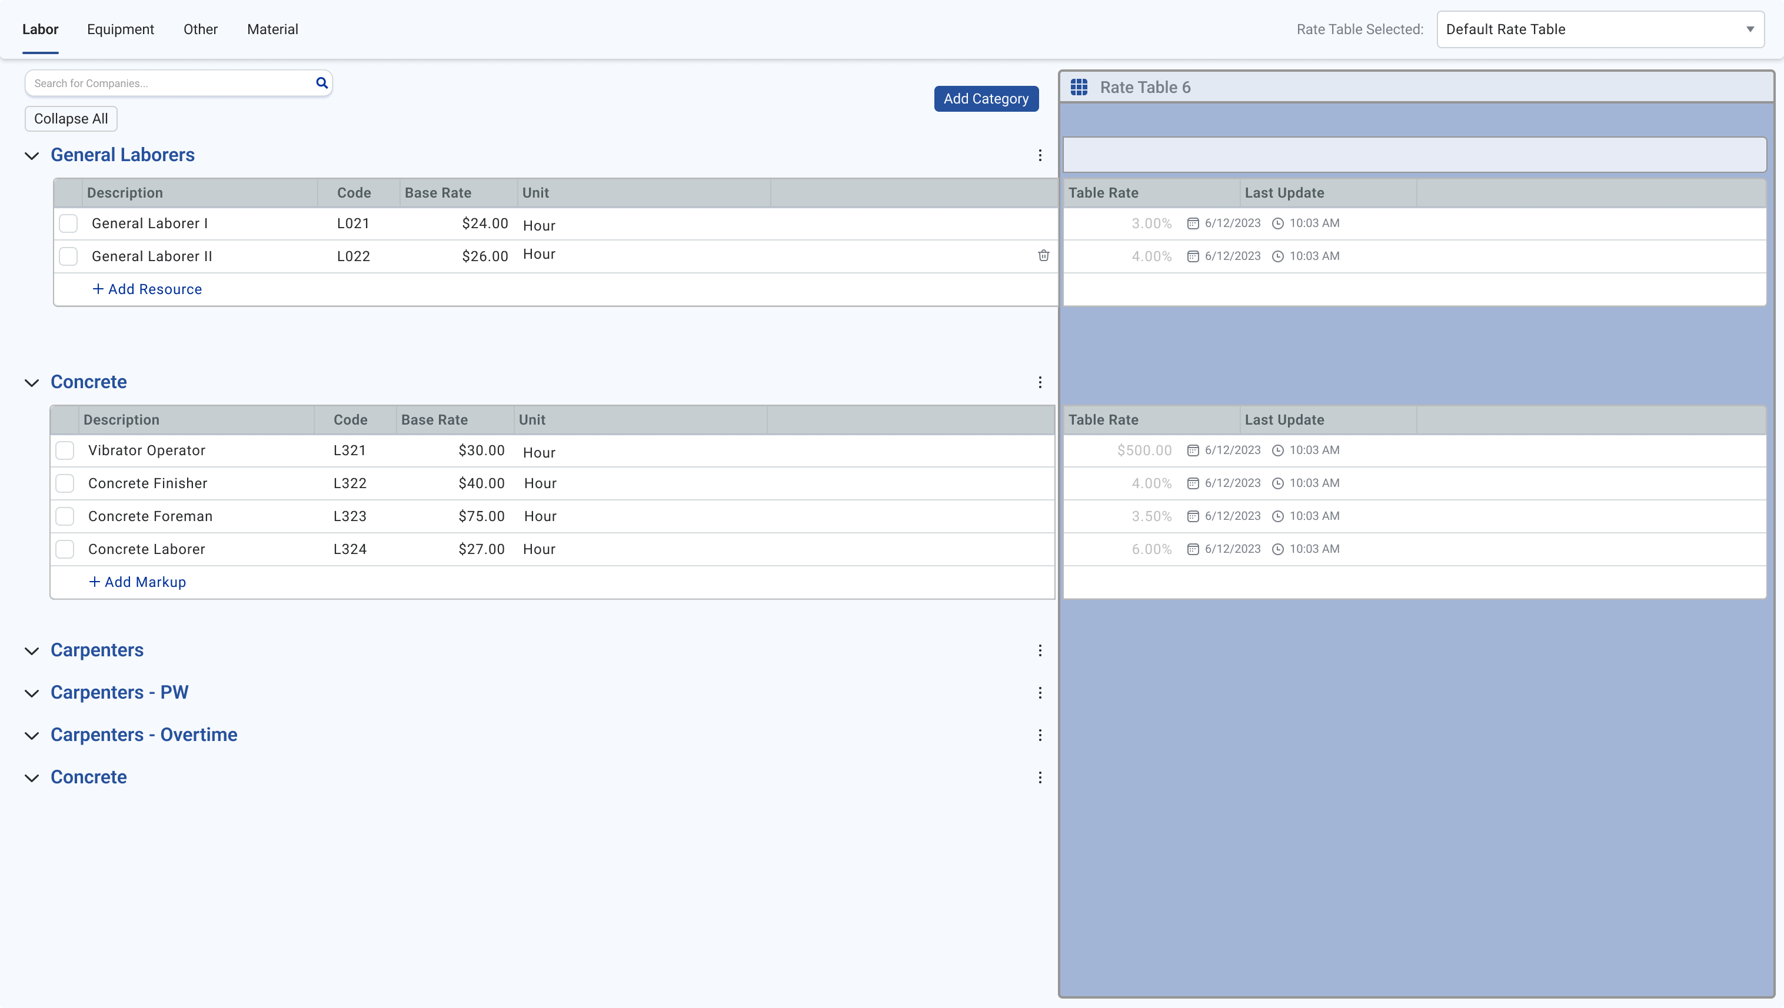
Notes:
Manage and maintain base rates

Slide 24
Notes:
Manage special pay through overtime and holiday pay
Manage materials and update selected material suppliers in seconds

Slide 26


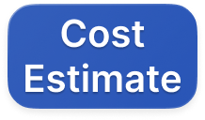







Notes:
As we deliver each of these capabilities, we be stitching together our products and move toward a full preconstruction platform.
Providing high quality reporting and deliverables
Access to cost history and data visualization
And… aggregate project and team communication

Slide 27




Notes:
One of the true values to the creation of a platform like DESTINI is the ability to seamlessly stitch together integrations between our product partners.

Slide 28







Notes:
Eliminate hacked together solutions to move data
Now that we have this platform imagine what you could do with it?
What if you could
Directly manage your own custom preconstruction process?
Keep track of the utilization of your team so that you could staff and plan precon projects ahead of time?
Report exactly the right data to exactly the right person?
Leverage AI to help communicate with your stakeholders?
Leverage data to surface insights into how your team is performing?
Leverage data into key areas of risk for specific projects as they happen?
What if all project communication could be accessed directly inside of that project
You could review when you received drawings,
what was communicated to the owner,
what you sent the subs and…
… how they responded!

Slide 29
Notes:
Eliminate hacked together solutions to move data
Now that we have this platform imagine what you could do with it?
What if you could
Directly manage your own custom preconstruction process?
Keep track of the utilization of your team so that you could staff and plan precon projects ahead of time?
Report exactly the right data to exactly the right person?
Leverage AI to help communicate with your stakeholders?
Leverage data to surface insights into how your team is performing?
Leverage data into key areas of risk for specific projects as they happen?
What if all project communication could be accessed directly inside of that project
You could review when you received drawings,
what was communicated to the owner,
what you sent the subs and…
… how they responded!

