Slide 1
The Art & Science of Conceptual Estimating
Introduction to The Beck Group

Slide 2

Company Overview
Diverse Market Sector Expertise
110+ Years of Construction
30+ Year Partner with Beck Tech
25+ Years with Architecture
1,000+ Employees in USA & Mexico
200+ Architecture & Design Staff
6 National Precon Staff
30 Regional Precon Staff

Slide 3
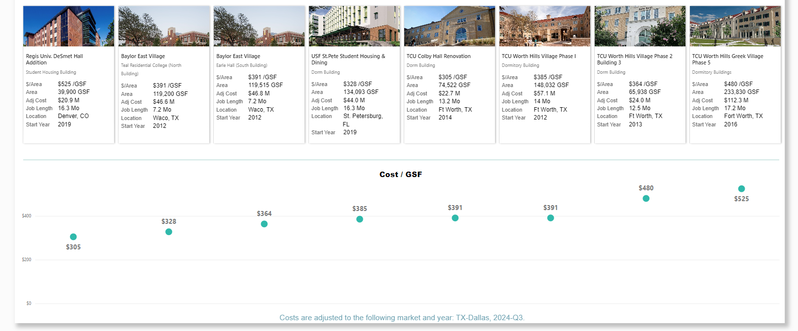
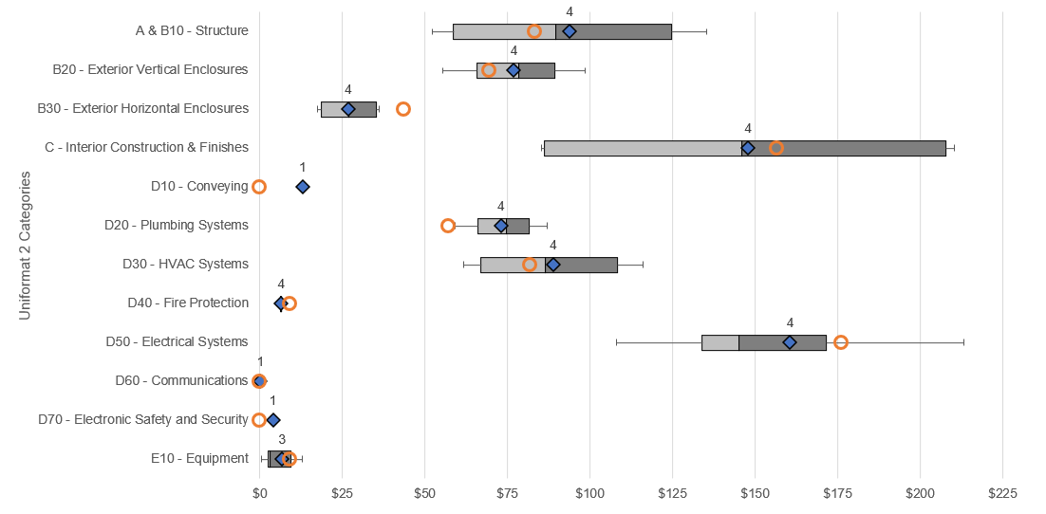
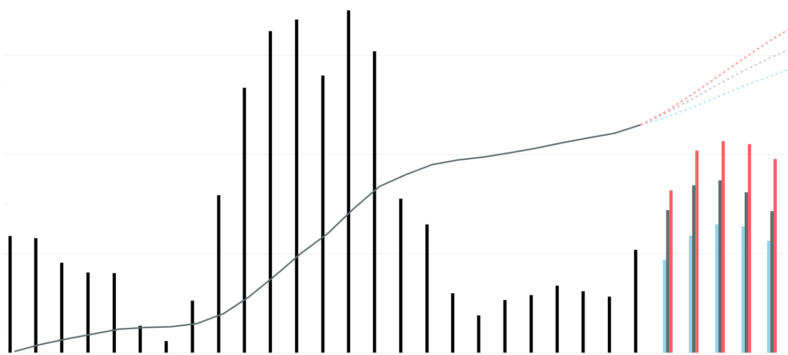
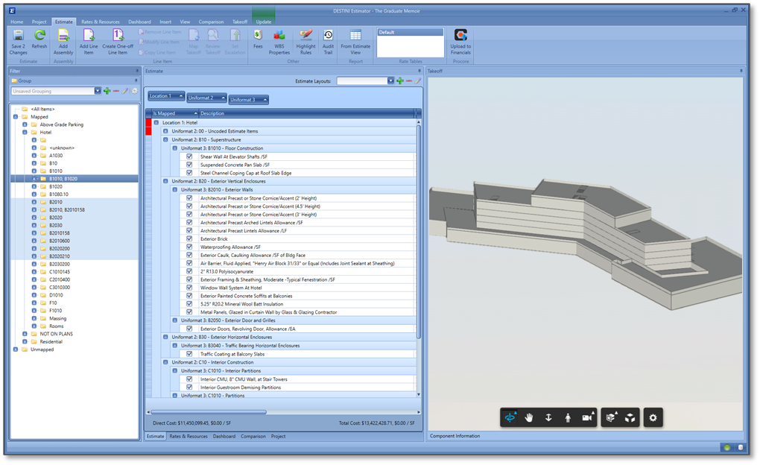
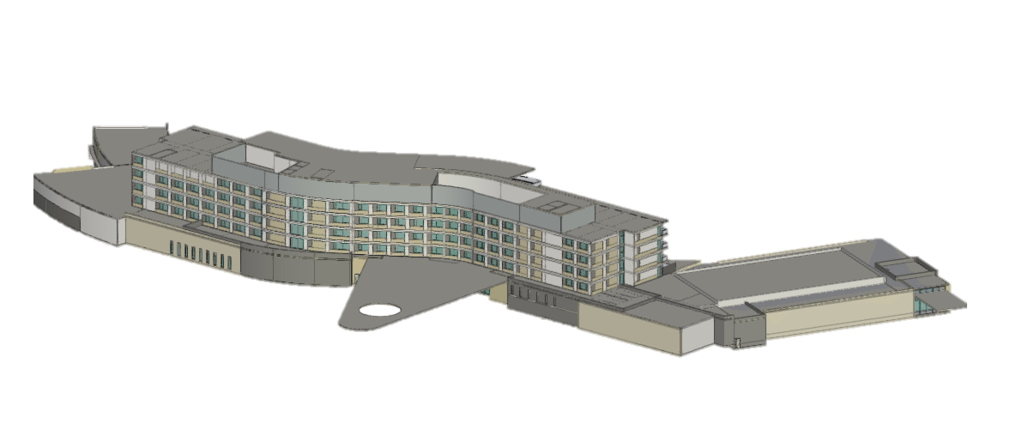

Conceptual Tools
Component Benchmarking
System Benchmarking
Escalation Forecasting
Integrated Estimating Process Revit + Estimator

