Slide 1
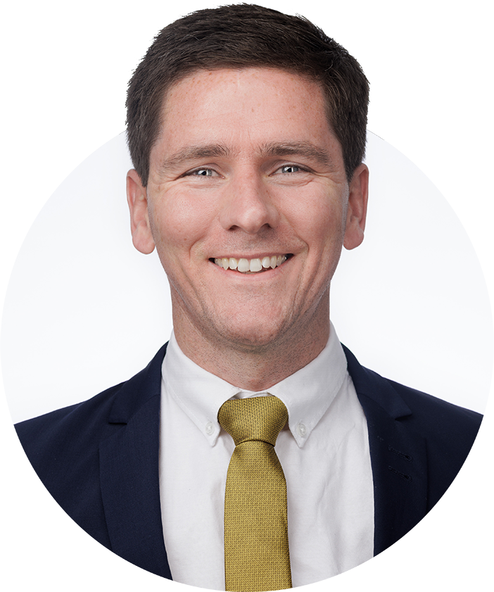
Gareth McGlynn

Slide 2
Disclaimer:
I am not an Estimator
I have never put an estimate together
BACKGROUND:
Electrical Engineering Degree
14 years of professional sports
Working with the trades in the Pibara, Western Australia
12 years of recruitment (Construction & IT)
8 years as CEO of Niche
5 years of Hosting The Preconstruction Podcast

Slide 3
THE
PRECONSTRUCTION PODCAST

Slide 4
NICHE Specialist Staffing Partners

Slide 5
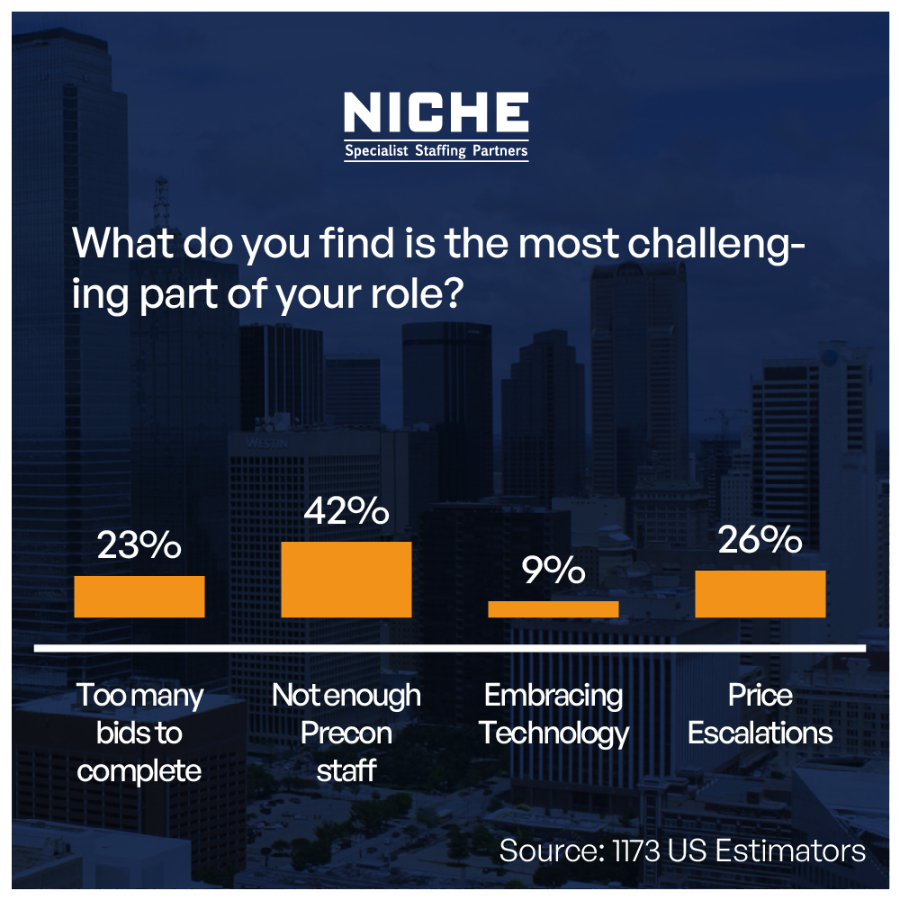
Recruit

Slide 6
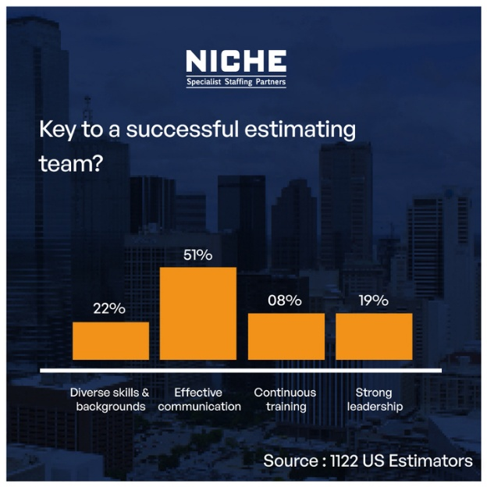
Retain

Slide 7
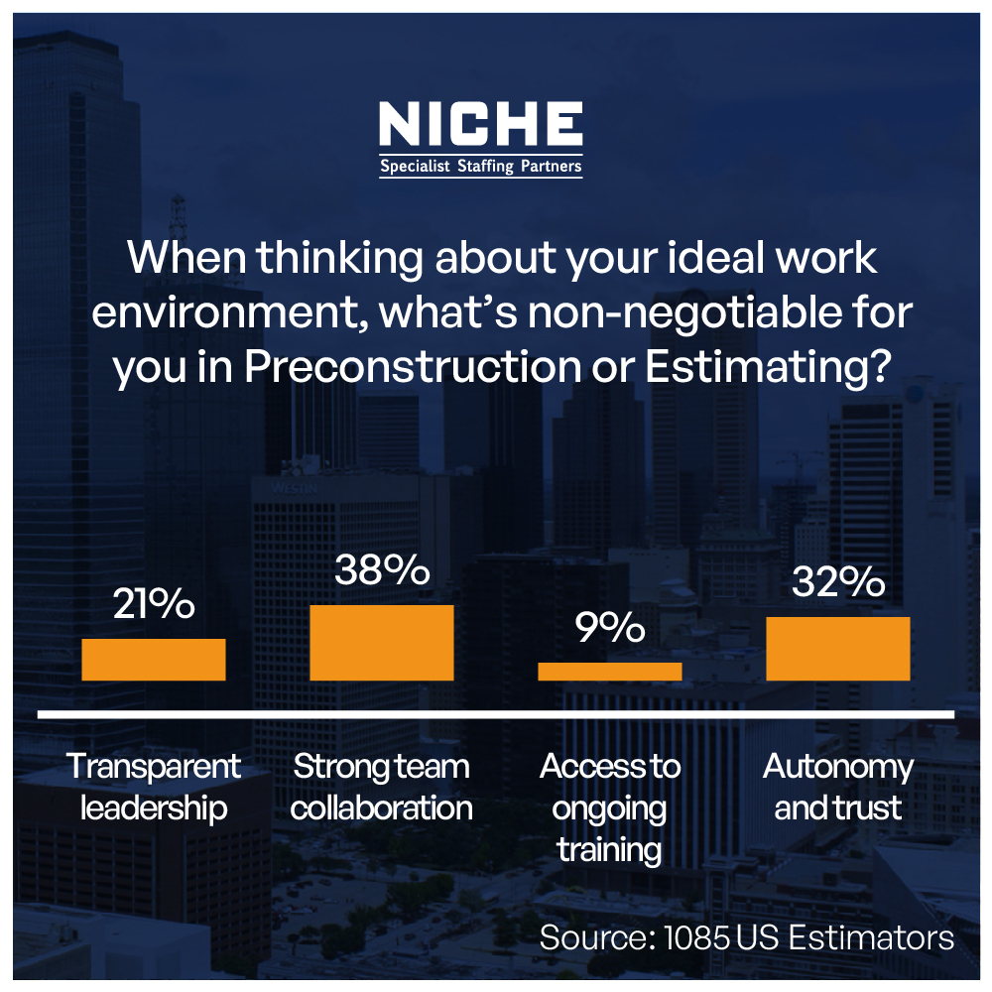
Develop

Slide 8
Always be hiring
Employee Value Proposition
Pulse check on your culture - REFERRALS

Slide 9
Q&A

Slide 10


