Slide 1

Evolving Pre-Construction:
Adapting to Limited Resources &
Increasing Demands
Beck-Technology.com

Slide 2






Meloni’s Story in
Construction
Math Nerd
Oklahoma
Architecture
Construction
The Beck Group
National AGC ELC Chair
TEXO
Design-Build

Slide 3

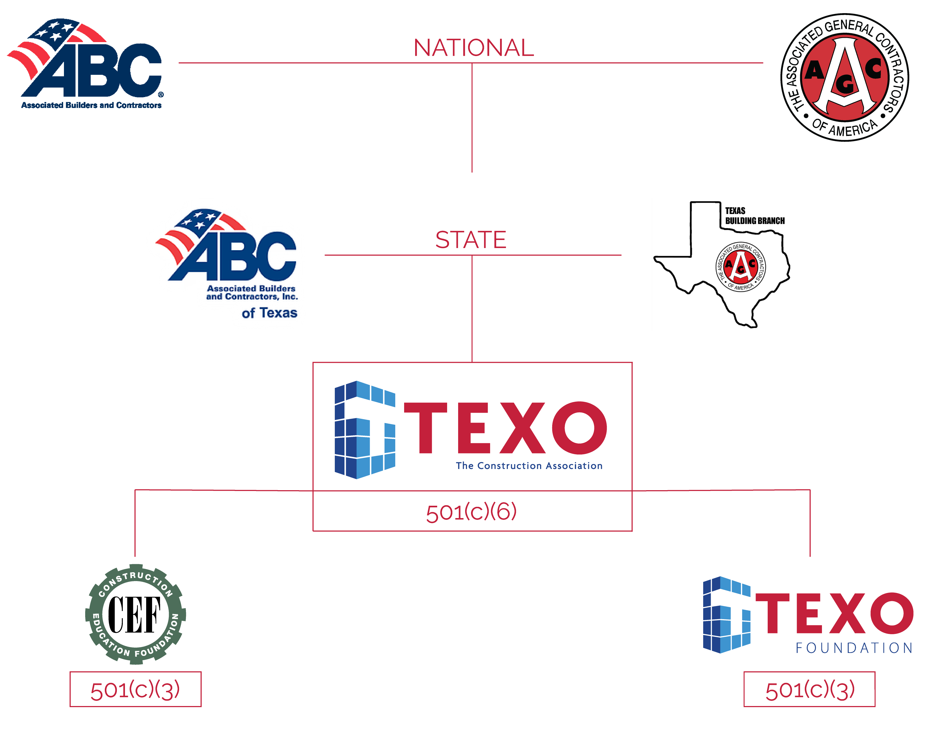
About
TEXO
TEXO
101
Unify. Advocate. Advance.
TEXO is working together to build the best construction community through unity and leadership.
Over 375 members who do more than $20B in work annually in North & East Texas
Focus Areas:
  Governmental Affairs
  Training & Development
  Safety Services
  Workforce Development (TEXO Foundation)

Slide 4
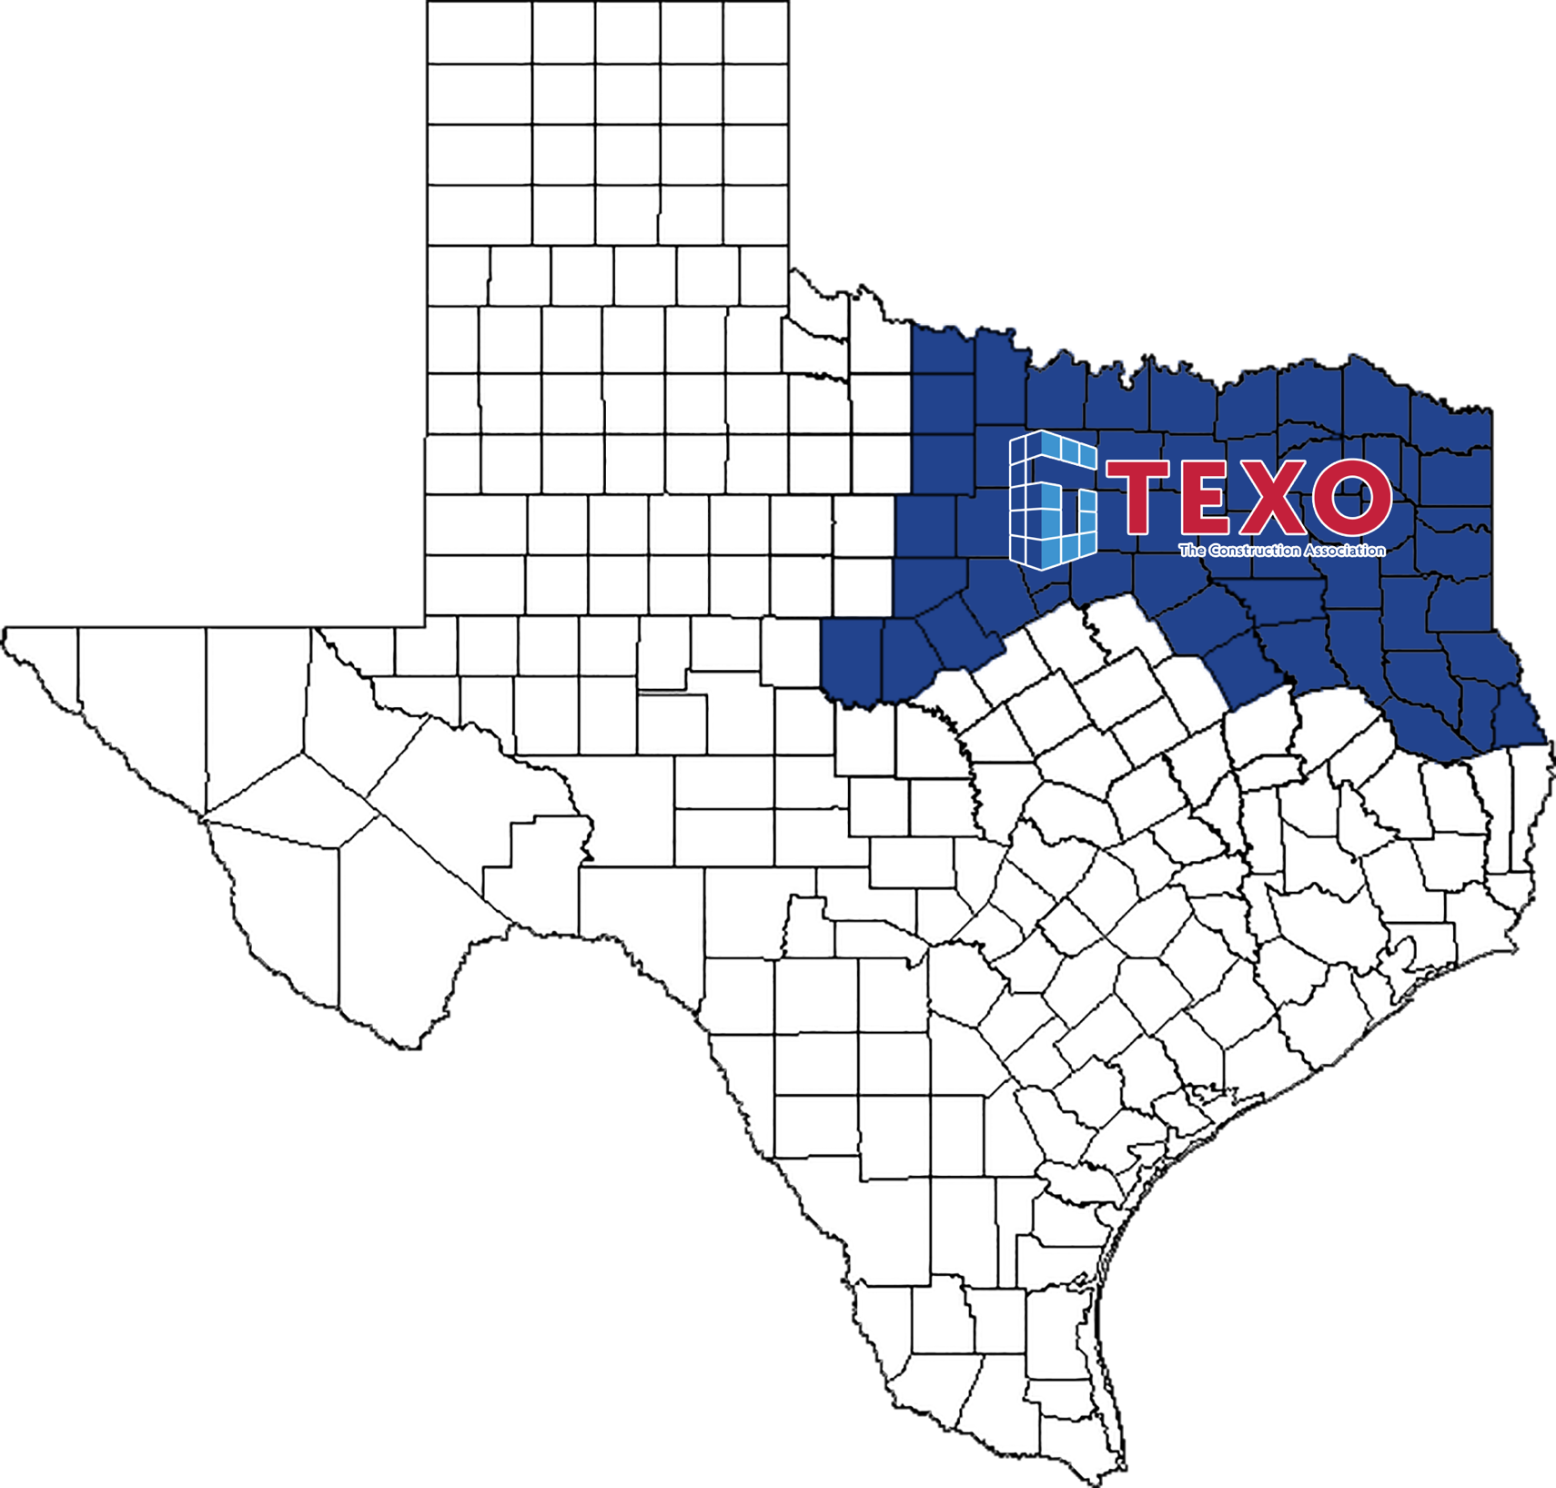
About
TEXO
TEXO By The
Numbers
378 Total Members
  98 General Contractors
  125 Specialty Contractors
  155 Industry
60 Counties in North & East Texas
  Estimated Population: Almost 10 Million (as of 2020 Census)
  Land Area: Over 45,000 sq mi
15 Staff Members

Slide 5
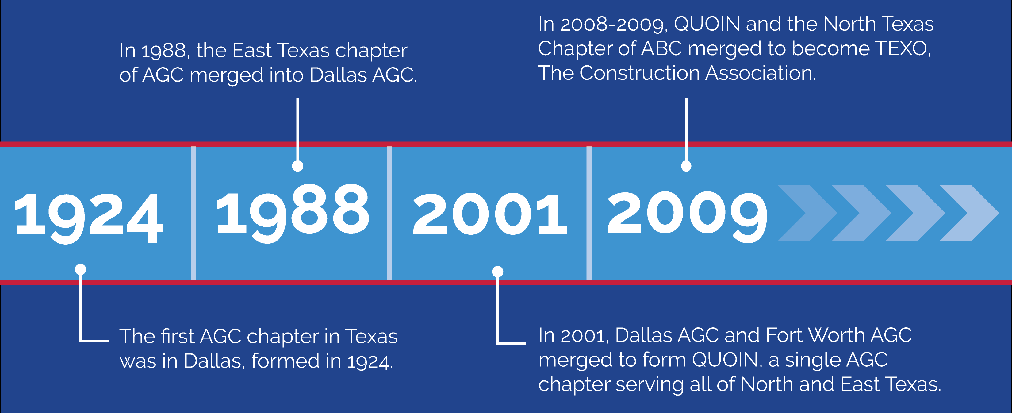
About
TEXO
The Journey to
Becoming TEXO

Slide 6

Texas Is
Growing
What’s Happening
In Texas?
Crown jewel of construction industry in the U.S.
400 metropolitan areas in the U.S., 3 of the Top 6 are in Texas
    DFW = #2
    Houston = #4
    Austin/Georgetown/Round Rock = #6
Continued acceleration is expected for the next 2 years

Slide 7
Texas Is
Growing
Texas Metro Construction Employment
Aug. 2023 – Aug. 2024, not seasonally adjusted
Aug. 2024:
% change from Aug. 2023:
Houston-The Woodlands-Sugar Land | 246,200
Dallas-Plano-Irving Metro Division* | 169,500
Fort Worth-Arlington Metro Division* | 89,700
Austin-Round Rock* | 89,300
San Antonio-New Braunfels | 68,000
Corpus Christi* | 24,500
Beaumont-Port Arthur* | 20,400
Source: BLS *The Bureau of Labor Statistics reports employment for construction, mining and logging combined for metro areas in which mining and logging have few employers. Construction-only employment change is shown for a metro if BLS posts that data.

Slide 8
Texas Is
Growing
Population Change by State
July 2022 – July 2023; US: 0.49%
Decrease
0-0.49%
0.5-0.99%
1.0-1.49%
1.5%+
Top 5
SC | 1.7%
FL | 1.6%
TX | 1.6%
ID | 1.3%
NC | 1.3%
0.4%
1.3%
0.9%
0.5%
NH
0.2%
-0.1%
0.6%
0.4%
0.3%
0.04%
-0.5%
VT
0.05%
0.4%
1.0%
-0.2%
0.5%
0.2%
-0.08%
MA
0.3%
1.1%
0.5%
-0.3%
0.2%
0.6%
0.4%
-0.2%
0.1%
0.3%
0.4%
CT
0.2%
RI
0.2%
0.3%
Bottom 5
NY | -0.5%
LA | -0.3%
HI | -0.3%
IL | -0.3%
WV | -0.2%
0.9%
0.04%
1.3%
DE
1.2%
NJ
0.3%
0.9%
1.1%
1.6%
0.7%
1.7%
0.03%
0.7%
1.1%
MD
0.3%
DC
1.2%
AK
0.02%
-0.3%
1.6%
HI
-0.3%
Source: U.S. Census Bureau, Dec. 2023 population estimates, www.census.gov/popest

Slide 9
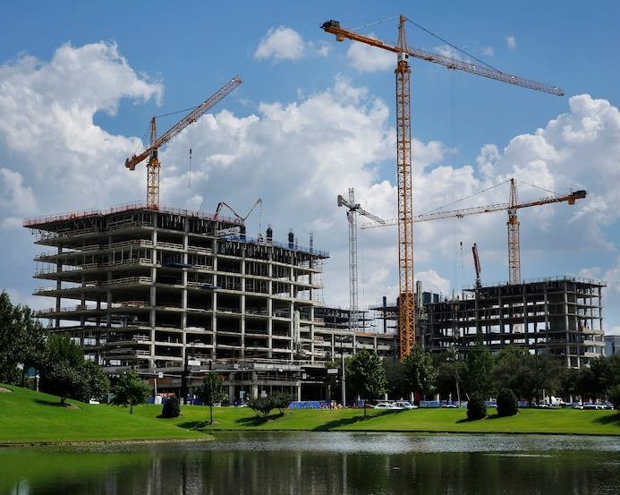
State of the
Industry
State of the
Construction
Industry

Slide 10
State of the
Industry
What We’re Hearing From Our Members:
General Contractors
Money seems to be “stuck” right now in a big mess. Once it breaks loose, everything will be crazy.
It’s hard to finish jobs right now.
The market is growing but so are labor force challenges, making it difficult to build the projects that are coming.
It’s a very political time!

Slide 11
State of the
Industry
What We’re Hearing From Our Members:
Specialty Contractors
It’s tough right now and the market is funky.
Numbers are increasingly aggressive & low leading to less-than-ideal scenarios.
Backlog is going the wrong way – “40% of backlog we’ve spent cost on between 3 projects has been shelved.”
Everything is stuck right now – “We’re predicting an insane Jan. & Feb. 2025 when projects start to finally go.”

Slide 12
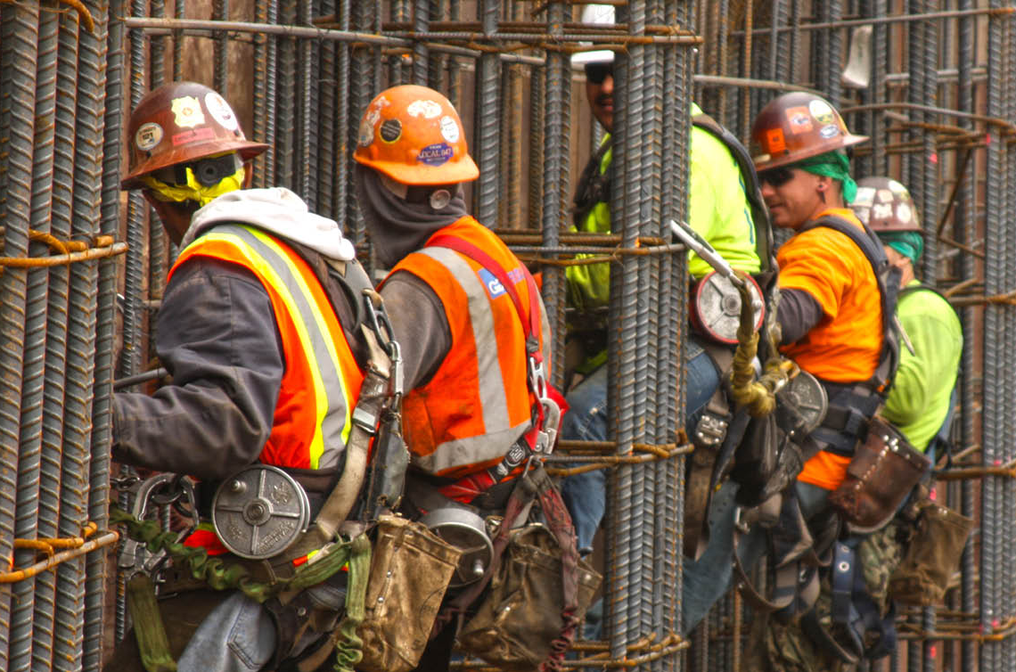
State of the
Industry
What Is Impacting
Our Industry?
Resource Constraints
  Volatile pricing / fees
  Shrinking labor force

Slide 13
State of the
Industry
Change in construction materials & labor costs, 2020-2024
Year-over-year change in producer price index (PPI) for nonresidential inputs and average hourly earnings (AHE) for nonresidential building and heavy & civil engineering construction, Feb. 2020 – July 2024
% change since:
July 2023
Feb. 2020
4.6%
AHE for nonresidential building*
24%
AHE for heavy & civil engineering*
3.5%
20%
PPI for nonresidential inputs**
0.8%
38%
*Seasonally adjusted (SA)
**Not seasonally adjusted (BLS does not post SA data for this series)
Source: Bureau of Labor Statistics, PPI, www.bls.gov/ppi ; AHE, https://www.bls.gov/ces/

Slide 14
State of the
Industry
Input and bid price changes, August 2024
Producer price indexes, 1 - & 12-mo. change (not seasonally adjusted)
August 2024 change from:
July 2024 August 2023
(1 month) (12 months)
Inputs to new nonresidential construction |  | 0.1% | -0.2%
Output (bid price) index for new nonresidential buildings |  | 0% | 1.2%
...but some input prices remain volatile
Copper and brass mill shapes |  | -1.9% | 10%
Steel mill products |  | -2.6% | -14%
​Diesel fuel |  | -2.0% | -22%
Source: BLS, producer price indexes, www.bls.gov/ppi

Slide 15
State of the
Industry
Contractors Are Eager to Hire
% of firms with openings for:
Source: 2024 AGC of America/Autodesk Workforce Survey

Slide 16

State of the
Industry
What Is Impacting
Our Industry?
Immigration (Workforce Development)
  Estimated 1.5m workers short by 2025
Political Climate
  US GDP (Gross Domestic Product) totaled $29T. Construction contributed $1.3T (4.5%)
Technology
  Potential 30 - 45% increase in productivity by adopting construction technology

Slide 17

The Effect on
Preconstruction
How Will Precon Be Affected By
These Challenges?

Slide 18
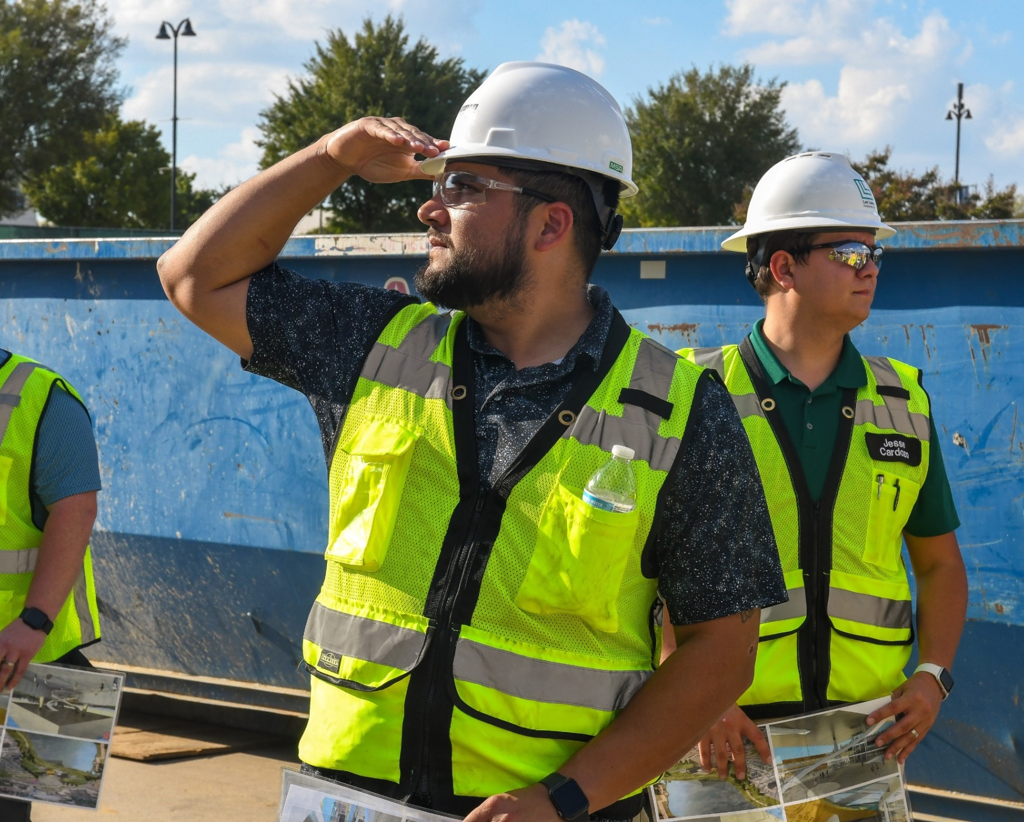
The Effect on
Preconstruction
How Will Precon Be Affected By
These Challenges?
Shifting Role | Design Services Role
  DD’s are now considered CD’s
  More collaboration with architects & engineers
Labor Force / Field Personnel
  Can’t sell what you can’t build
Supply Chain
  Everyone needs the same parts

Slide 19
The Effect on
Preconstruction
How Will Precon Be Affected By
These Challenges?
Time Constraints
  9 out of 10 jobs are over budget
  2022 – 23 inflation is greater than previous 10 years
Competition
  400 markets in the country | 12 receive majority of funding
Technology
  AI biggest disruptor | Resource to compliment workflows

Slide 20

The Effect on
Preconstruction
How can Precon help solve some of these industry challenges?
Design Phase Services Role
  Collaborative mindset
  Design Assist and Design Build more popular
Technology Implementation
  AI is a tool
  Pre-fab
  Interaction with the field / Data collection

Slide 21
The Effect on
Preconstruction
Internal Company
Assistance
Help hire or recruit from within for this role
  Collaborative approach
Training in the field
  If you haven’t physically seen it, it’s hard to really understand it.

Slide 22
The Effect on
Preconstruction
Internal Company
Assistance
Business Development personality
  Face of the company
Handoff meetings
  Transition meeting to the field
  Exhibit 1 negotiating

Slide 23

The Effect on
Preconstruction
The Precon Role:
“Always playing defense so the Operations Managers can play good offense.”

Slide 24

Let’s Connect on LinkedIn!
QUESTIONS?
MELONI RANEY, PRESIDENT & CEO
MELONI@TEXOASSOCIATION.ORG
Beck-Technology.com

