Slide 1


Economic Outlook
October 2024
Beck-Technology.com
Jay Denton
Chief Economist, Radix

Slide 2
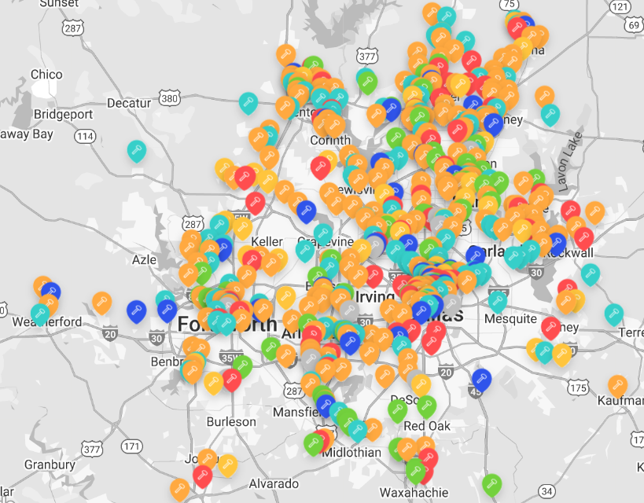
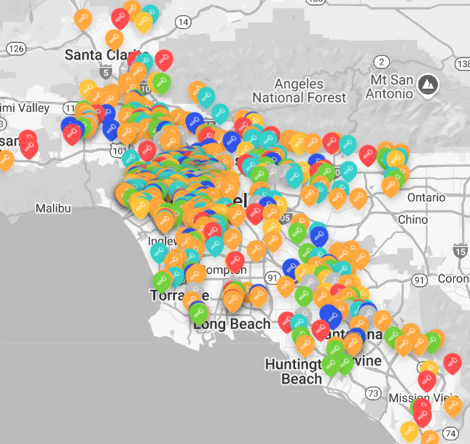
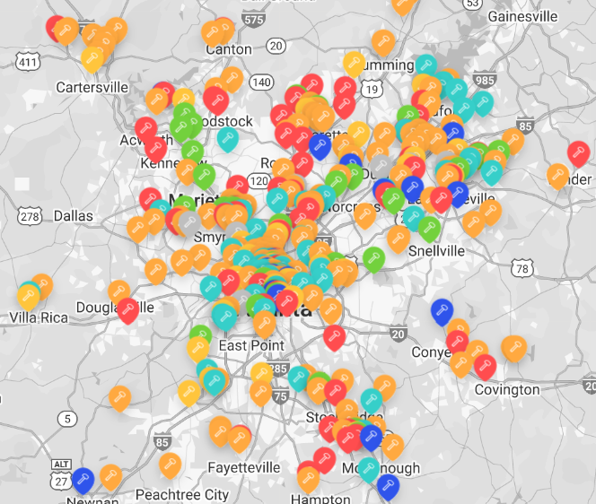
My Focus is Multifamily
Industry recently had one million units under construction
Dallas-Forth Worth
SoCal
Atlanta
Sources: Radix, BuildCentral; Map includes properties planned, under construction, or recently completed

Slide 3
Why I Focus on Inventory Growth in Multifamily
New construction is very influential on MF vacancy rates
Sources: Radix, Census

Slide 4
Today’s Presentation
Labor Market
Economy
Demographics
Cooling, but still positive
Construction is a leader for job growth
Wage pressures remain
Inflation tamed
Housing shortage and affordability challenges
Consumers still spending
Population movements
Impact to in-demand jobs the next decade
Types of construction that might be more/less needed

Slide 5
U.S. Labor Market is Cooling to a Sustainable Level
Current job gains similar to pre-pandemic
September’s Job Report:
254k jobs added
4.1% unemployment rate
4.0% wage growth
WSJ Forecast Survey (Oct 14):
130k jobs added monthly next 12 months
Less downside risk than previous surveys
Sources: Radix, BLS, The Wall Street Journal

Slide 6
Economists See Lower Chance of Recession after Recent Reports
Lower inflation, strong job growth and consumer spending help
CNBC reported Goldman Sachs recently lowered its chance of recession to 15%, essentially the same as any “normal” period.
Sources: Radix, The Wall Street Journal, CNBC

Slide 7
Many Markets Have Seen A Steep Slowdown in Job Growth
Annual job growth by metro area
Several of the typical “high growth” markets look like this. In this example, current job growth is at half the normal pace of when the U.S. economy is strong.
Select markets have settled into a job growth range close to the long-term average. This feels a little more like a soft landing.
Sources: Radix, BLS

Slide 8
Just a Few Industries Represent the Majority of Jobs Added in 2024
U.S. year-to-date job gain by industry
The top 4 industries represent 81% of jobs added in the U.S. this year.
Sources: Radix, BLS

Slide 9
Construction Job Growth Has Outpaced U.S. Average Since Great Recession
Annual Job Growth – Construction compared to all industries
Biggest YTD job gains thru Sept ‘24:
120k – Specialty Trade Contractors
24k – Non-residential Buildings
21k – Heavy and Civil Engineering
18k – Residential Buildings
Residential Construction
Non-Residential Construction
All Industries
Sources: Radix, BLS

Slide 10
More Employees Staying at Current Job Due to Market Dynamics
Fewer employees quitting
Sluggish private sector = fewer new jobs created
Layoffs below LTA
Less aggressive compensation growth
Source: Radix

Slide 11

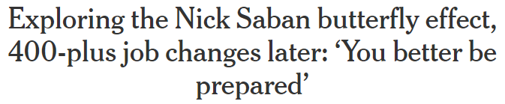
Job Vacancy Chain – The Ripple Effect of Employee Turnover
Example Using Nick Saban’s Retirement
Source: The Athletic

Slide 12
Employee Lifecycle Metrics
U.S. Trends – All Industries
Fewer employees are quitting
Not as many jobs being opened
Layoffs still below normal levels
Sources: Radix, BLS

Slide 13
The Wage Premium for Switching Jobs has Eroded
U.S. Wage Growth, All Industries
Job Switchers
Source: Federal Reserve Bank of Atlanta; Based on 3-month moving average

Slide 14
Construction Shows More Stability than Other Industries
Job Openings Have Moderated, but other Metrics Steady
Sources: Radix, BLS

Slide 15
Construction Workers Find New Job Faster Than Other Industries
Duration of Unemployment – Median Weeks by Industry
Sources: Radix, BLS

Slide 16
Competition for Labor Leading to Stronger Wage Growth for Construction
U.S. Wage Growth (12-mo Avg)
Construction
Source: Federal Reserve Bank of Atlanta; Based on 12-month moving average

Slide 17
Long-term Labor Market Projections
2023-2033
Healthcare, social assistance, tech, professional, utilities, and warehousing are expected to have the strongest growth.
Education and retail will be sluggish.
Healthcare support jobs are projected to grow by 15.2%.
Construction and extraction jobs are expected to grow by 5.6%.
6.7 million jobs are projected to be added; Slower pace due to lack of labor.
Source: BLS

Slide 18
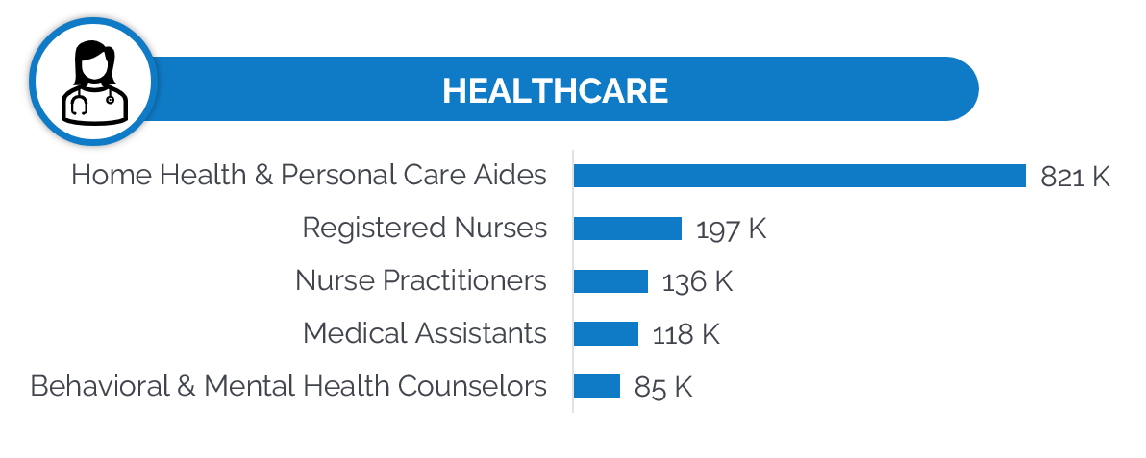
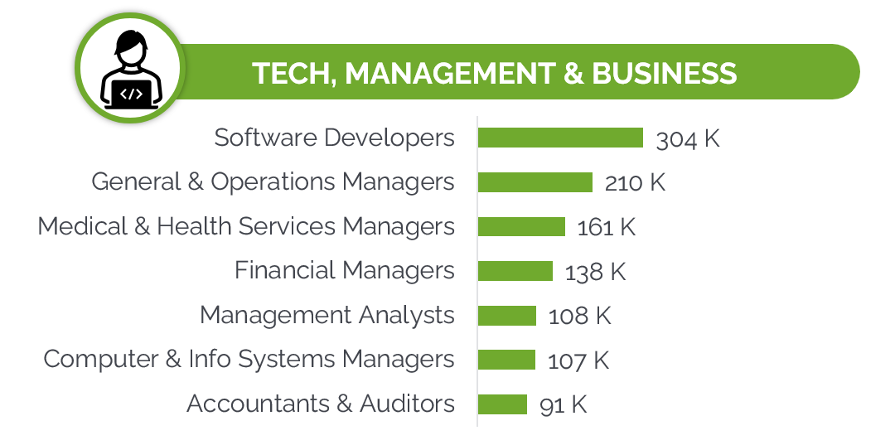
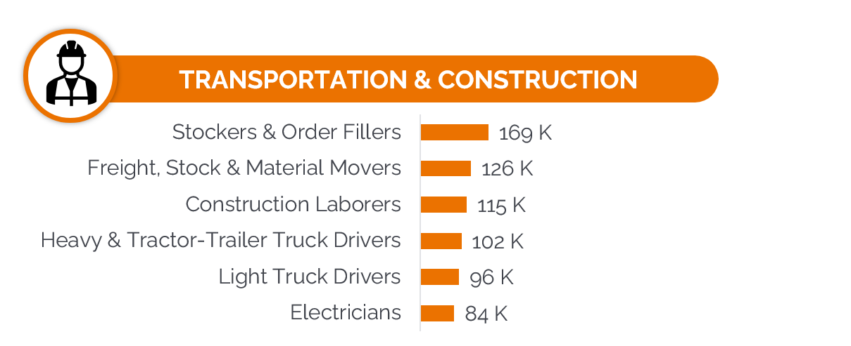

Jobs in Most Demand Through 2033
Number of jobs projected to be added the next decade
Sources: BLS, LaborIQ

Slide 19
U.S. Construction Spending Approaching $2.2 Trillion Per Year
Growth in residential spending moderated when interest rates increased
Construction spending totaled $2.13T in the 12 months ending August 2024.
Spending is up:
4.1% YoY
7.6% YTD
Includes costs of labor, materials, taxes, architecture and engineering work.
Sources: Radix, Census; Seasonally adjusted annual rates used; Data through August 2024

Slide 20
Change in Construction Spending Aug ‘23 to Aug ‘24
Manufacturing and Power had highest growth
Note – Commercial in this chart is based on retail, wholesale, and other service providers.
Sources: Radix, Census; Seasonally adjusted annual rates used; Data through August 2024

Slide 21
Input Cost Growth for Construction has Normalized
Rate peaked at 20%-35% in 2022 depending on building type
Data is based on new construction.
Does not include labor, imports, or taxes.
Sources: Radix, BLS

Slide 22
Index of Construction Cost for Non-residential Buildings
While growth has slowed, prices remain elevated
This is why there is the phrase “prices are sticky” because prices often remain at higher levels once they’ve increased due to structural reasons.
Sources: Radix, Census

Slide 23
Consumer Price Growth Close to Fed Target of 2%
Growth peaked at 9% in Summer 2022
Sources: Radix, BLS

Slide 24


Single-Family Housing Remains Unaffordable
Example of change in monthly payment due to mortgage rates
2020-2021
Today
$500,000
3% interest rate
$2,353 per month
$500,000
6.2% interest rate
$3,117 per month
Source: Online mortgage calculator using 30-year mortgage, 20% down, and other typical estimated fees such as insurance and taxes

Slide 25
Interest Rate Projections
WSJ economist survey
Projections based on responses of 60+ economists surveyed by The Wall Street Journal.
Consensus average is approx:
50 bps cut by end of 2024
150 bps cut by end of 2025
Note, mortgage rates do not always follow the exact trend of the federal funds rate.
Sources: Radix, The Wall Street Journal

Slide 26
Southeast and Southwest Dominate Change in Population
Top 7 States for Population Gain 2020-2023
 | 2020-2023 Population
State | Gain | Growth
Texas | 1,268,940 | 4.3%
Florida | 1,019,427 | 4.7%
North Carolina | 381,679 | 3.7%
Georgia | 296,837 | 2.8%
Arizona | 244,661 | 3.4%
South Carolina | 241,404 | 4.7%
Tennessee | 200,398 | 2.9%
Top 7 States | 3.7 million | 4.0%
U.S. Total | 3.3 million | 1.0%
Utah and Idaho were next on the list, and they have some of the largest relative changes in population.
California, New York, and Illinois combined to lose more than 1.3 million in population during this period, offsetting the gains of many other states.
Sources: Radix, Census

Slide 27
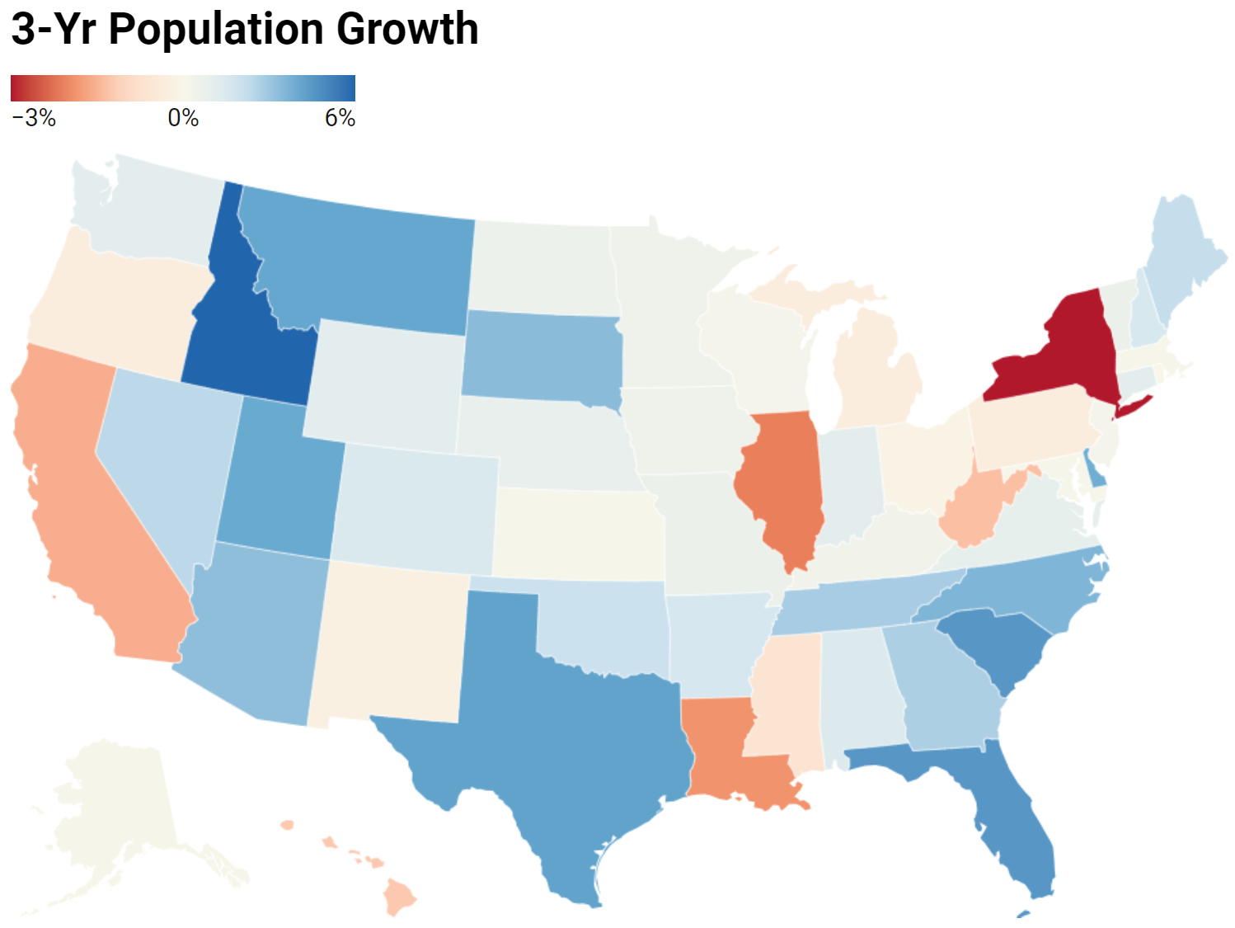
Population Growth by State: 2020-2023
Strongest growth was in:
Southeast
TX and Southwest
Mountain West
Sources: Radix, Census, Comparison is July 2020 to July 2023

Slide 28
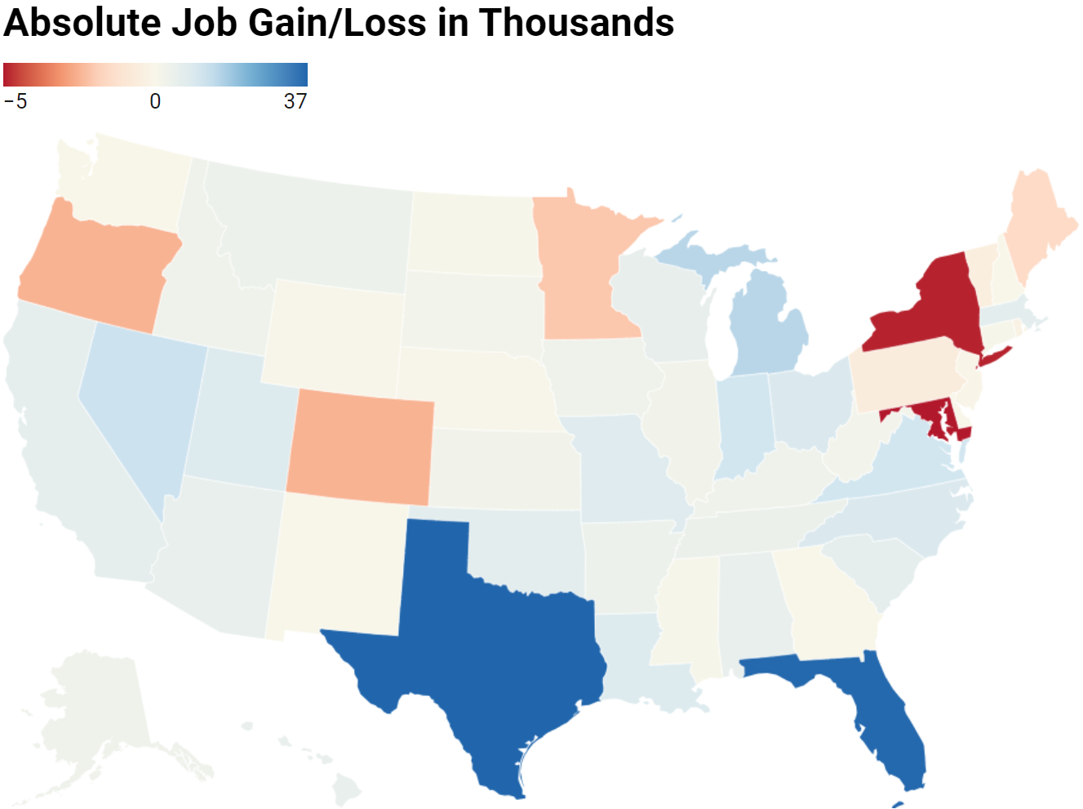
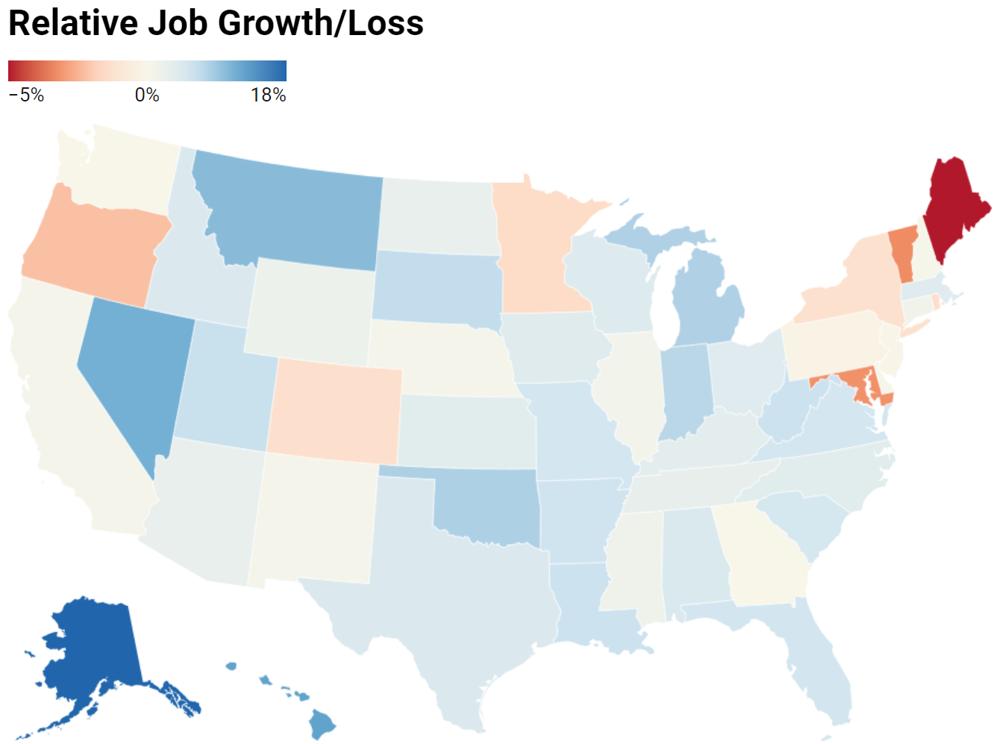
Annual Job Gain and Growth by State – August 2024
Based on Construction Industry
Sources: Radix, Census; Comparison is July 2020 to July 2023

Slide 29
Wrap Up
Labor Market – positive, but continued cooling
Construction jobs – steady growth
Inflation – mostly tamed, but wage pressures persist
Demographics – will influence types of jobs are created, buildings are needed, and which states and metro areas will growth the most

Slide 30
THANK YOU
Beck-Technology.com

