Slide 1
2026
Construction Outlook:
Economic Forces Reshaping Preconstruction Strategy

Slide 2
Stephen Jones
Senior Director, Industry Insights, Dodge Construction Network
BA: Johns Hopkins University; MBA: Wharton
6 years: Design-Build
  Proprietor of a design-build millwork company
19 years: Architecture/Engineering
  Principal at a major A/E (now Stantec)
4 years: Construction Technology
  Vice President, Primavera Systems (now Oracle)
22 years: Dodge
  Industry Insights Research

Slide 3

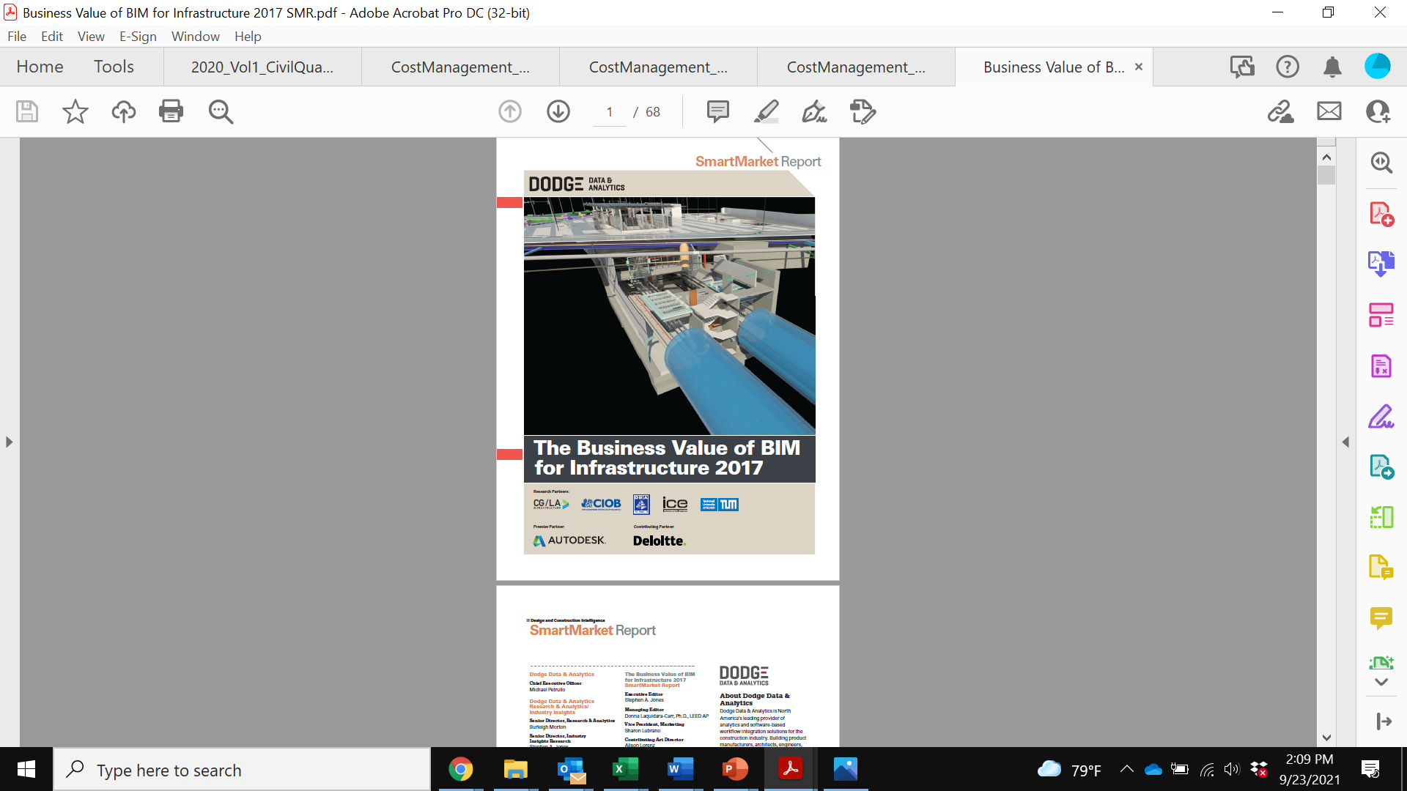
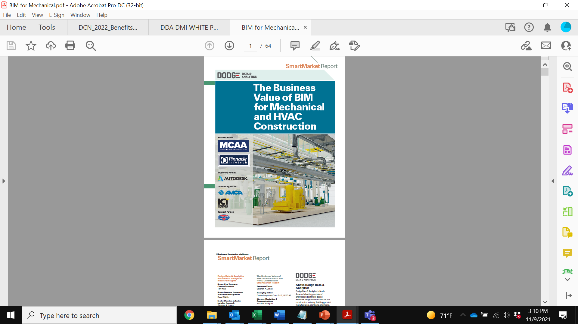
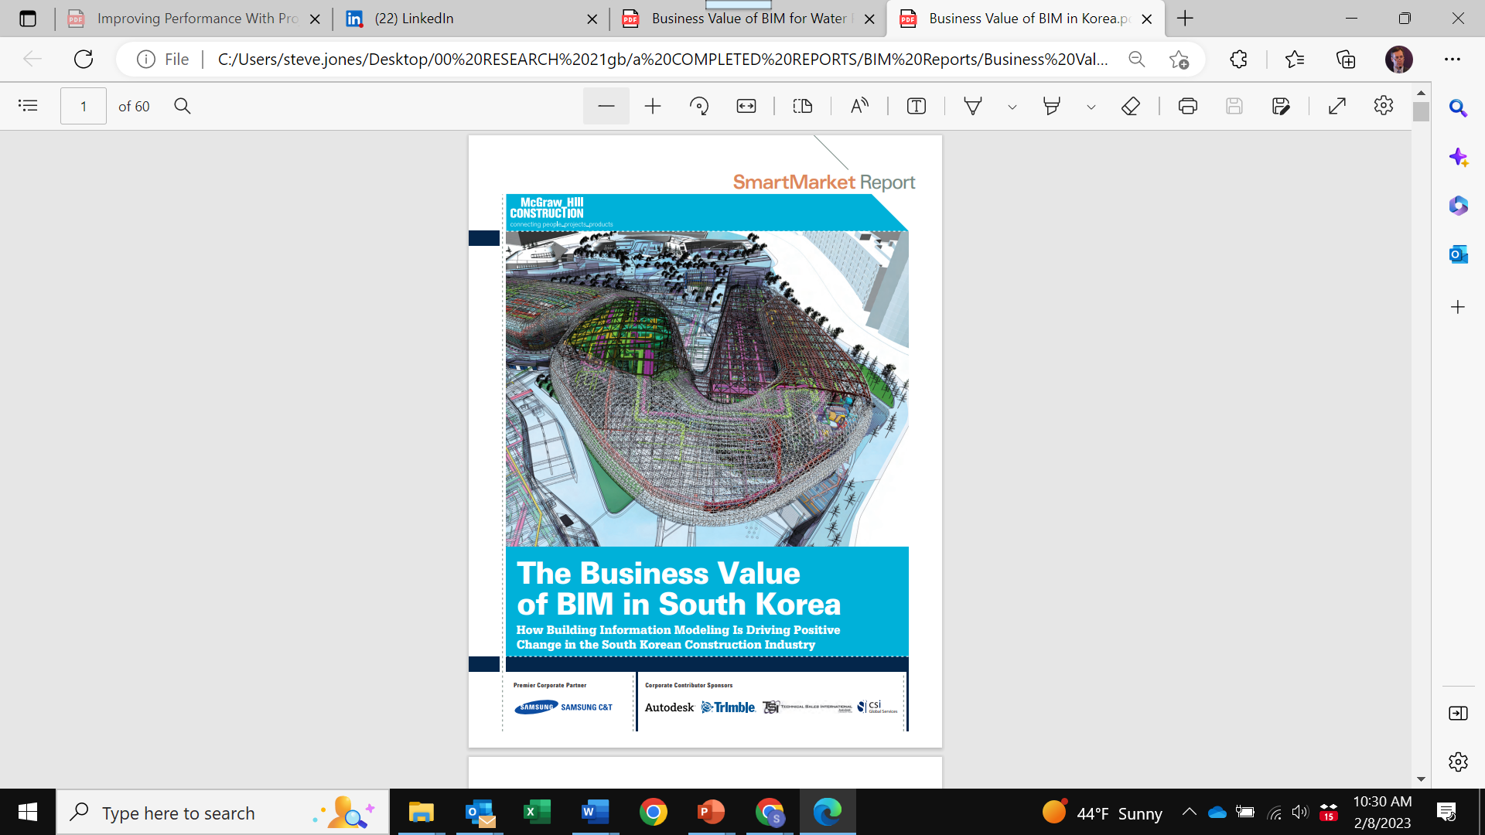
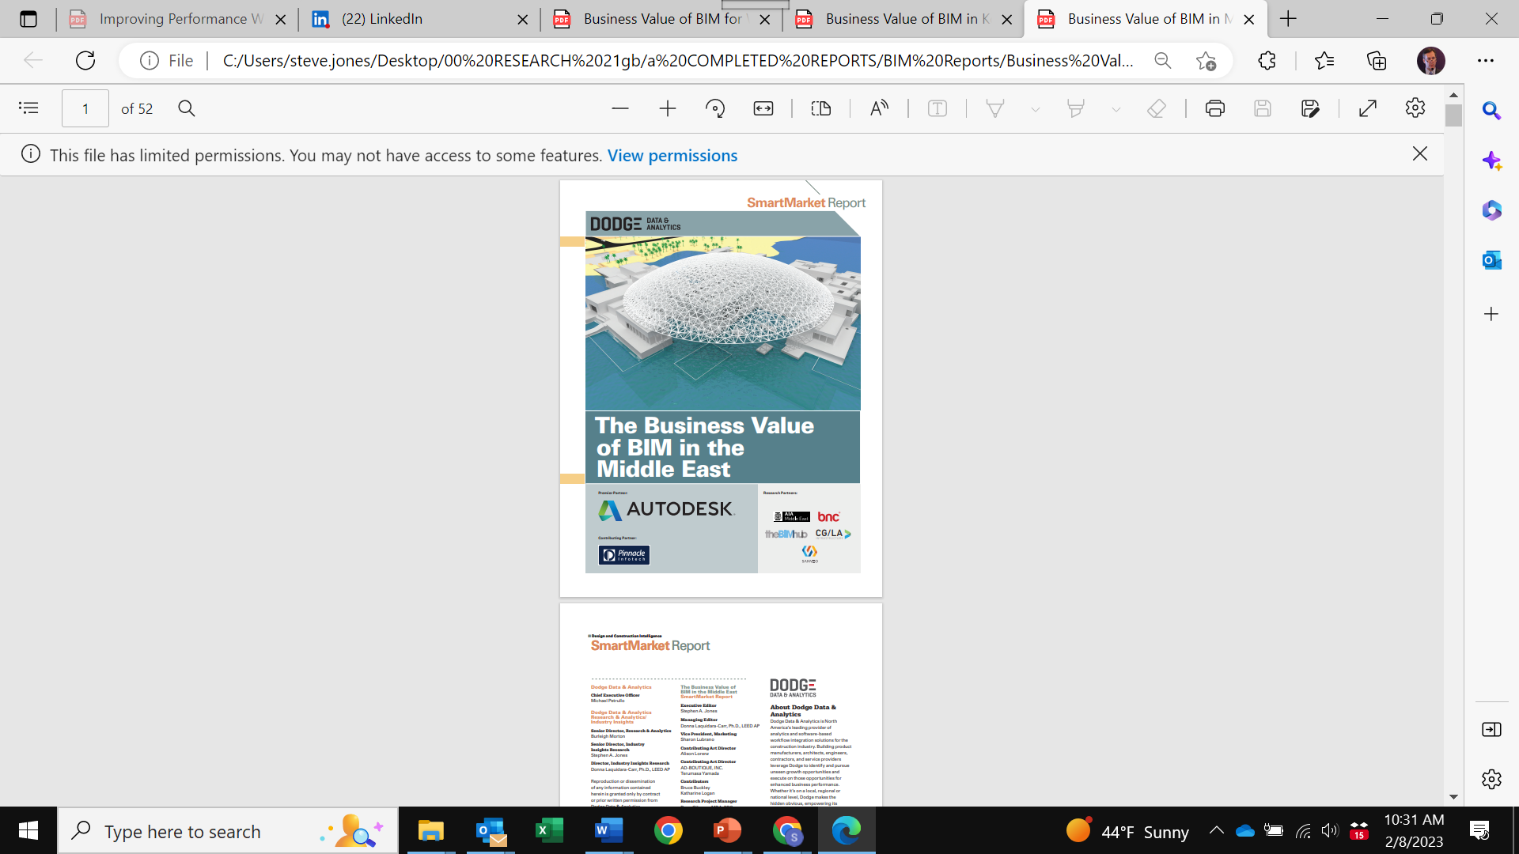
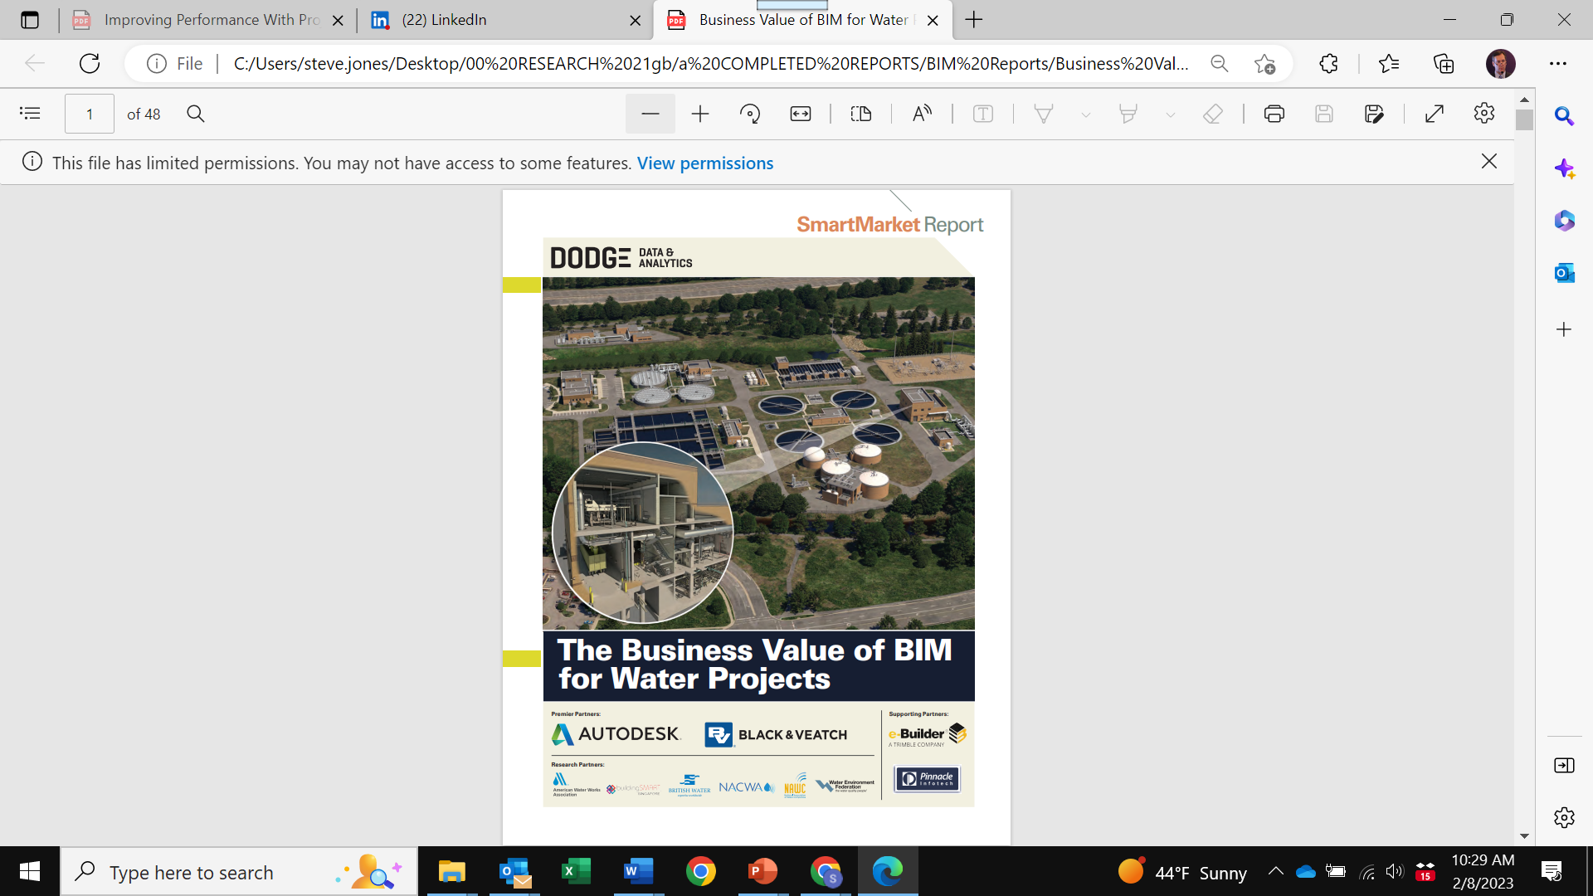
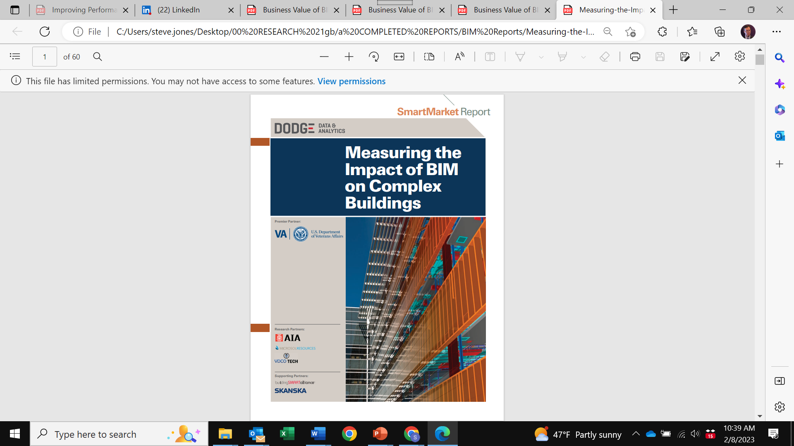
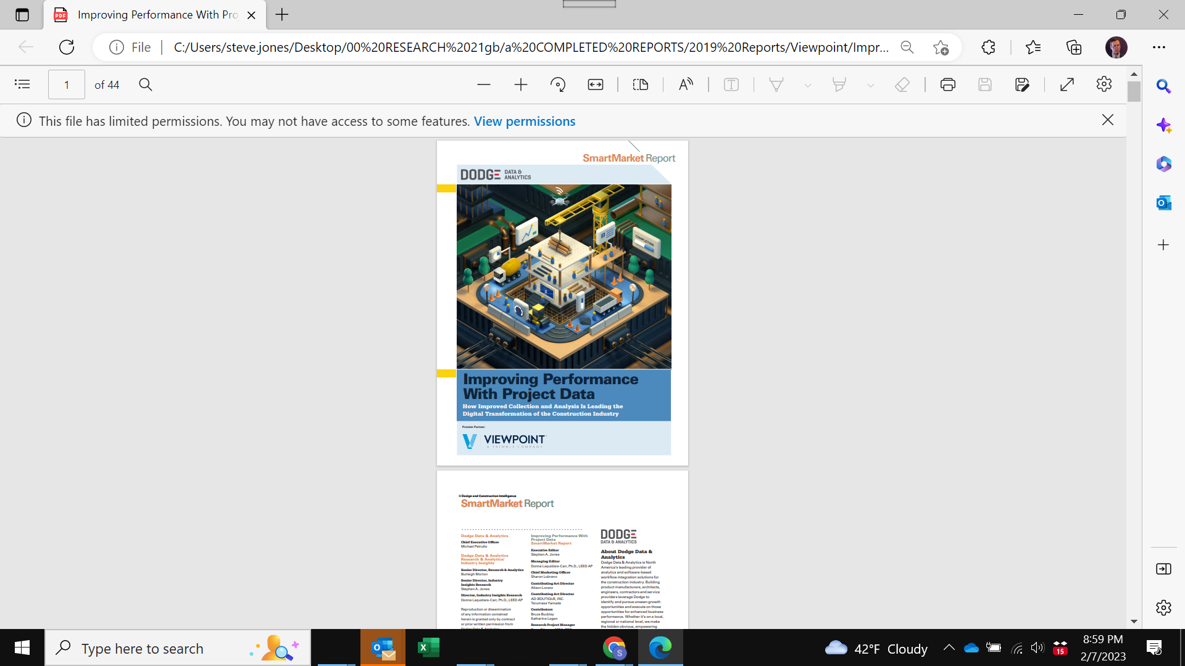

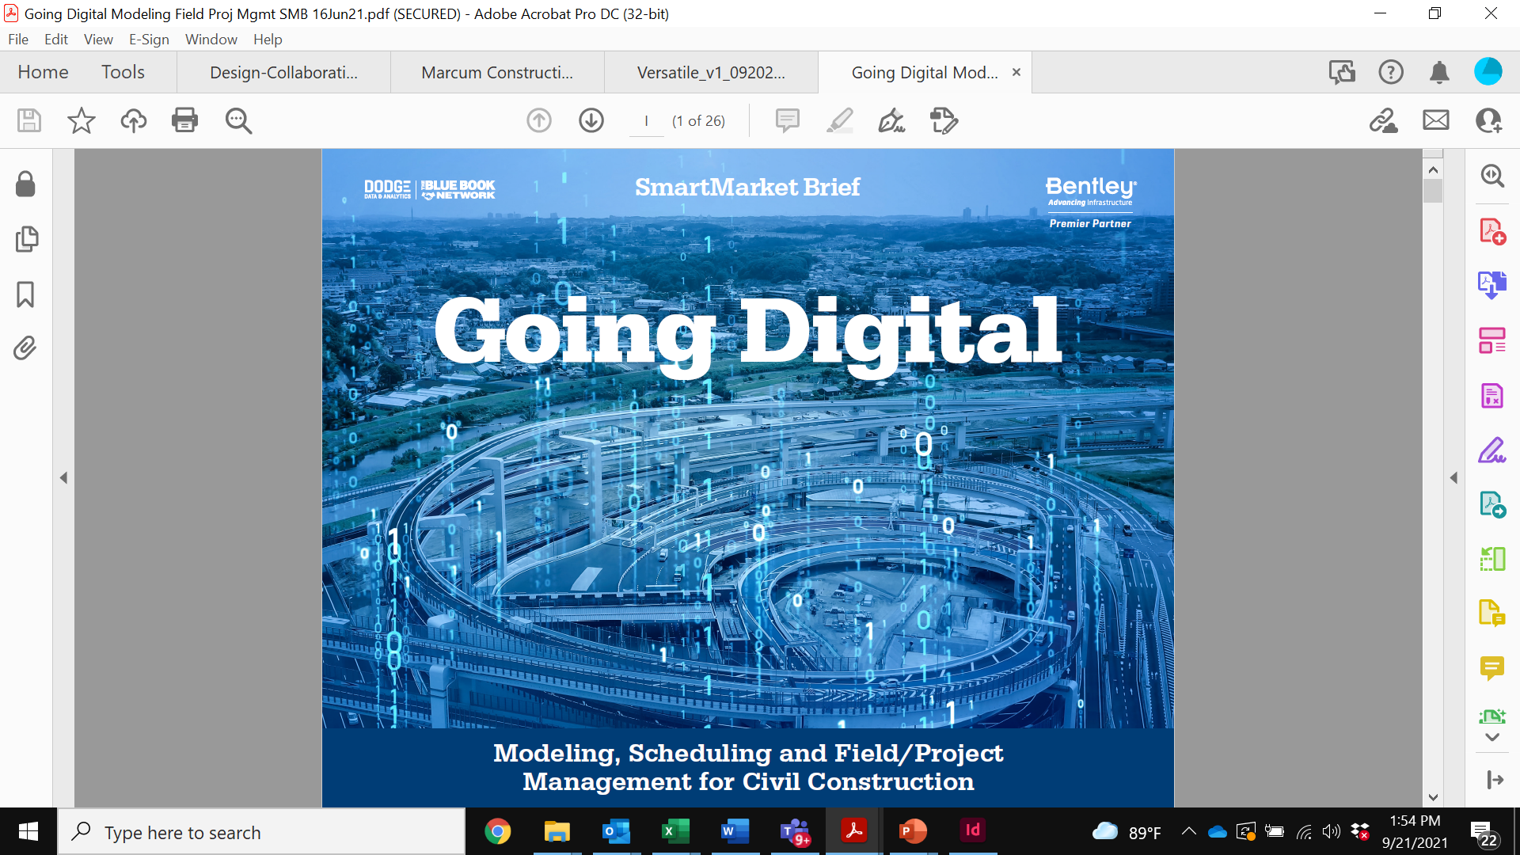
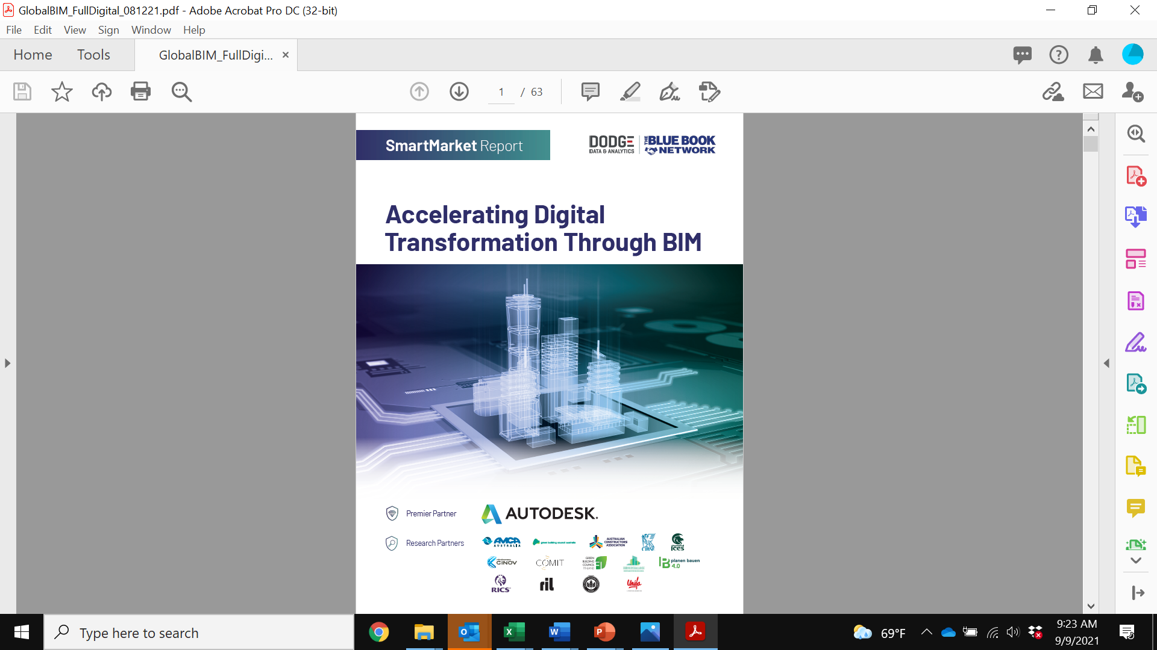
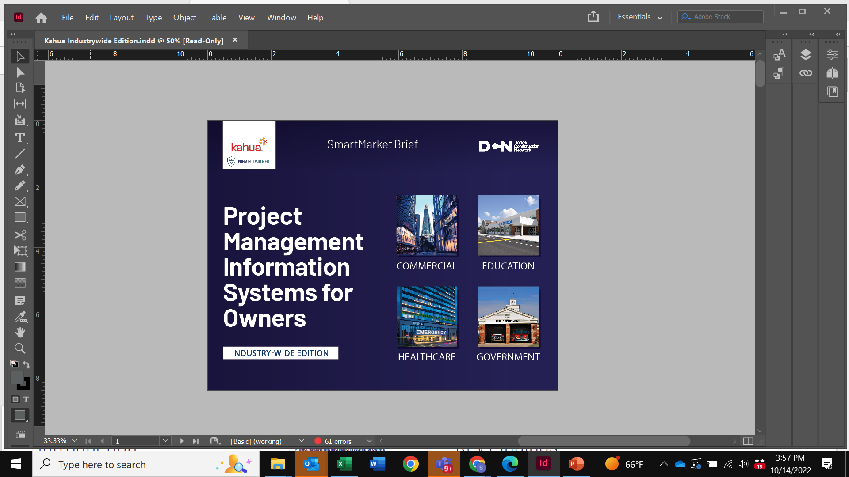
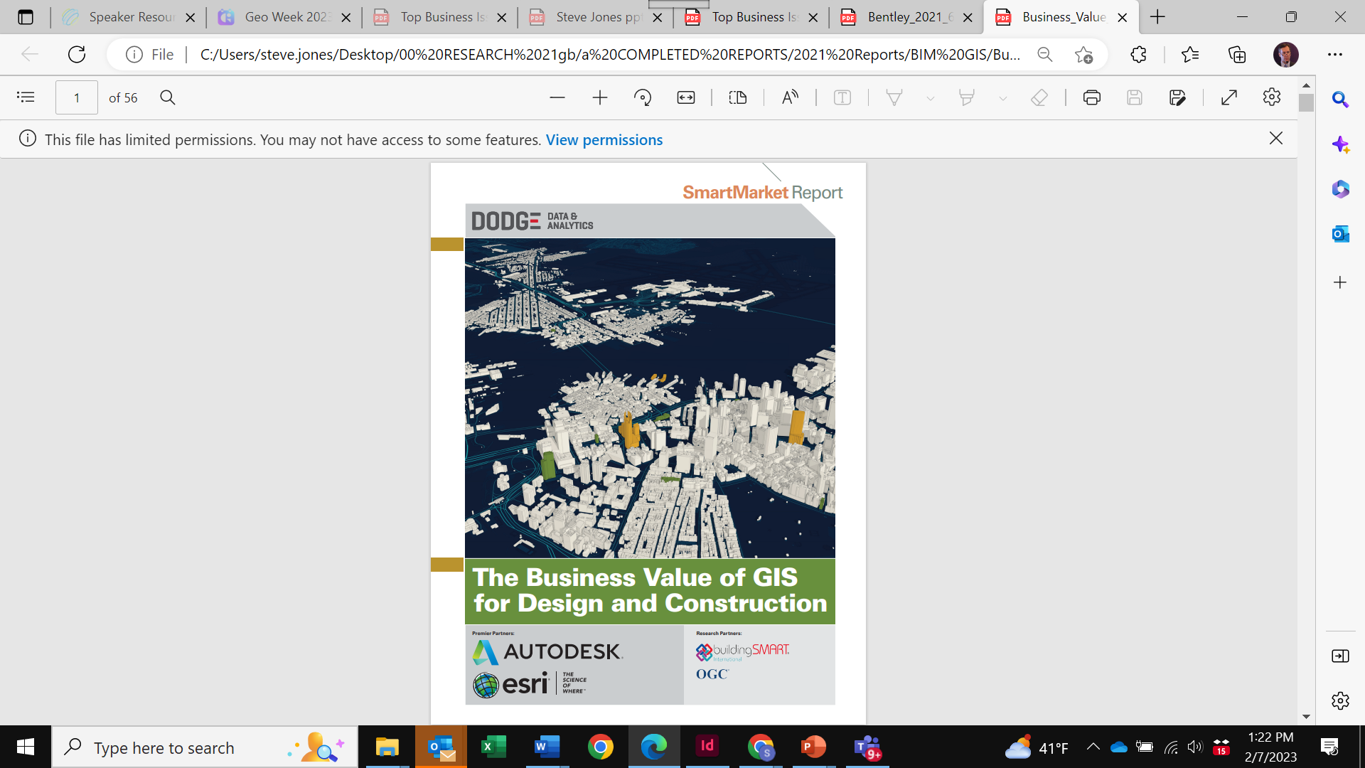

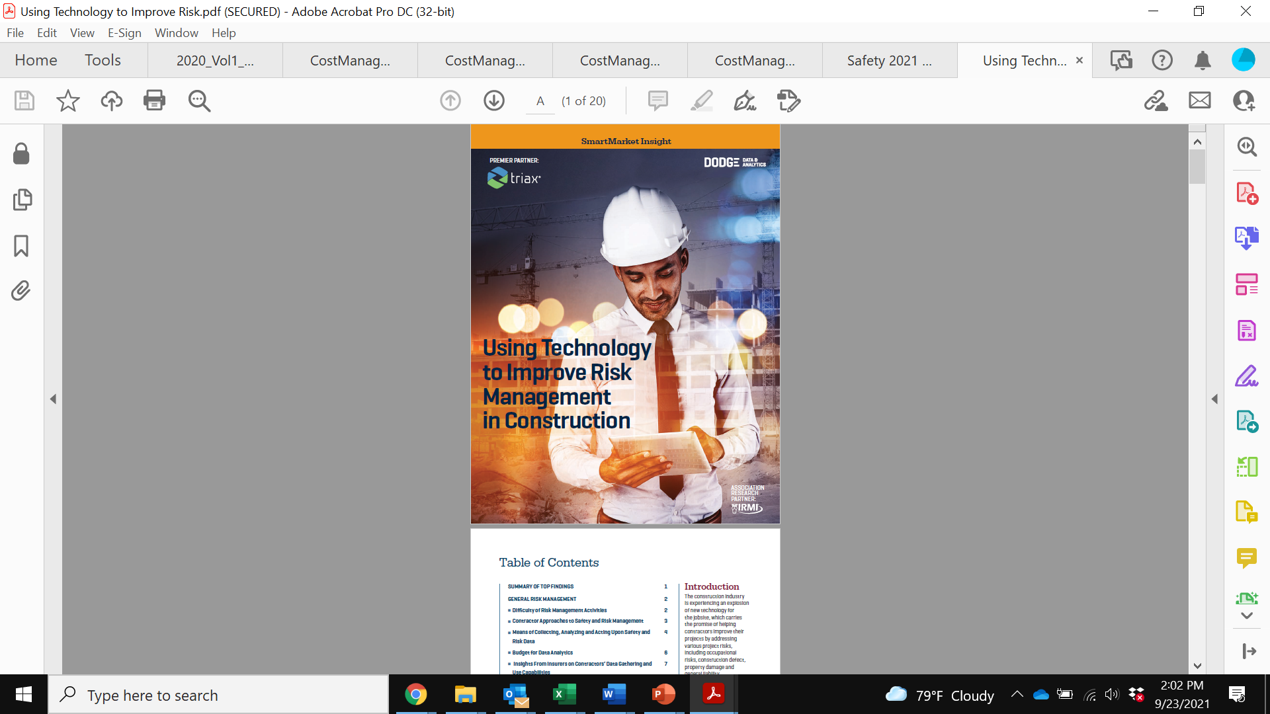
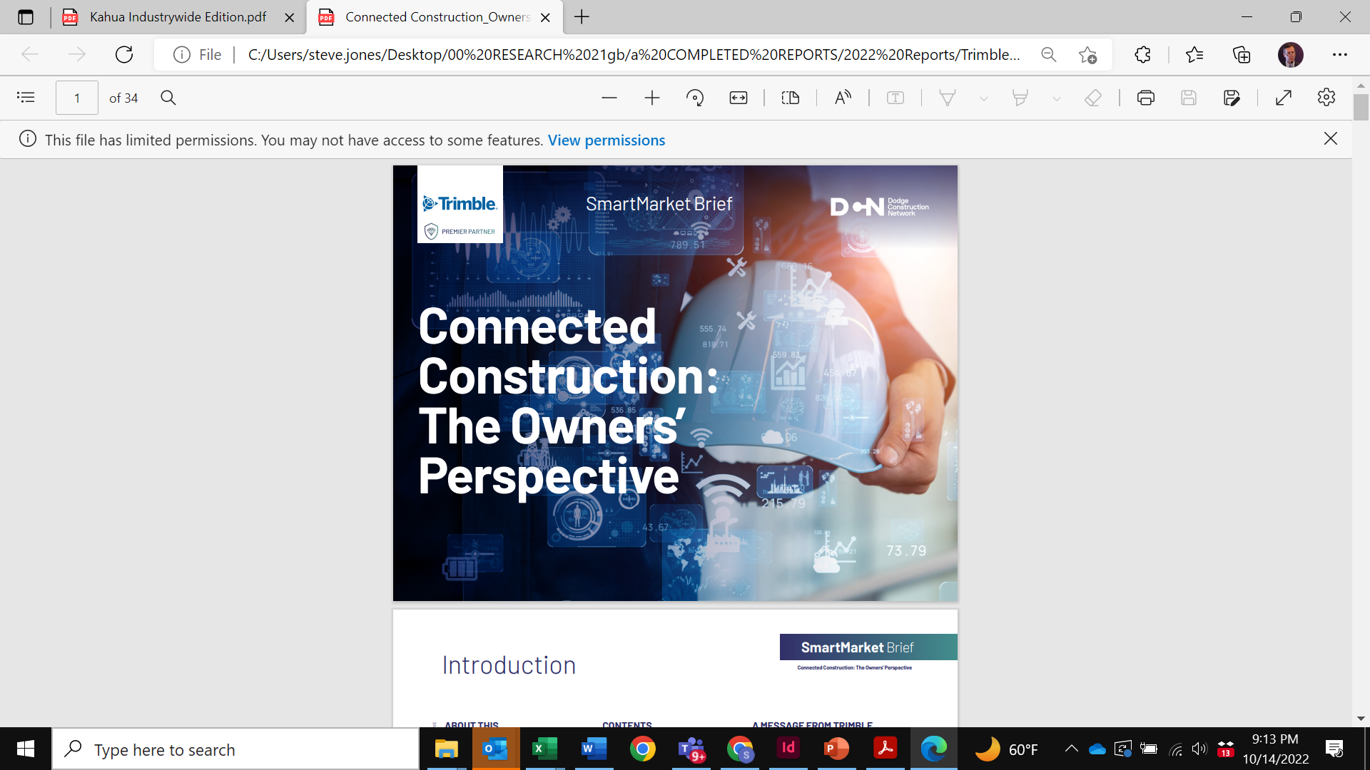
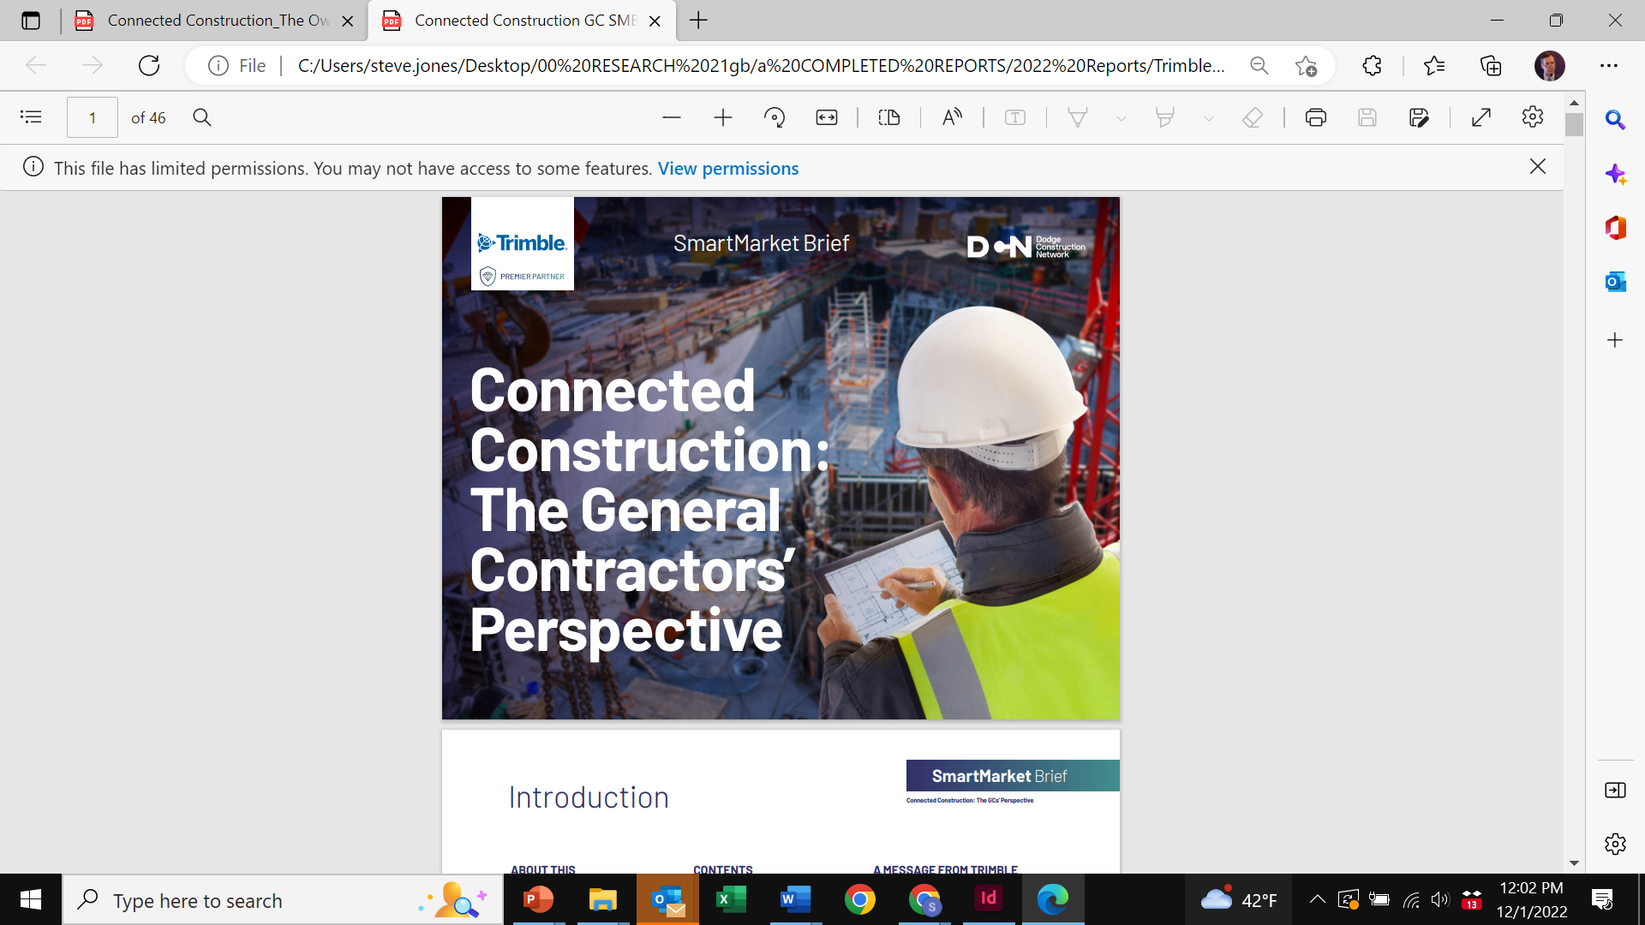
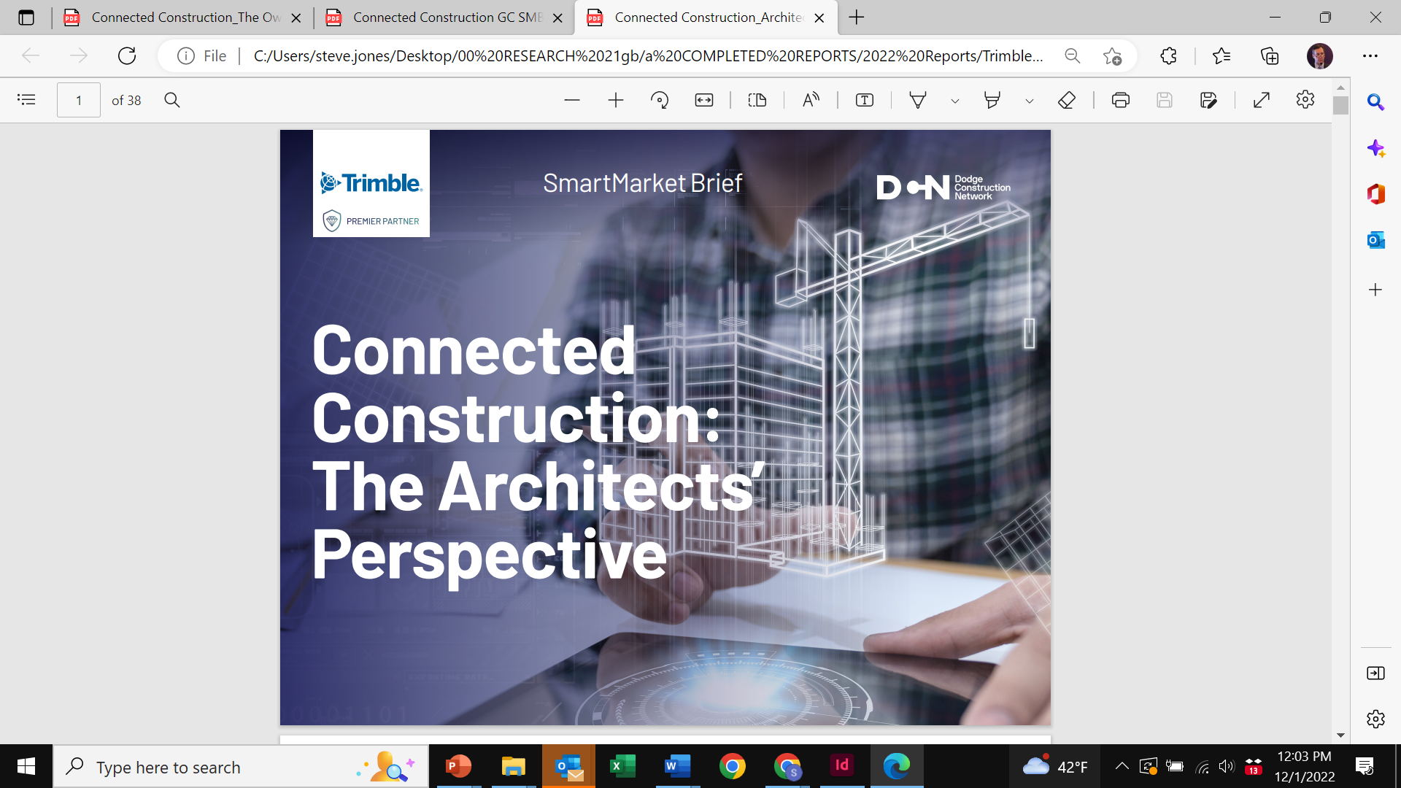
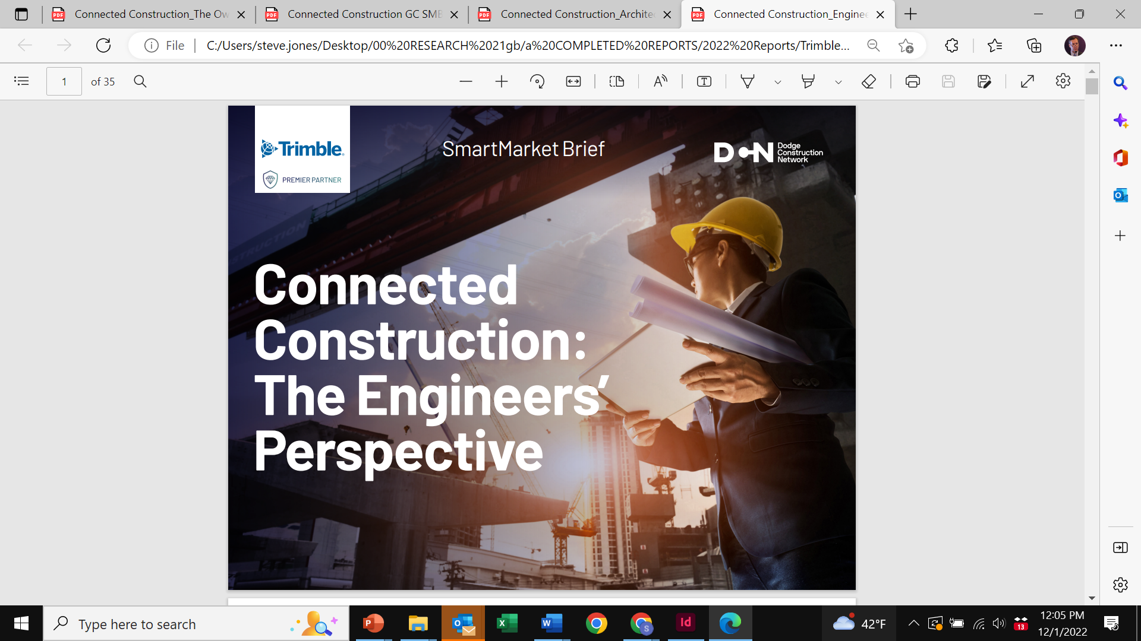

Dodge Industry Insights Research
Dozens of free research reports on key industry trends

Slide 4
Dodge Industry Insights Research
Dozens of free research reports on key industry trends
Who’s Doing What
and
What’s Working Best

Slide 5
Agenda
1. Current Economic Climate
2. The Evolving Role of Preconstruction
3. Technology & Data Trends
4. Economic Impact on Preconstruction Practice
5. Future Outlook/New Research

Slide 6
Macroeconomic Environment
Uncertainty Clouds the Outlook

Slide 7
Macroeconomic Factors
The macroeconomy has throttled back significantly.
Consumer spending has been stagnant
Housing sales have slowed considerably
Job market continues to weaken
DODGE FORECAST
DODGE FORECAST

Slide 8
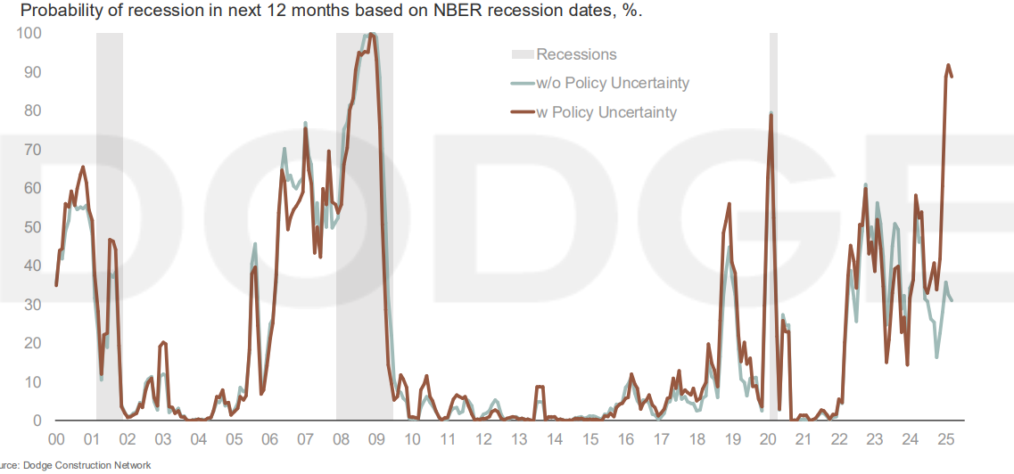
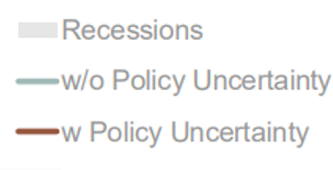
Recession Risks Are Unclear
*
*
*
*

Slide 9
Federal Policies
Tariffs Will Put Pressure on Construction Costs
  Average 5.5% by mid-2027
PPI for Goods Inputs to Construction
(Year over year growth rates 2011-2025)
COVID-19

Slide 10
Federal Policies
The One Big Beautiful Bill (OBBB)
Modest short-term economic benefits:
Senate delaying most cost-cutting until after 2026 midterms
Remaining in effect:
  Qualified business income deduction
  Provisions for R&D expenses
  QOZ (Qualified Opportunity Zones)
  Income tax cut
  Jobs Act (TCJA)
Significant long-term economic challenges due to higher deficits and debt:
  CBO says OBBB will add $3.4T to deficits over 10 years increasing the debt-to-GDP ratio from around 100% now to about 130%
  Spending cuts (student loan payment-plan changes, phasing out of Inflation Reduction Act (IRA) tax credits, and Medicaid cuts) reducing those costs by only 30%

Slide 11

Federal Policies
The One Big Beautiful Bill (OBBB)
Deportations :
OBBB contains a massive increase to the Immigration and Customs Enforcement agency (ICE) will lead to large volumes of deportations.
Overall US construction workforce is approximately 20% foreign-born. Closer to 40% in many states.
Many are documented but the concentration of foreigners will likely draw ICE’s attention to construction sites.

Slide 12
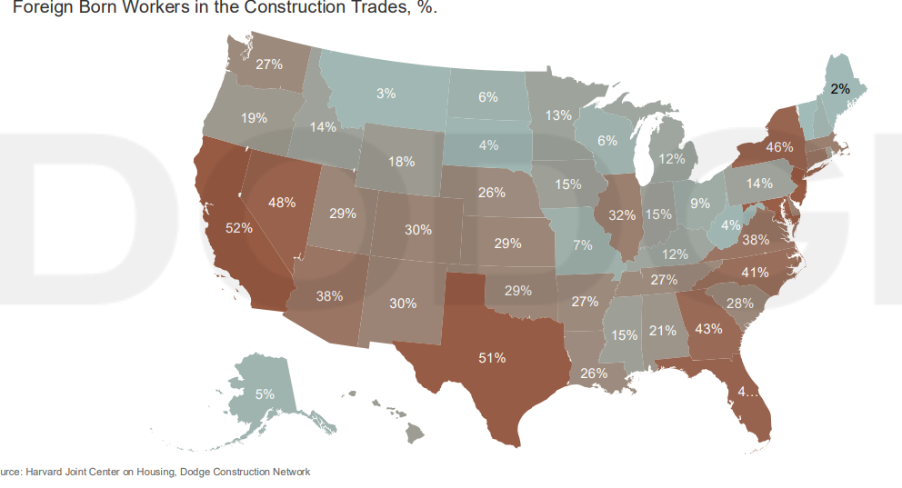
Deportations Will Hit Biggest Markets

Slide 13
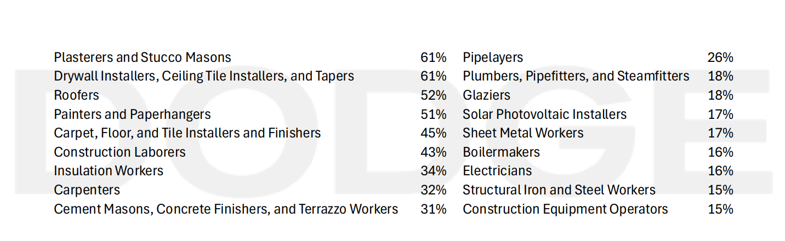
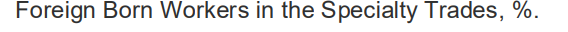
Wide Variation by Skills/Trades

Slide 14
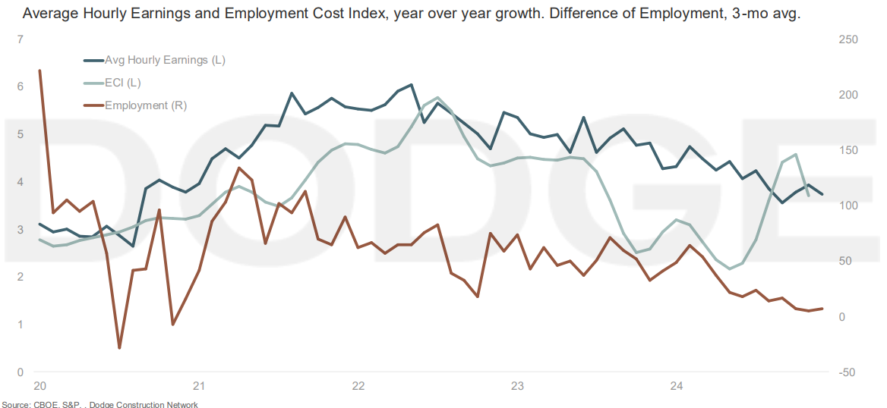
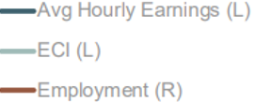
Construction Labor Market Cooling
Supply/demand balance for construction?
Approaching
COVID levels
Impact of COVID

Slide 15
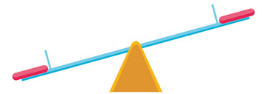
Interest Rates
Federal Reserve, Government Bonds and Lenders
ROCK
HARD PLACE
Inflation
& Jobs
Fed
Funds
Rate

Slide 16
Interest Rates
Federal Reserve, Government Bonds and Lenders
Dodge’s economists forecast that the Fed will risk inflation and cut rates
Jerome Powell’s term ends mid-2026
His successor is likely to be more aligned with White House re: lowering rates
DODGE FORECAST

Slide 17
Interest Rates
Federal Reserve, Government Bonds and Lenders
DODGE FORECAST
DODGE FORECAST

Slide 18
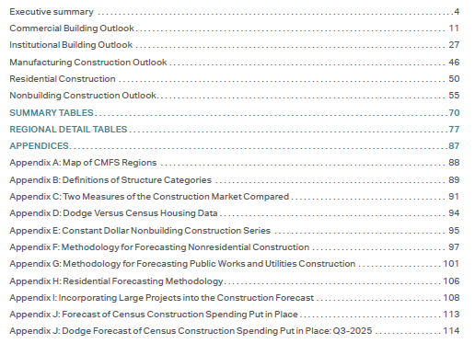
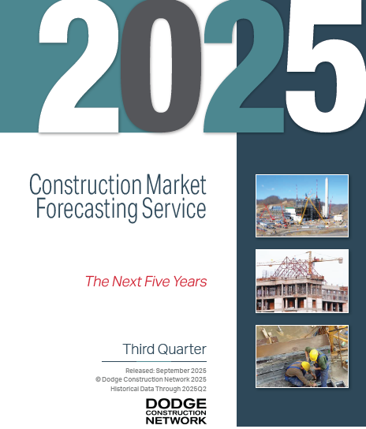
Construction Sector Forecasts

Slide 19
Construction Sector Forecasts
Buildings
Commercial (includes Residential and Manufacturing)
Institutional
Non-Building
Infrastructure
Energy/Telcom
Public Works

Slide 20
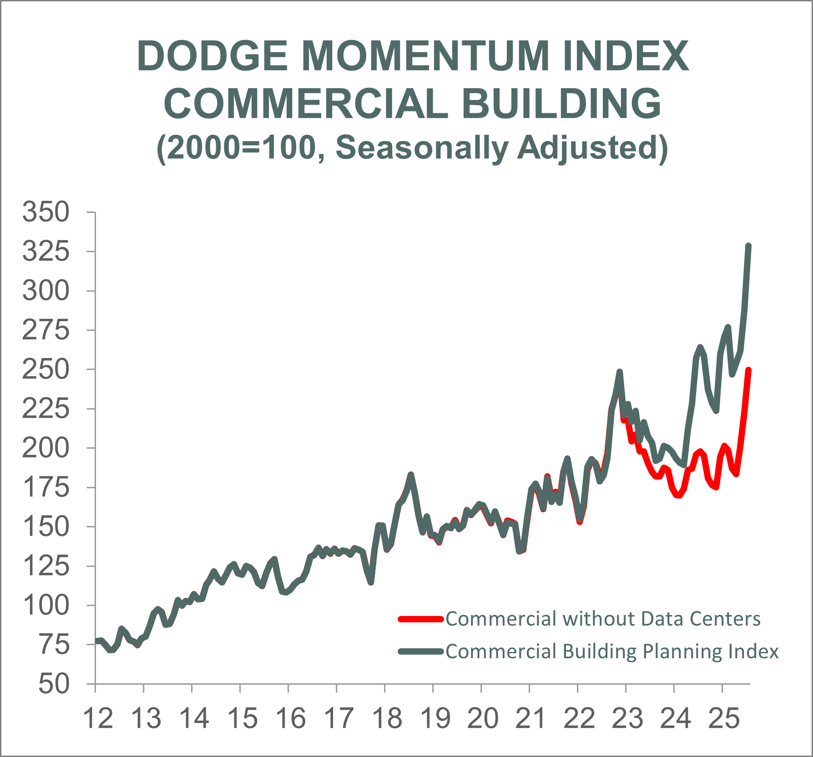
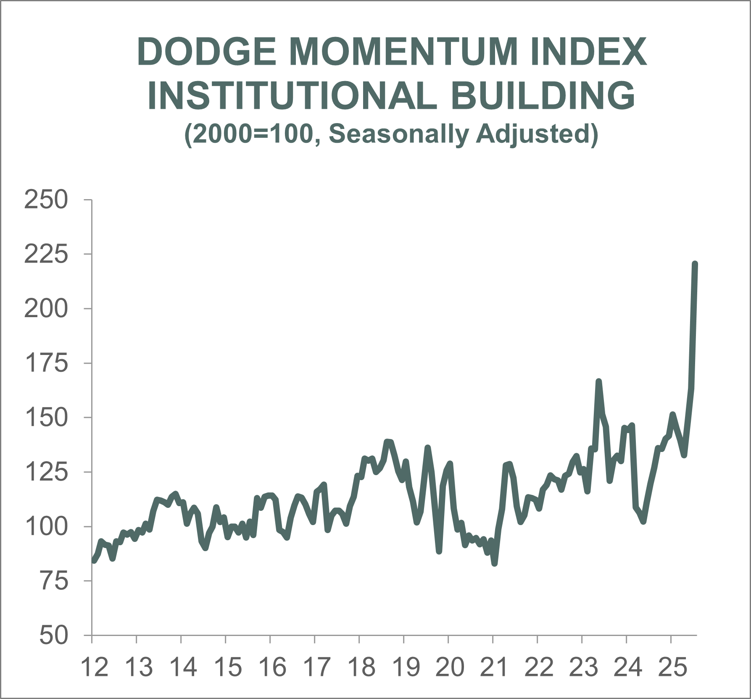
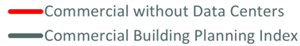
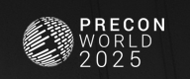
Project Pipeline will Support Near-term
Source: Dodge Construction Network
Notes:
This is free and comes out the 5th business day of every month. If a customer wants to be added to the email distribution list (Analytics.Fulfillment@construction.com can add new emails), they will also receive the free data file (going back to 2002).
DMI measures the momentum of nonresidential building projects entering the planning queue, based on the value of projects in DGN (V1 projects). We exclude projects over $500 million and we also exclude manufacturing and transportation projects. While the DMI has seen substantial growth lately, most of it remains centered around strength in data center planning (aside from July) – and more recently, warehouse activity. Despite the growth, it’ll take longer for it to translate into construction starts – given how slow projects are taking to move through the planning process.
Why was July so strong? Planning data skyrocketed in the month of July on the back of several large projects entering the planning queue for data centers, research & development labs, hospitals and service stations. Combined with more organic momentum in planning for hotels, warehouses, and recreational projects, cumulative activity drove record highs in the DMI. After months of wait-and-see due to tariff uncertainty, owners and developers have begun to move forward with projects and assumed higher costs for them. As economic and fiscal uncertainty remains prevalent, volatility in planning activity will remain elevated.

Slide 21
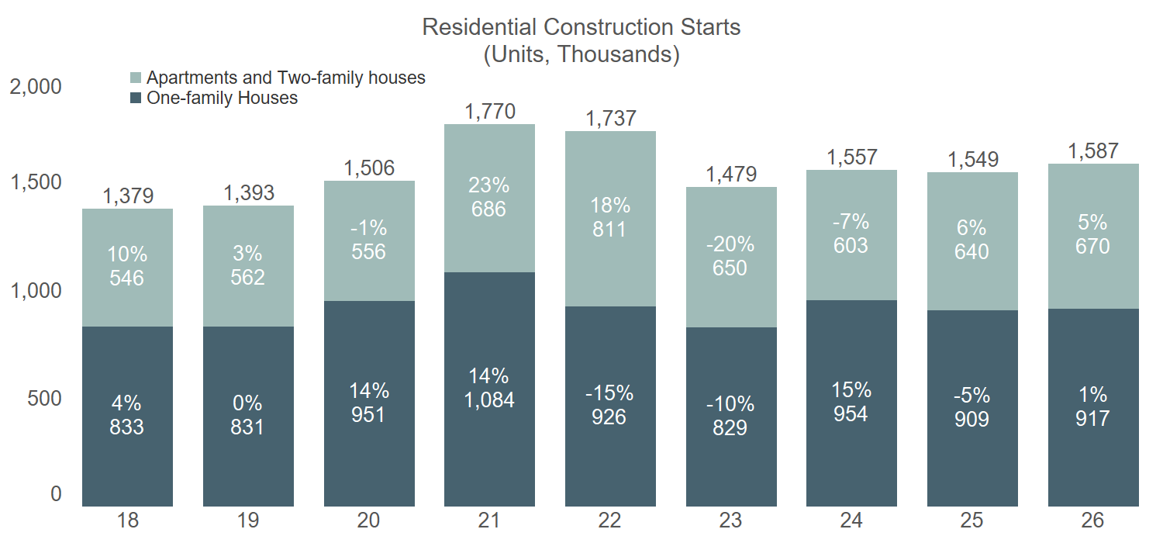
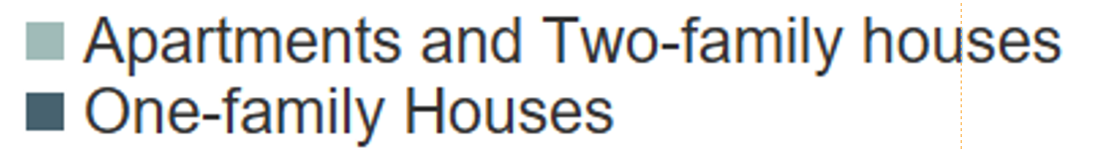
Residential (SFR and MFR)
Affordability and rates discourage SFR and encourage MFR (rental)
Forecast
COVID spike
Source: Dodge Construction Network
Notes:
Single family construction has been underwhelming in 2025.
Housing affordability and lack of supply, particularly for entry-level homes, remain the primary barriers preventing buyers from entering the market.
Current 30-year fixed mortgage rates are firmly in the 6.5% to 7% range, and home prices remain historically high, despite a recent slight decline.
While buyers may have once been willing to stretch their budgets to enter the housing market, the growing risk of recession and a weakening labor market are compelling many potential buyers to pause home-buying plans.
Beyond 2025, slower immigration will also constrain household formations and, as a consequence, housing demand.
Multifamily construction should see a stronger year in 2025. *Can highlight as bright spot/area of opportunity*
As buyers continue to be priced out of the single family market, demand on the rental side will be sustained — or buyers will opt to purchase more affordable townhouses or condominiums.
Multifamily completions, however, peaked in the first quarter of 2024 and have largely been pulling back since. In response, multifamily planning activity has been steadily rising over the last year — correlating to the year-to-date growth in multifamily starts in 2025.
Weaker demographic trends and less housing demand will then drive multifamily starts to pull back through the remainder of the forecast period.
Housing Shortage:
At present, Dodge assumes the housing market is undersupplied by roughly 1.2 million units, which has sustained strong demand for new housing and kept upward pressure on home prices over recent years. Over the next five years, as the housing shortage eases, demand for new housing is also expected to normalize — driving a flatter outlook for single family construction starts in the current iteration of the forecast. *Revisions: The out-years of our residential forecast have been sizably downgraded for this reason*

Slide 22
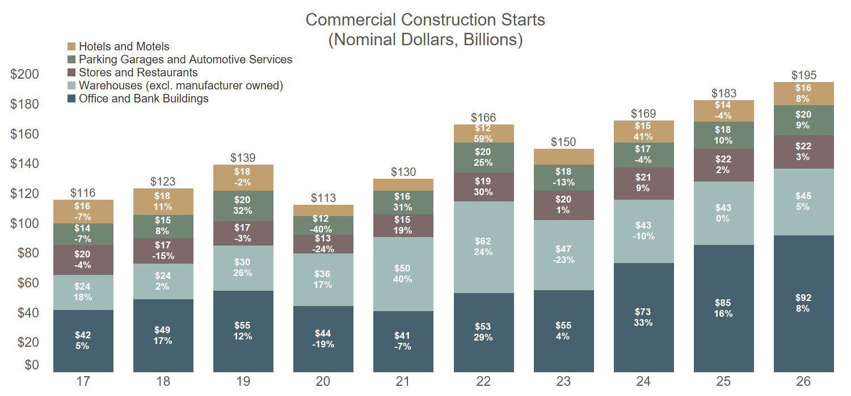
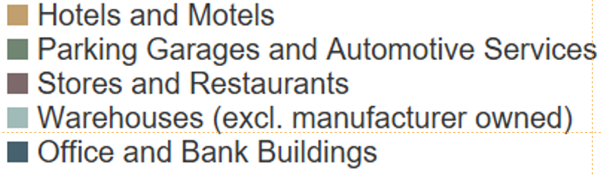
Data Center Construction Propels Growth
Forecast
(incl. Data Centers)
Source: Dodge Construction Network
Notes:
Dollar value in chart is all in <- new, additions, renovations, and inflation
Commercial starts will grow 8% in 2025, bolstered by growth in data center construction and parking garages.
Retail stores, warehouses, and hotels are the most vulnerable to a pullback in consumer spending, more selective lending standards, and higher materials costs. These sectors, therefore, face the most near-term risk. With data centers excluded, growth in the remaining commercial sectors will expand by a muted 5% in 2025.
Data centers will continue to see steady expansion in 2025 & 2026, driven by outsized demand for AI & cloud infrastructure *Area of opportunity*
Slow re-emergence of the warehouse market (Amazon activity has steadily picked up in the first half of 2025) is also a positive – even though overall growth this year will be flat, 2026 is more positive. *Area of opportunity*

Slide 23
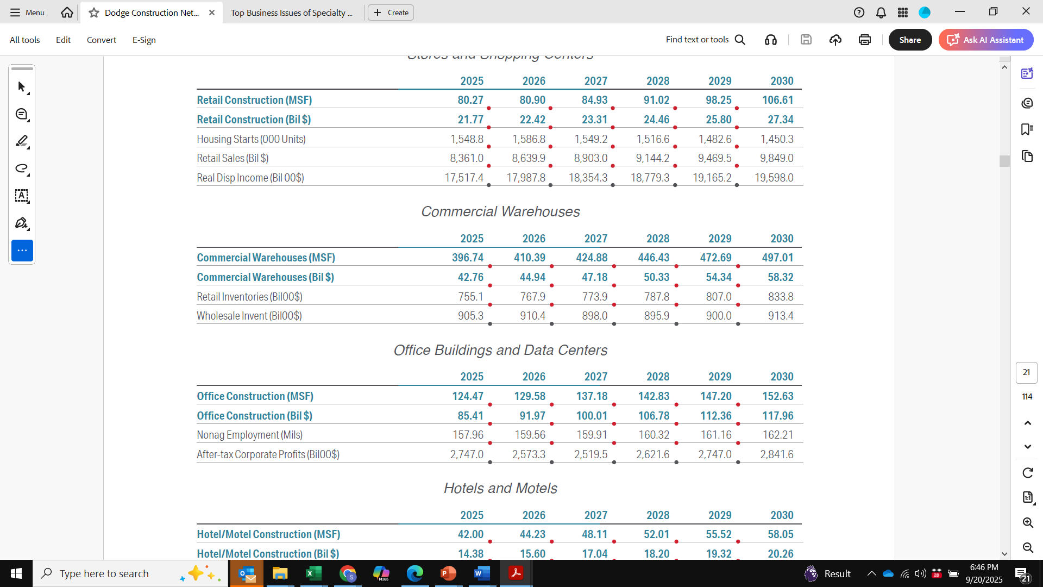
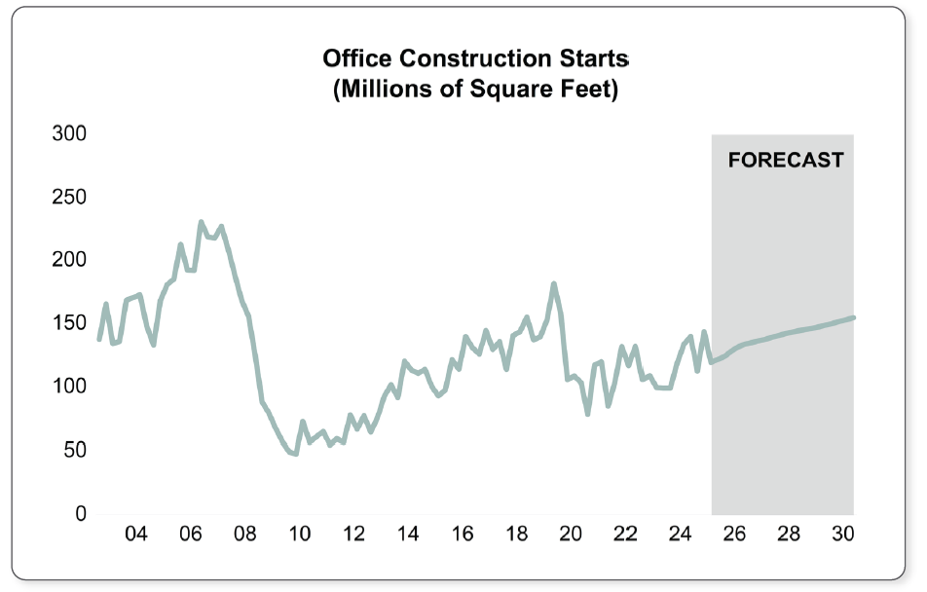
Five-Year Forecast: Office & Data Centers
+22.6%
+38.1%

Slide 24
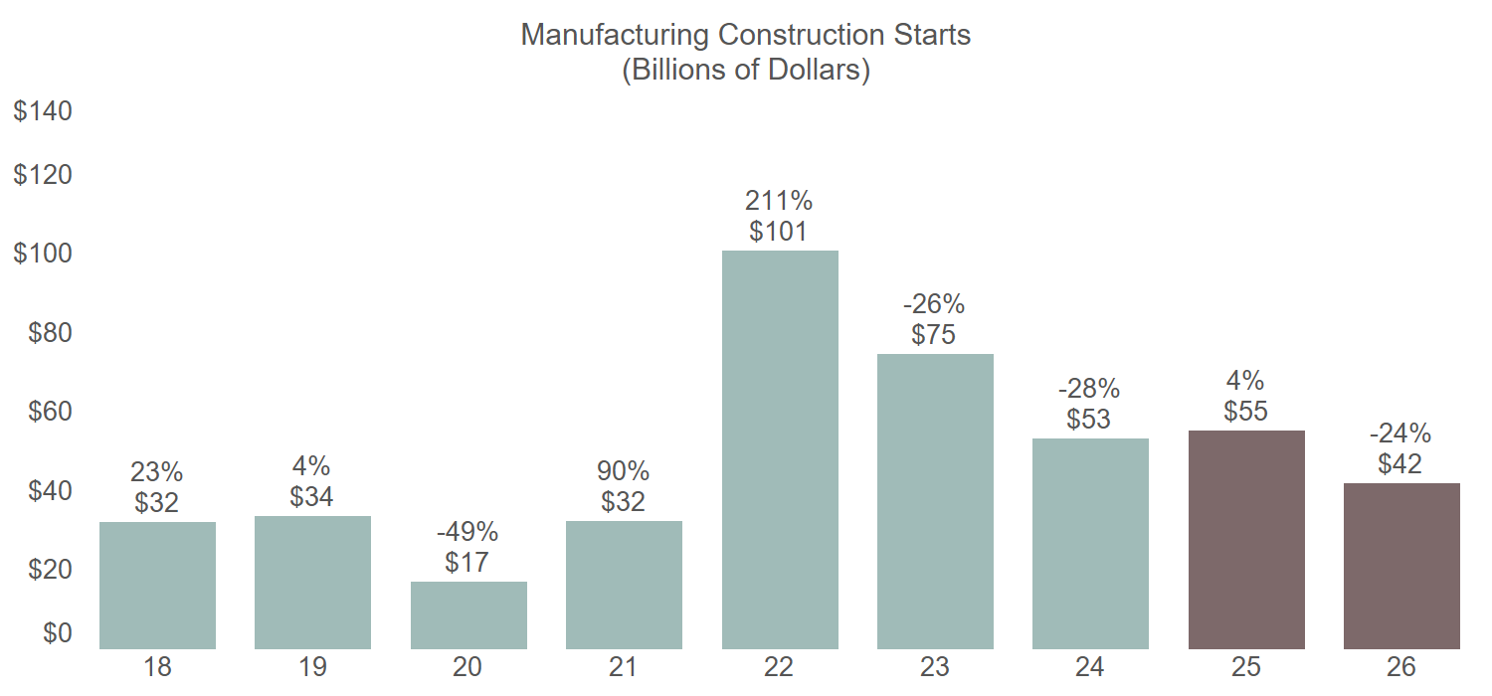
Manufacturing Outlook Faces Uncertainty
Changing tariffs create uncertainty re: higher input costs, supply chain issues, etc.
Forecast
Source: Dodge Construction Network
Notes:
Manufacturing construction starts have had a volatile start to the year.
First quarter: Major pullback driven by changing tariff policies (increased risks around higher input costs, supply chains issues, and uncertainty around long-term pricing)
Second quarter: Massive rebound thanks to $10B TSMC semiconductor plant breaking ground & normalizing of MFG construction levels
The high cost-per-square foot of semiconductor plants is driving stronger dollar-value growth this year,
Revisions: Last quarter, MFG was going to be negative for the year – so the dollar value forecast has been moderately upgraded; but the narrative remains the same. Square footage and constant dollar projections remain solidly negative.

Slide 25
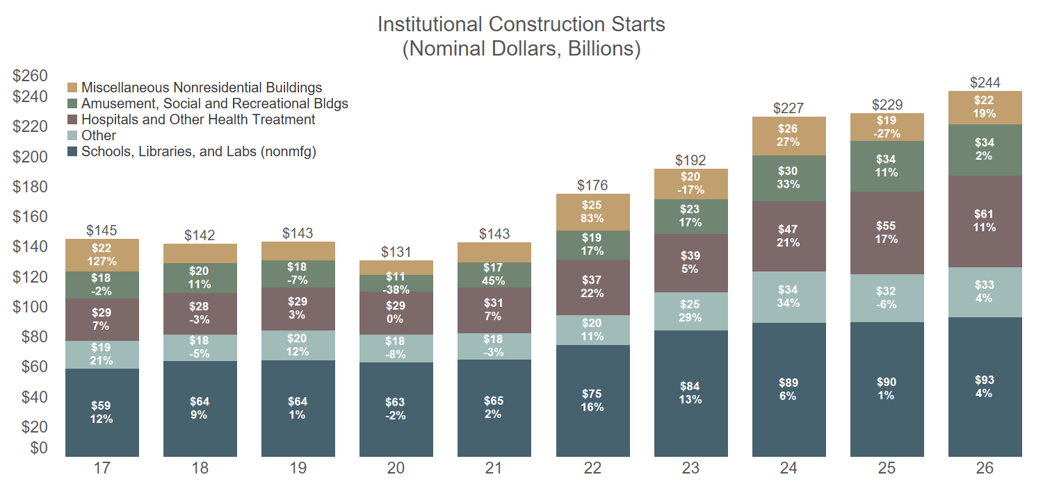
Weakness in Education Impacts Institutional
Less federal funding, higher endowment tax, weaker demographics
Forecast
Source: Dodge Construction Network
Notes:
Institutional starts were on a tear in 2024 with large projects in the healthcare, recreation, and transportation sectors pushing starts up 18% to $227 billion. This year will see even more large projects starting, including the second phase of the Rikers Island prison replacement and the Midtown Port Authority Bus Terminal Replacement in New York NY.
Education construction is weak due to risks around less federal funding, higher endowment tax, weaker demographics. Revisions: YTD performance in education has driven continuous downgrades throughout the last two quarters.
The January start of the $5 billion Children’s Health & UTSW New Pediatric Campus in Dallas TX will prop up healthcare construction this year. Hospital construction should be more insulated in 2025 than urgent care clinics and nursing homes.
Dollar Value by STC:
Hospitals: +18% in 2025, +16% in 2026
Clinics: +14% in 2025, +1% in 2026
Area by STC:
Hospitals: +8% in 2025, +3% in 2026
Clinics: +4% in 2025, +3% in 2026
In aggregate, institutional starts will expand by 1% in 2025 even as healthcare and recreational starts post solid growth. Unfortunately, more muted education, dormitory, and transportation construction will offset growth in the other sectors.

Slide 26
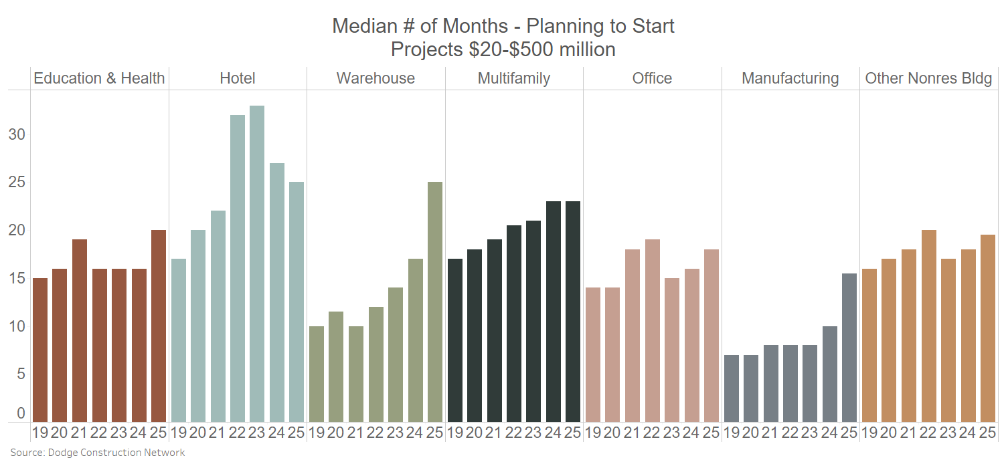
Project Delays Remain an Issue
Source: Dodge Construction Network
Notes:
This measures how long projects are taking to get from planning through project start.
Education and health have been pretty steady since 2019, but the private building side has seen project planning slowing down.
Why is this happening:
Uncertainty around tariff & economic policies has caused owners & developers to slow down their planning process (this is the primary trend for 2025)
Prior to 2025, projects were slowing down due to: Elevated material prices, worsening labor shortages, and specific market conditions (i.e. warehouses being in sectoral decline; weak demand for new office space, etc.)

Slide 27
Construction Sector Forecasts
Buildings
Commercial (includes Residential and Manufacturing)
Institutional
Non-Building
Infrastructure
Energy/Telcom
Public Works

Slide 28
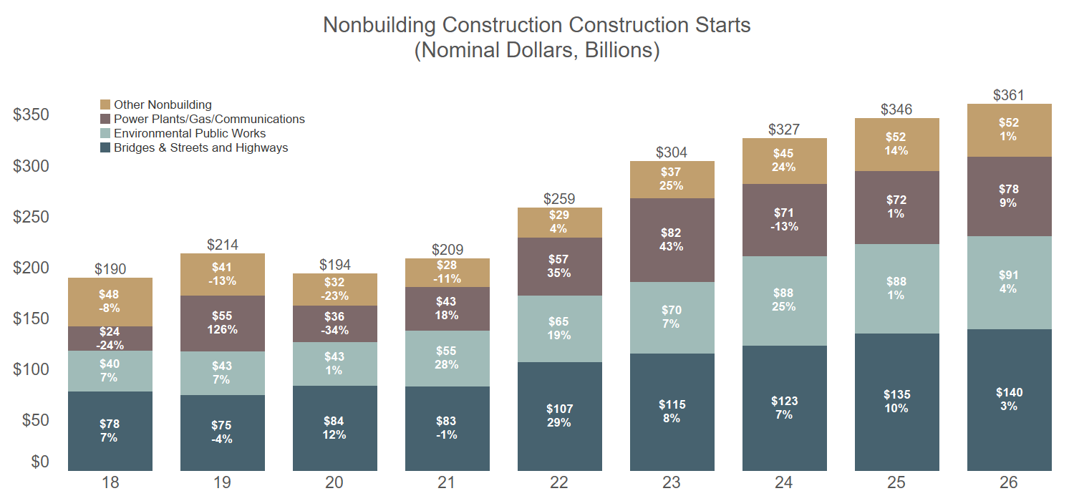
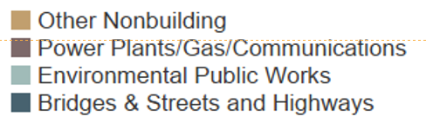
Infrastructure Funding Drives Nonbuilding Growth
Forecast
Source: Dodge Construction Network
Notes:
This forecast assumes there will be no additional major infrastructure law, akin to the Infrastructure Investment and Jobs Act (IIJA), passed in the next five years. While the U.S. will likely see the start of a new five-year surface transportation plan in 2027, those funds will be a fraction of the total IIJA outlay.
One of the larger downgrades in the current forecast comes in electric power-related construction. Solar and wind projects accounted for 71% of electric power starts in 2024 but are now facing weaker federal funding and expiration of tax credits. But – demand should remain strong for electric power generation driven by climate change (more demand on the grid overall for electricity), buildouts of data centers and manufacturing projects
Dollars from the IIJA and IRA had been driving strong activity in the environmental public works. But, as federal funding dwindles, growth in environmental public works should follow suit. Notably, the Environmental Protection Agency (EPA) faces potentially severe cuts in FY2026, including potential cuts to the State Revolving Funds (SRFs) for water infrastructure projects amongst others. Uncertainty also remains around funding for the U.S. Army Corps of Engineers (USACE). This forecast assumes that funding for the EPA and USACE will largely remain in place — but it is becoming increasingly likely that future funding cuts will constrain overall project activity.

Slide 29
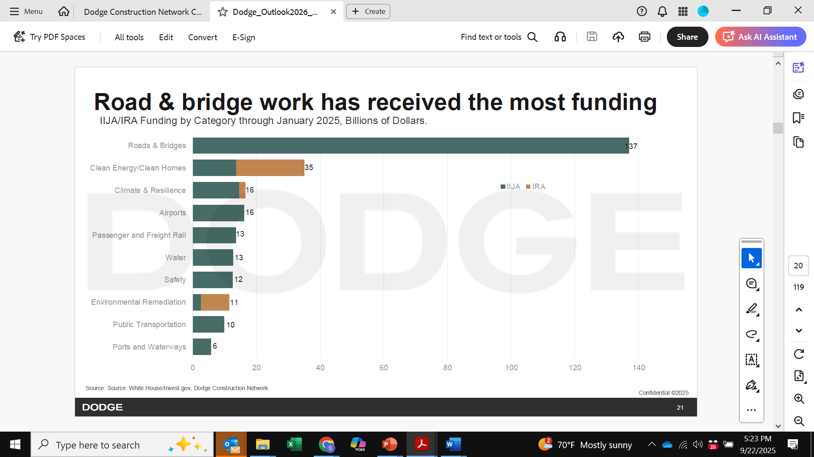

Slide 30
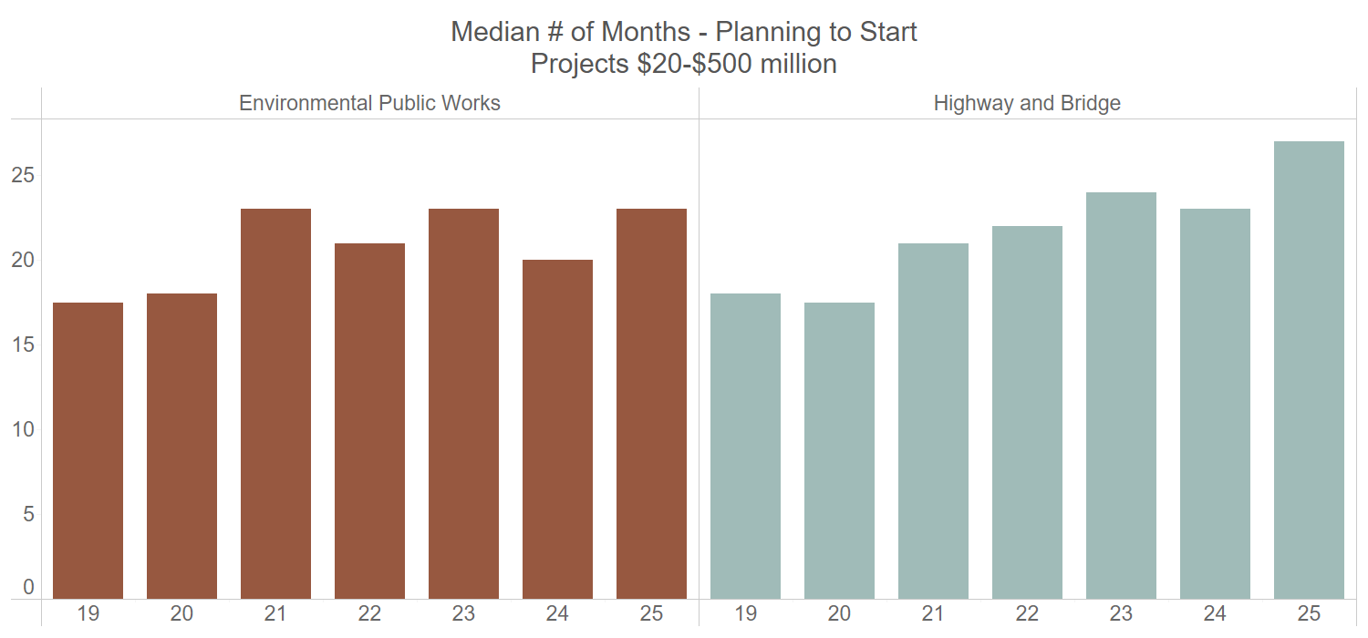
Project Delays Remain an Issue
Source: Dodge Construction Network
Notes:
Same as previous slide, just for infrastructure

Slide 31
Overall Forecast

Slide 32
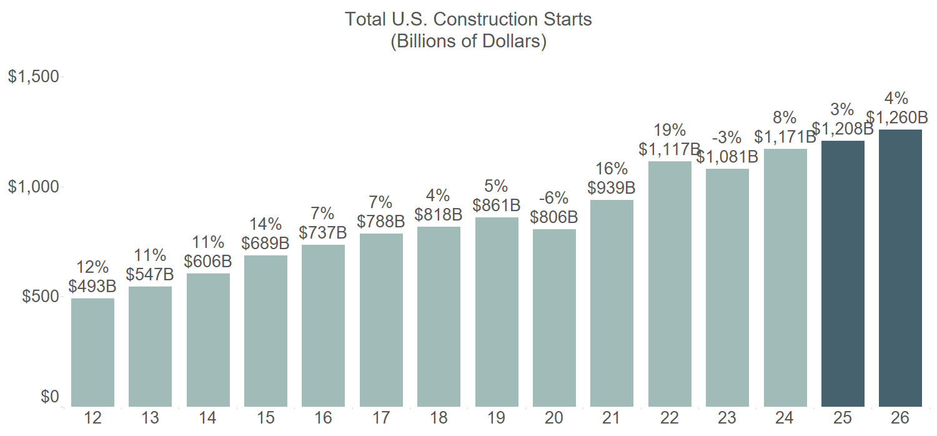
Total Construction Starts: 2025 and 2026
Weaker Residential and Institutional Flatten Growth
 | Constant Dollar Growth
2024 | 6%
2025F | 0%
2026F | 3%
Forecast
Source: Dodge Construction Network

Slide 33
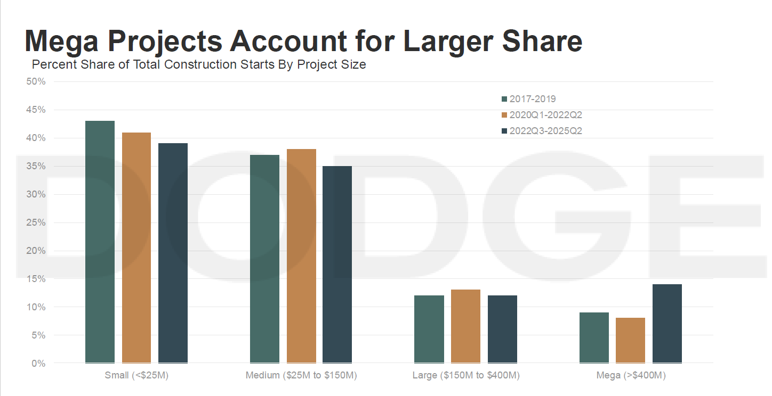

Slide 34
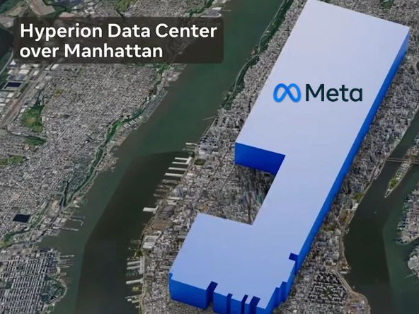
Meta 5GW Hyperion Data Center
Overlayed on Manhattan for sense of scale

Slide 35
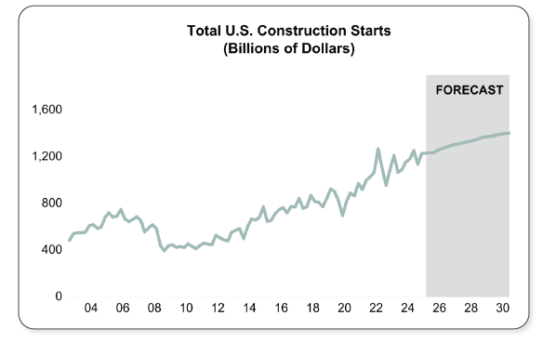
Total Construction Starts: Five Year Forecast
Dollars ($B*)
2026: 1,260.0 (+4.3%)
2027: 1,306.0 (+3.7%)
2028: 1,336.8 (+2.4%)
2029: 1,372.2 (+2.6%)
2030: 1,396.7 (+1.8%)
(*not indexed for inflation)

Slide 36
Agenda
1. Current Economic Climate
2. The Evolving Role of Preconstruction
3. Technology & Data Trends
4. Economic Impact on Preconstruction Practice
5. Future Outlook/New Research

Slide 37
The Evolving Role of Preconstruction
KEY TRENDS
From Estimating to Strategy
  Preconstruction is moving beyond “pricing a set of drawings” into being the strategic front end of projects.

Slide 38
The Evolving Role of Preconstruction
KEY TRENDS
From Estimating to Strategy
  Preconstruction is moving beyond “pricing a set of drawings” into being the strategic front end of projects.
Integration with Owners
  Owners increasingly expect early contractor input on constructability, sustainability, procurement risk, and life-cycle cost

Slide 39
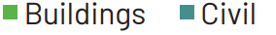
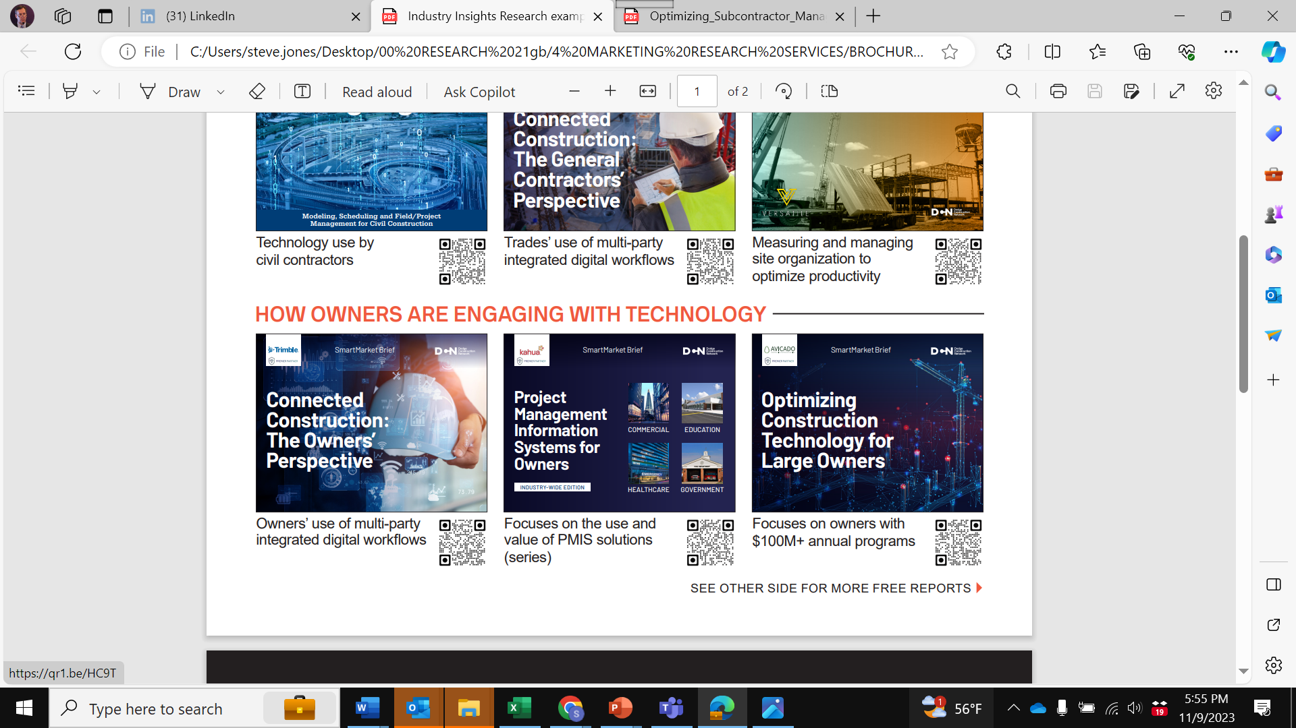

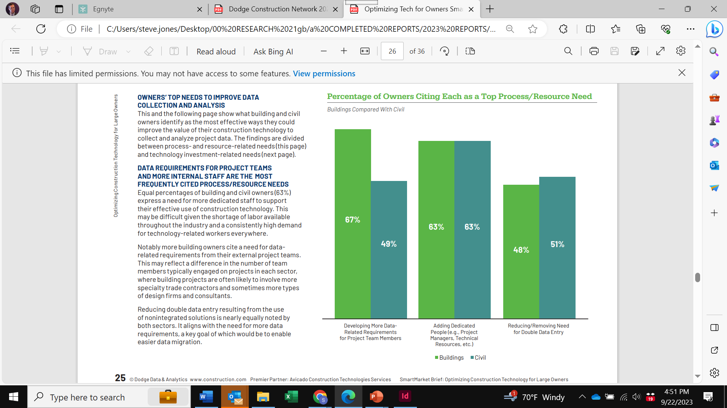




Owners: PMIS Adoption Driving Digital Control
Owners Increasingly Driving Project-Wide Digital Procedures
The Owner
The Owner Platform (PMIS)

Slide 40

Owners: PMIS Adoption Driving Digital Control
Owners Increasingly Mandating (Their) Digital Tools
Owners who mandate frequently report better accuracy, completeness, timeliness and consistency of the project data in their PMIS.
Frequency of Mandating That Contractors Use the Owner’s PMIS
62%

Slide 41
Owners: PMIS Adoption Driving Digital Control
Owners are:
Using more construction tech
Rolling out project team data standards
Contractually requiring digital processes
Beginning to require use of their PMIS
Owners Increasingly Mandating (Their) Digital Tools
Owners who mandate frequently report better accuracy, completeness, timeliness and consistency of the project data in their PMIS.
Frequency of Mandating That Contractors Use the Owner’s PMIS
62%

Slide 42



Owners: Evolution Towards Data-Centric Practices
Public and private
Buildings and non-building
Active building programs
RELEASED: Q2, 2025

Slide 43

Owners: Evolution Towards Data-Centric Practices
Practice at Least One From That Category
Public and private
Buildings and non-building
Active building programs
RELEASED: Q2, 2025
Average Share Practicing All From That Category

Slide 44


Owners: Evolution Towards Data-Centric Practices
Public and private
Buildings and non-building
Active building programs
RELEASED: Q2, 2025

Slide 45
The Evolving Role of Preconstruction
KEY TRENDS
From Estimating to Strategy
  Preconstruction is moving beyond “pricing a set of drawings” into being the strategic front end of projects.
Integration with Owners
  Owners increasingly expect early contractor input on constructability, sustainability, procurement risk, and life-cycle cost
Critical Role in Risk Management
  Given volatility, preconstruction teams need to scenario-plan around material price swings, lead times, and alternative supply options.

Slide 46



Risk Management: Challenges and Practices
Holding Building Products/Materials Pricing
Share of Contractors Who Had to Accept a Window From a Supplier That Is Short Enough to Increase Their Risk
100 GCs and 51 trades
Buildings and non-building
RELEASED: Q4, 2024
Median Window for Holding
Building Products/Materials Pricing
Without Increasing Risk (30 Days)

Slide 47


Risk Management: Challenges and Practices
Effective Strategies for Reducing Supply Chain Risks
PRECONSTRUCTION
100 GCs and 51 trades
Buildings and non-building
RELEASED: Q4, 2024
Most users cite effectiveness
(4 or 5 on a scale of 1-5)

Slide 48


Risk Management: Challenges and Practices
Frequency of Collaborating With Client in Preconstruction and
Construction to Mitigate Supply Chain Disruptions and Inflation
55%
100 GCs and 51 trades
Buildings and non-building
RELEASED: Q4, 2024

Slide 49


Risk Management: Challenges and Practices
Impact of Collaborating With Clients to Mitigate Supply Chain/Inflation Risks
Starts in Preconstruction
100 GCs and 51 trades
Buildings and non-building
RELEASED: Q4, 2024

Slide 50
Agenda
1. Current Economic Climate
2. The Evolving Role of Preconstruction
3. Technology & Data Trends
4. Economic Impact on Preconstruction Practice
5. Future Outlook/New Research

Slide 51

Technology & Data Trends
KEY TRENDS
Digital Estimating and Model-based Takeoffs
  BIM-linked quantity takeoffs and AI-enhanced cost modeling are reducing cycle times.
MODEL
QUALITY

Slide 52



BIM: Model Quality
KEY TRENDS
Digital Estimating and Model-based Takeoffs
  BIM-linked quantity takeoffs and AI-enhanced cost modeling are reducing cycle times.
AUTODESK @ AU 2025:
3D generative AI foundation models linked to Forma database

Slide 53
Technology & Data Trends
KEY TRENDS
Digital Estimating and Model-based Takeoffs
  BIM-linked quantity takeoffs and AI-enhanced cost modeling are reducing cycle times.
Predictive Analytics
  Economic data and project history being linked to forecasting tools will improve accuracy under uncertain conditions.

Slide 54
Technology & Data Trends
KEY TRENDS
Digital Estimating and Model-based Takeoffs
  BIM-linked quantity takeoffs and AI-enhanced cost modeling are reducing cycle times.
Predictive Analytics
  Economic data and project history being linked to forecasting tools will improve accuracy under uncertain conditions.
Collaboration Platforms
  Evolution to cloud-based platform solutions that connect owners, architects, engineers, and contractors earlier are improving feedback loops, transparency and speed.

Slide 55



Evolution: The Digital Journey of Construction
Manual
Automated
Digital

Slide 56
















Evolution: Market is Saturated With “Point Solutions”
Advanced Materials
AI/ML
AR/VR
Autonomous
Vehicles
BIM
Digital Twins
Drones UAV
IoT
Reality
Capture
3D Printing
Mobile
Modular
Prefab
Photogrammetry
Robotics
Blockchain

Slide 57

Evolution: Disconnected (Internally and Externally)
Manual
Automated
Digital
Single purpose/function
Single user/company-type
Proprietary data formats
Not “connecting” the ecosystem
Silos of Excellence
(aka “Digital Fiefdoms”)

Slide 58


Slide 59

Evolution: Advancing Into the Connected Era
Manual
Automated
Digital
Connected
Integrated, Connected Functionality and Collaborative Processes
Notes:
If you change any logos use replace picture
Try to keep all logos lined up both vertically and horizontally
may use guides to help you
make sure dynamic guides are on to help

Slide 60
Technology & Data Trends
KEY TRENDS
Digital Estimating and Model-based Takeoffs
  BIM-linked quantity takeoffs and AI-enhanced cost modeling are reducing cycle times.
Predictive Analytics
  Economic data and project history being linked to forecasting tools will improve accuracy under uncertain conditions.
Collaboration Platforms
  Cloud-based solutions that connect owners, architects, engineers, and contractors earlier are tightening feedback loops.
Sustainability and ESG Objectives
  Preconstruction will increasingly include embodied carbon accounting and long-term operational performance modeling

Slide 61
Agenda
1. Current Economic Climate
2. The Evolving Role of Preconstruction
3. Technology & Data Trends
4. Economic Impact on Preconstruction Practice
5. Future Outlook/New Research

Slide 62
Economic Impact on Preconstruction Practice
KEY TRENDS
Volatility = The Value of Preconstruction
  Uncertain markets make early, accurate decision-making more valuable than ever.

Slide 63
Economic Impact on Preconstruction Practice
KEY TRENDS
Volatility = The Value of Preconstruction
  Uncertain markets make early, accurate decision-making more valuable than ever.
Contractor Positioning and Competitive Advantage
  Firms with strong preconstruction capabilities can differentiate themselves and win more negotiated work because they earn trust.

Slide 64
Competitive Advantage: Effective Preconstruction
FMI Study on Preconstruction:
Organizations with above-average preconstruction effectiveness are 52% more profitable and report 65% less rework.
Effective preconstruction leads to 40% higher client satisfaction and greater repeat business.
Factors Impacting “Effectiveness”:
Formal Processes:
  Organizations with high-performing preconstruction have formal, agreed-upon procedures.
A More Integrated Approach:
  Blurring the lines between preconstruction and project execution for better collaboration.
Digital Tools:
  Connect designs, tenders, and budgets into a single source of truth
  Improve transparency and information flow.

Slide 65
Economic Impact on Preconstruction Practice
KEY TRENDS
Volatility = The Value of Preconstruction
  Uncertain markets make early, accurate decision-making more valuable than ever.
Contractor Positioning and Competitive Advantage
  Firms with strong preconstruction capabilities can differentiate themselves and win more negotiated work because they earn trust.
Margin Protection
  Better preconstruction practices protect margins in volatile markets by avoiding underbidding, supply chain disruptions, subcontractor defaults, etc..

Slide 66




Subcontractor Defaults: Technology for Prequalification
2024 AGC Study on Subcontractor Defaults:

Slide 67
Economic Impact on Preconstruction Practice
KEY TRENDS
Volatility = The Value of Preconstruction
  Uncertain markets make early, accurate decision-making more valuable than ever.
Contractor Positioning and Competitive Advantage
  Firms with strong preconstruction capabilities can differentiate themselves and win more negotiated work because they earn trust.
Margin Protection
  Better preconstruction practices protect margins in volatile markets by avoiding underbidding, supply chain disruptions, subcontractor defaults, etc..
Market Segmentation and New Business Strategy
  Some sectors are booming, while others are soft, each has its unique demands — preconstruction intelligence can shape direction to increase likelihood of success.

Slide 68
Agenda
1. Current Economic Climate
2. The Evolving Role of Preconstruction
3. Technology & Data Trends
4. Economic Impact on Preconstruction Practice
5. Future Outlook/New Research

Slide 69
Future Outlook
KEY TRENDS
AI Integration
  Cost modeling, risk analysis, and scheduling will become increasingly AI-enabled.
New Dodge survey of contractors is underway on use and benefits of 24 AI-enabled processes (already commercially available)
Three in Preconstruction:
Automated quantity takeoffs
Managing subcontractor pre-qualification
Managing the invitation-to-bid processes

Slide 70
Future Outlook
KEY TRENDS
AI Integration
  Cost modeling, risk analysis, and scheduling will become increasingly AI-enabled.
Industrialized Construction
  Growth of DfMA, prefabrication and productization/modular construction puts more design, sourcing and cost decisions into preconstruction.
Two new Dodge research reports will be released in late 2025/early 2026
Industrialized Construction:
Benchmark current state of DfMA, prefabrication and productization/modular construction in US
Use, benefits, challenges, forecasts, etc.
BIM to Fabrication:
Benchmark current state for mechanical

Slide 71
Future Outlook
KEY TRENDS
AI Integration
  Cost modeling, risk analysis, and scheduling will become increasingly AI-enabled.
Industrialized Construction
  Growth of DfMA, prefabrication and productization/modular construction puts more design, sourcing and cost decisions into preconstruction.
Data-centric Owners
  Owners will demand structured handover data starting in preconstruction to optimize asset management and support Digital Twins.

Slide 72

AI + Industrialization + Data-Centric Owners

Slide 73
Future Outlook
KEY TRENDS
AI Integration
  Cost modeling, risk analysis, and scheduling will become increasingly AI-enabled.
Industrialized Construction
  Growth of DfMA, prefabrication and productization/modular construction puts more design, sourcing and cost decisions into preconstruction.
Data-centric Owners
  Owners will demand structured handover data starting in preconstruction to optimize asset management and support Digital Twins.
Economic Cycles
  Even if growth slows, projects will be judged more heavily on certainty, speed to market, and life-cycle value — all anchored in preconstruction.

Slide 74


Future Outlook
KEY TRENDS
Knowledge Transfer
  How your organization will leverage the experience of seasoned preconstruction professionals to train, guide and nurture incoming staff

Slide 75
New Dodge Research
Free reports on key trends

Slide 76





Recent Research Reports
FREE

Slide 77

Questions
Thank you!!!!!
steve.jones@construction.com

