Slide 1

DESTINI Platform
Best Practices
Beck-Technology.com
John Reich
Andrew Holt
Doug Maiden

Slide 2
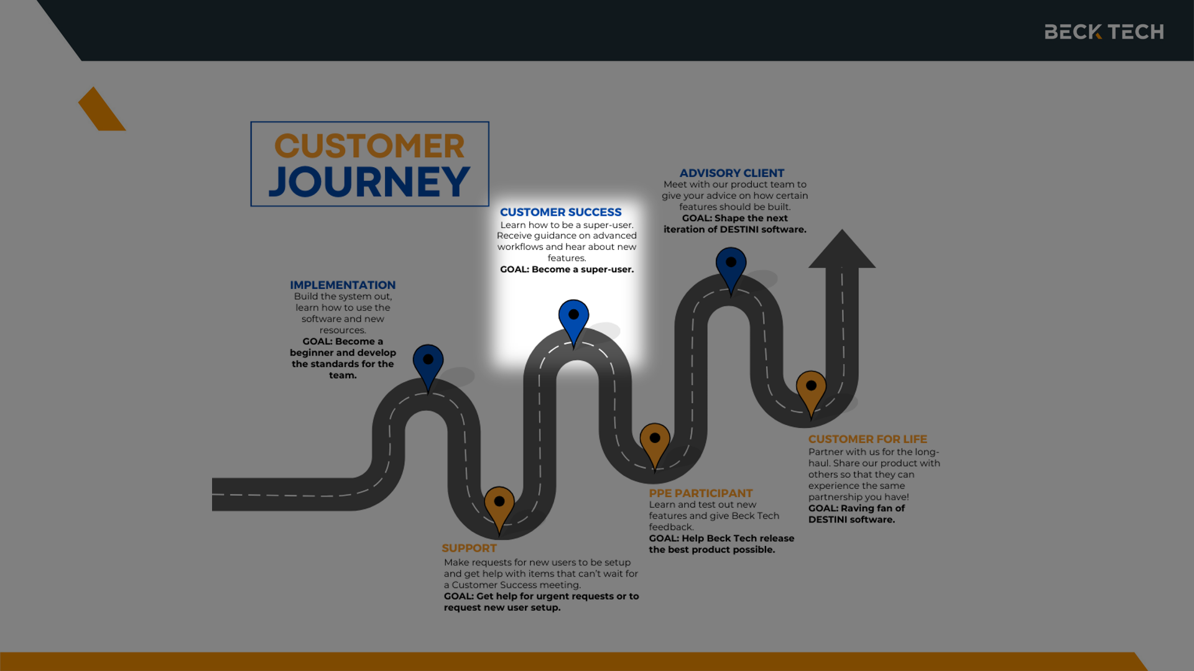
Customer Success
Collaborate with Experts
Sample text

Slide 3
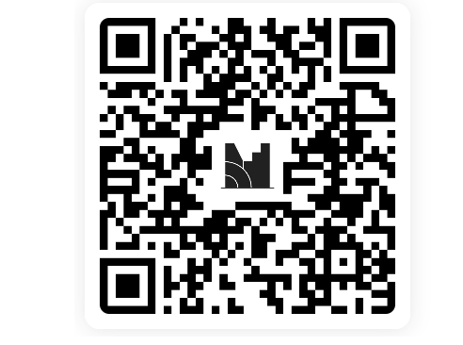
Join Menti.com | Use Code 5846 3082
Ask Us Anything
Beck-Technology.com

Slide 4
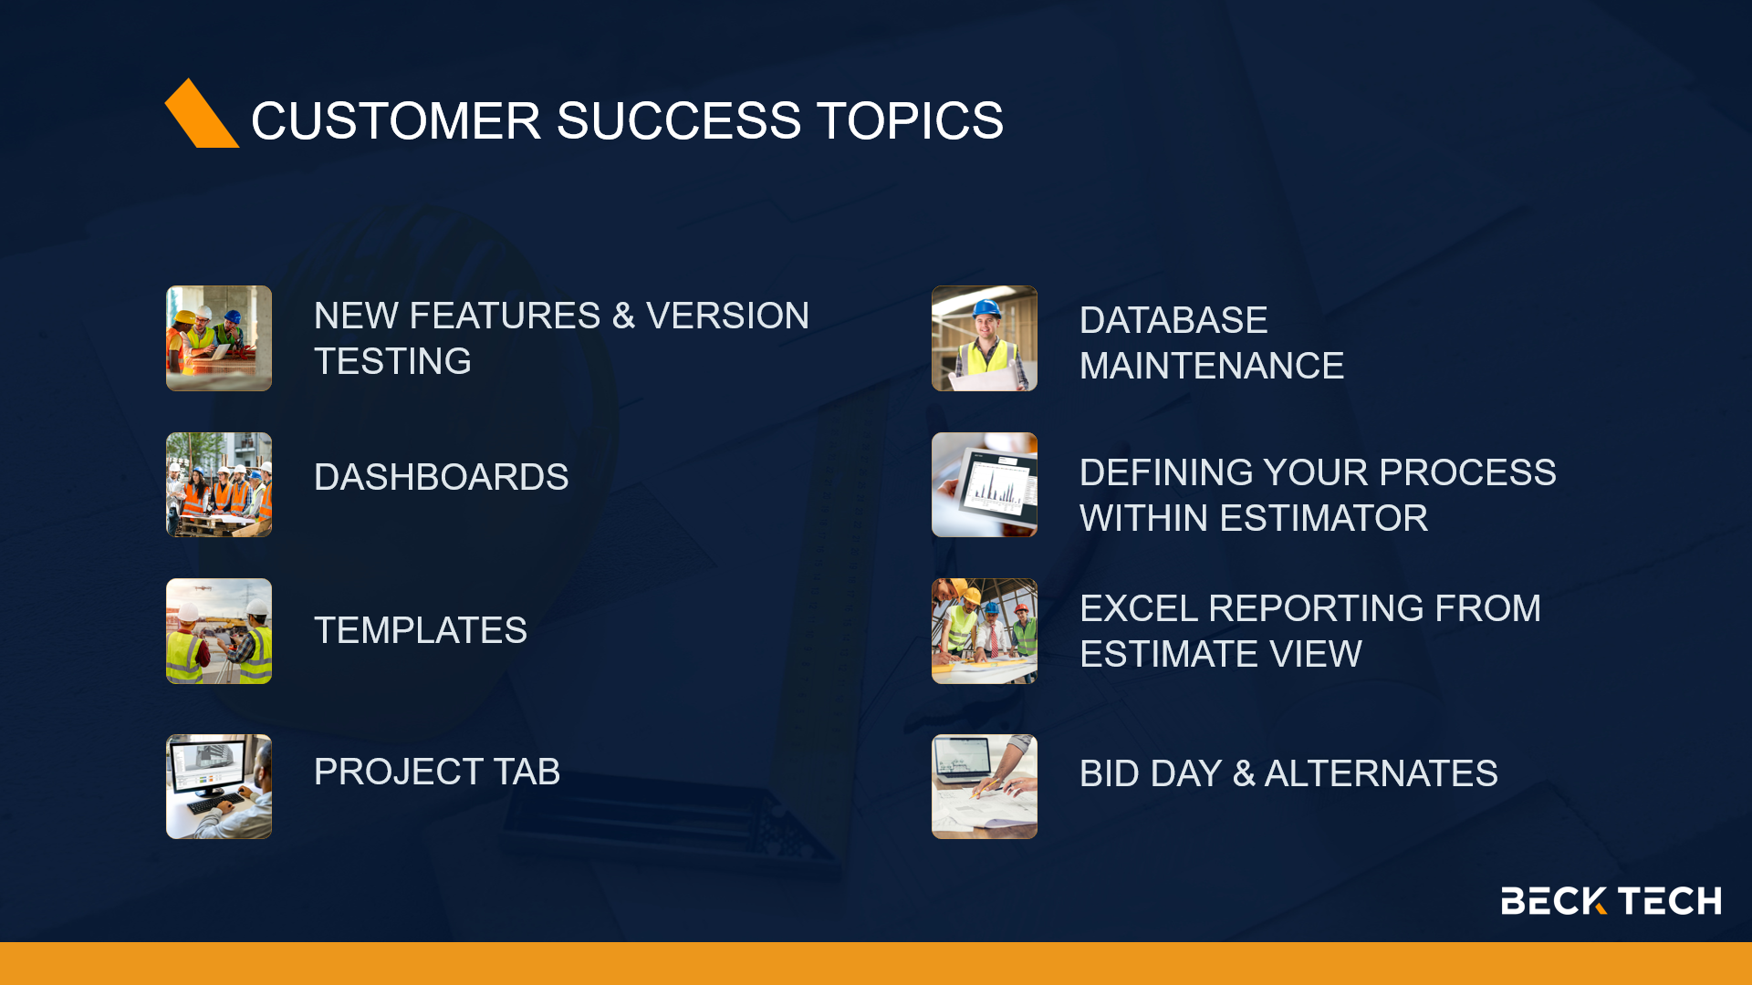

Slide 5
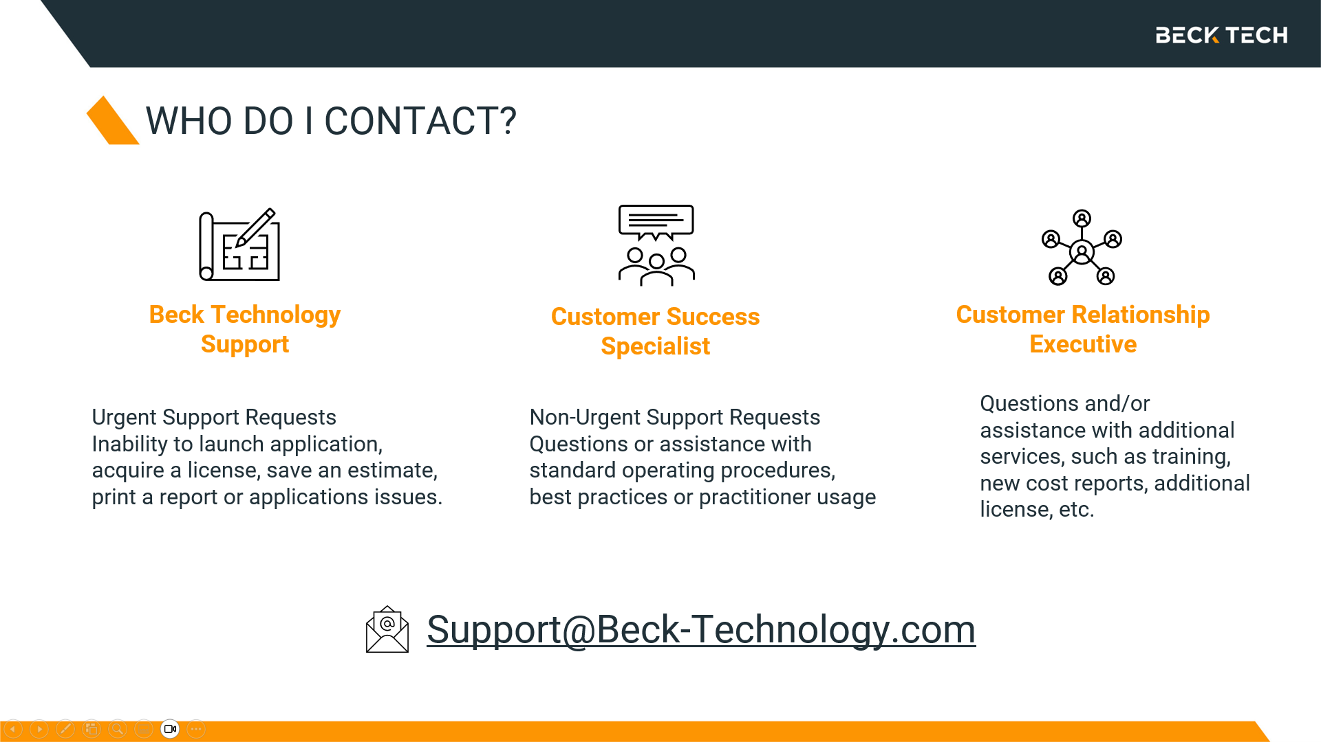

Slide 6
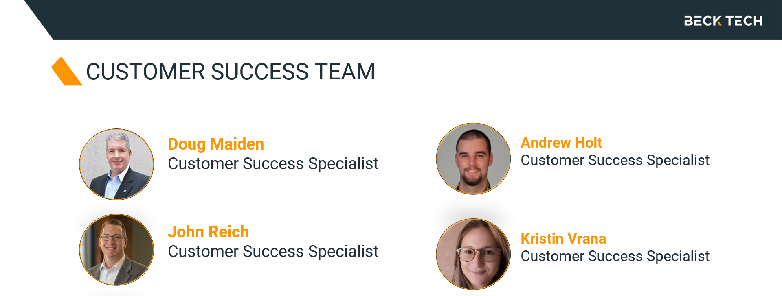

CustomerSuccess@Beck-Technology.com

Slide 7
THANK YOU
PRESENTATION TEMPLATE
Beck-Technology.com

