Slide 1

DESTINI HUB
Beck-Technology.com

Slide 2
Why DESTINI HUB?
Speed up implementation and shorten time-to-value
  Out-of-the-box content
  No customer setup required
  Customer spending less time during implementation
Efficient workflows and ongoing value
  Less upkeep of standard content as the product evolves
  Ability to provide innovative content

Slide 3
HUB Levels
Baseline HUB
Uncosted database with assemblies
Standard dashboard
Standard Power BI cost history dashboard
Four (4) standard reports
Standard customer success commitment
Access to Beck Tech training portal
Quarterly reviews with CRE team
HUB+
Includes Baseline HUB, plus:
HUB database with costs added through BNI
Additional customer success hours with hands-on training
Additional reports*
Additional dashboards*
* As additional functions are created
BNI Cost Database
Additional direct access to BNI data
  Roughly 9500 line items
HUB will continually evolve with support from Customer Community

Slide 4

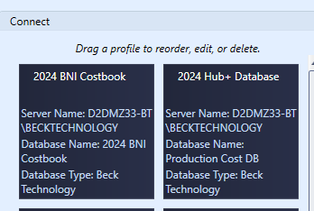
Updates & New Content
All cost databases will be updated annually
  New pricing
  New/improved assemblies
  Distributed as a new DB into their hosted environment
Other content will be added/updated as generated

Slide 5
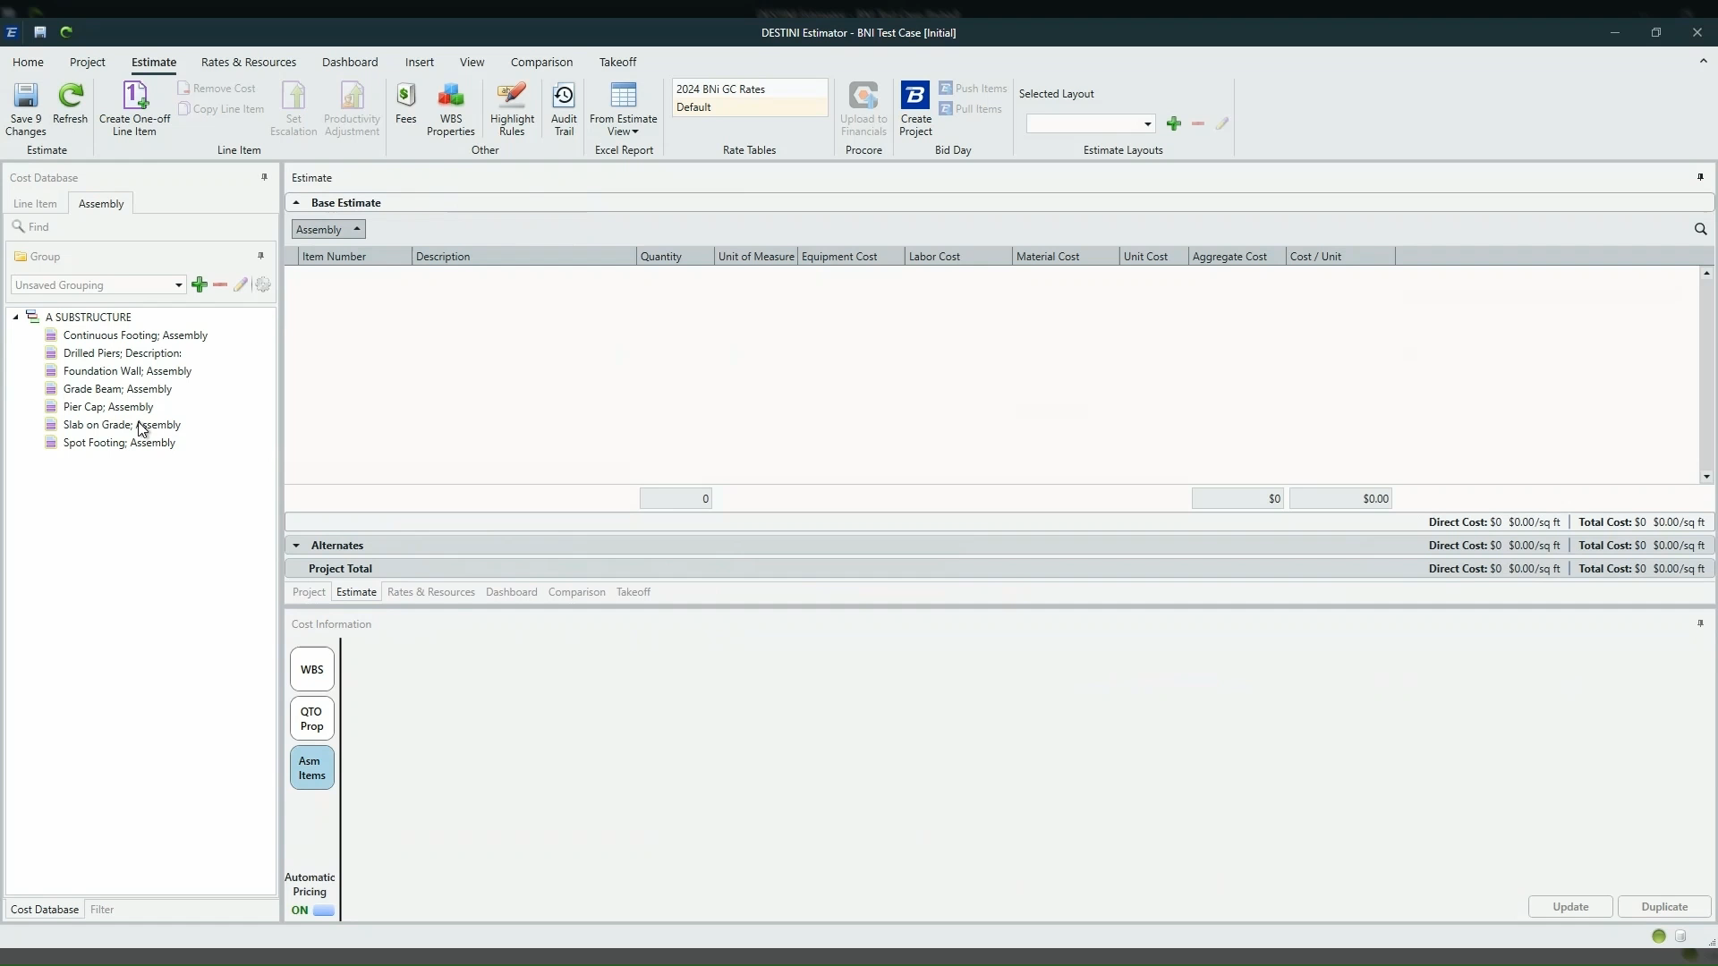
Assembly Demo

Slide 6
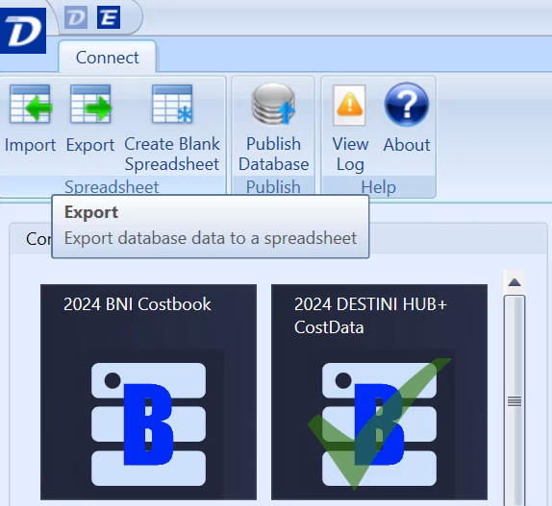
Make the DB Yours
Export a copy of the HUB and your database

Slide 7
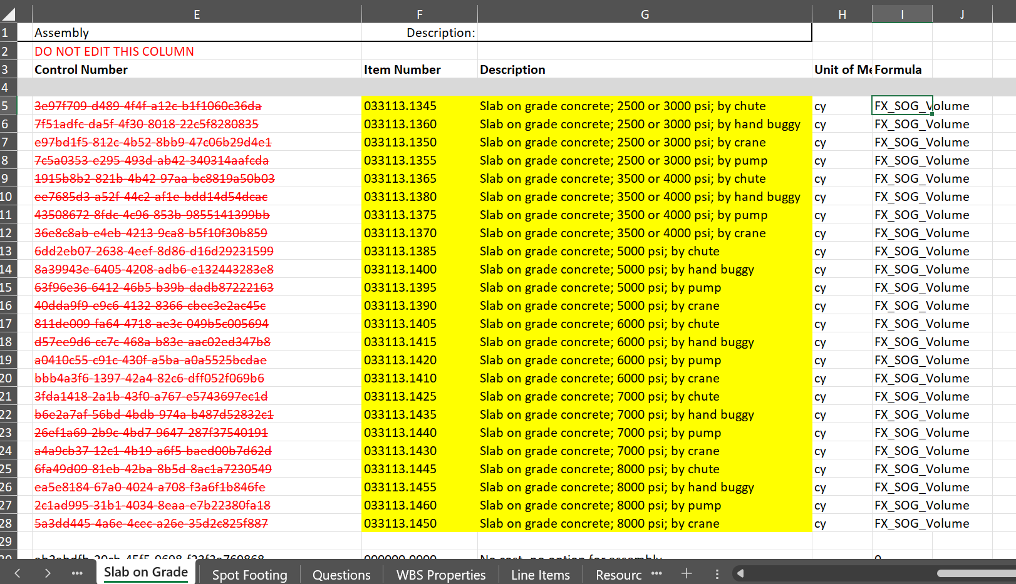
Replacing the Line Items

Slide 8
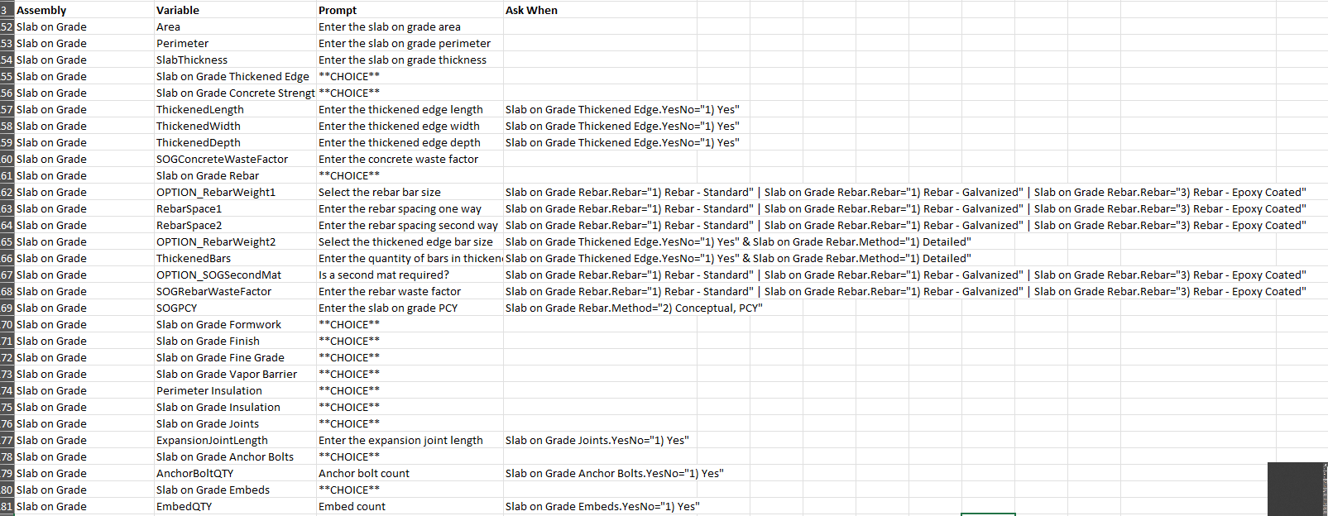
Copy the Questions

Slide 9
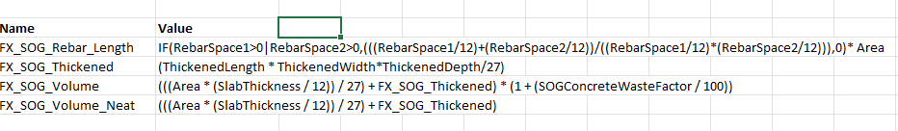
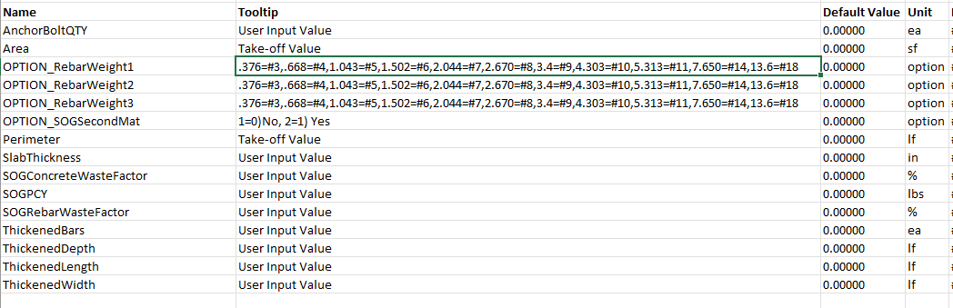
Copy the Formulas and Variables

Slide 10
Q&A
Beck-Technology.com

Slide 11
THANK YOU
Email: CustomerSuccess@beck-technology.com
Beck-Technology.com

