Slide 1

Consuming Data
Leveraging Spreadsheets
Beck-Technology.com
CHRIS REEDER, PRECONSTRUCTION TECHNOLOGY MANAGER
BRASFIELD & GORRIE

Slide 2





My Background
Chris Reeder
Preconstruction Technology Manager
11 years in Construction / Estimating
17 years in Preconstruction Technology
CReeder@BrasfieldGorrie.com
brasfieldgorrie.com

Slide 3

Preconstruction Technology Manager
My Role
Fast Deadline-Driven Deliverables = Slow Tech Adoption
Advocate - Liaison - Translator for my Stakeholders
        Tech Vendors
        IT Services
        Analytics
        Developers
        Integrated Processes between departments
Quarterback Pilots for New Tech
Maintain Apps & Databases
Training
Change Manager

Slide 4
Preconstruction Technology Manager
My Role
Change Manager

Slide 5


What We will Cover
Consuming Data & Leveraging Spreadsheets
A Change Strategy for Win-Win
Recognize the Opportunities
Negotiate the Challenges
Future of Spreadsheets?
Single Source of Truth & Automation

Slide 6
Recognize the Opportunities
Data: We already have all the data we need
Insert your Track Record
  60+ years in business
  220+ active projects
  19 Market Sectors
  17 states with active projects

Slide 7
Recognize the Opportunities
Experience: Experts at Our Fingertips
Industry knowledge--cost and strategy
Wealth of Subject Matter Experts
Bank of Retrospectives / Lessons Learned
Successful practices and deliverables
One Company / Internal JVs

Slide 8
Negotiate the Challenges
The “Tried and True”
Time Constrained
Change Adverse
Spreadsheet Trusting

Slide 9
Negotiate the Challenges
What’s so problematic with spreadsheets?

Slide 10
Negotiate the Challenges
What’s so problematic with spreadsheets?
Enron had over half a million internal emails subpoenaed.
A spreadsheet lab extracted over 50,000 spreadsheets, removing all the duplicates and leaving 16,189 unique spreadsheets.
The Results?

Slide 11
Negotiate the Challenges
What’s so problematic with spreadsheets?
On average, five worksheets were added to a spreadsheet, with an average of 755 mistakes each.
24% of Enron spreadsheets with at least one formula contain an Excel error.

Slide 12
Negotiate the Challenges
What’s so problematic with spreadsheets?
On average, five worksheets were added to a spreadsheet, with an average of 755 mistakes each.
24% of Enron spreadsheets with at least one formula contain an Excel error.
That’s Enron.

Slide 13
Negotiate the Challenges
What’s so problematic with spreadsheets?
The State Department of Education in Utah miscalculated its budget by $25M due to a faulty reference in a spreadsheet.

Slide 14
Negotiate the Challenges
What’s so problematic with spreadsheets?
In 2012, JP Morgan Chase lost an estimated $6B citing spreadsheet miscalculations (summing instead of averaging)

Slide 15
Negotiate the Challenges
What’s so problematic with spreadsheets?
The European Spreadsheet Risks Interest Group (EuSpRIG) calculated that 90% of all spreadsheets contain an error.

Slide 16
Negotiate the Challenges
What’s so problematic with spreadsheets?
In 2016, two researchers found publicly available Genome Research papers with 35,175 spreadsheets attached to those papers.
They found 987 spreadsheets that had one or more autocorrect errors turning a gene into a date.
These were attached to 704 research papers, resulting in 19.6% of genome research having an autocorrect error.

Slide 17
Negotiate the Challenges
What’s so problematic with spreadsheets?
In 2016, two researchers found publicly available Genome Research papers with 35,175 spreadsheets attached to those papers.
They found 987 spreadsheets that had one or more autocorrect errors turning a gene into a date.
These were attached to 704 research papers, resulting in 19.6% of genome research having an autocorrect error.

Slide 18
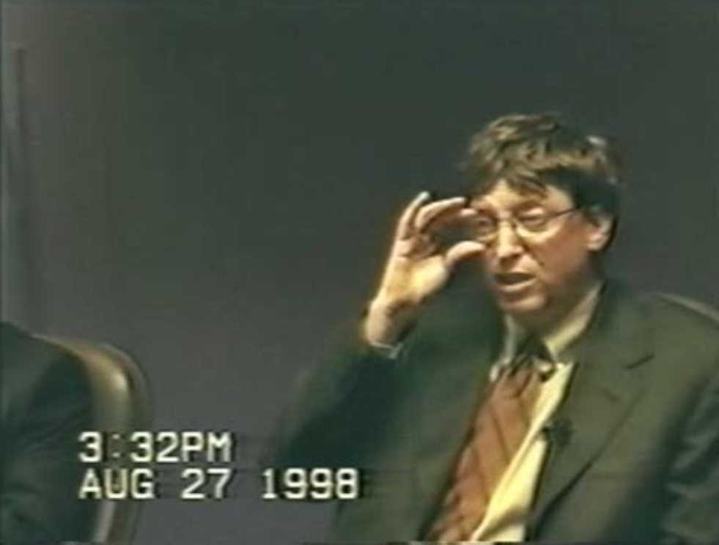

What’s to come of our beloved Spreadsheets?

Slide 19
Leveraging Spreadsheets with DESTINI Estimator
Strategies to Win-Win

Slide 20
Leveraging Spreadsheets with DESTINI Estimator
Strategies to Win-Win
Keep the Spreadsheets but Govern the Source of Truth

Slide 21
Leveraging Spreadsheets with DESTINI Estimator
Strategies to Win-Win
Keep the Spreadsheets but Govern the Source of Truth
Leave the heavy lifting of Critical Calcs to DESTINI Estimator

Slide 22
Leveraging Spreadsheets with DESTINI Estimator
Strategies to Win-Win
Keep the Spreadsheets but Govern the Source of Truth
Leave the heavy lifting of Critical Calcs to DESTINI Estimator
Produce your Tried-and-True Deliverables and Outputs in Excel

Slide 23
Single Source of Truth & Automation
Leveraging Spreadsheets with DESTINI Estimator
DESTINI becomes the single data mine where our teams influence the outcomes of the project

Slide 24
Single Source of Truth & Automation
Leveraging Spreadsheets with DESTINI Estimator
DESTINI becomes the single data mine where our teams influence the outcomes of the project
The outputs are generated in Excel with vetted and accurate math matching the Source of Truth

Slide 25
Single Source of Truth & Automation
Leveraging Spreadsheets with DESTINI Estimator
DESTINI becomes the single data mine where our teams influence the outcomes of the project
The outputs are generated in Excel with vetted and accurate math matching the Source of Truth
Liberty is maintained to analyze and edit the outputs—to influence the Source of Truth

Slide 26
Single Source of Truth & Automation
DESTINI Estimator to Excel
Excel Integrations within DESTINI Estimator
  Project Tab / Project Properties
  From Estimate View
  Dashboards
  Custom Multi Tab Spreadsheets

Slide 27
Single Source of Truth & Automation
DESTINI Estimator to Excel
Showcase Custom Reporting in DESTINI Estimator

Slide 28
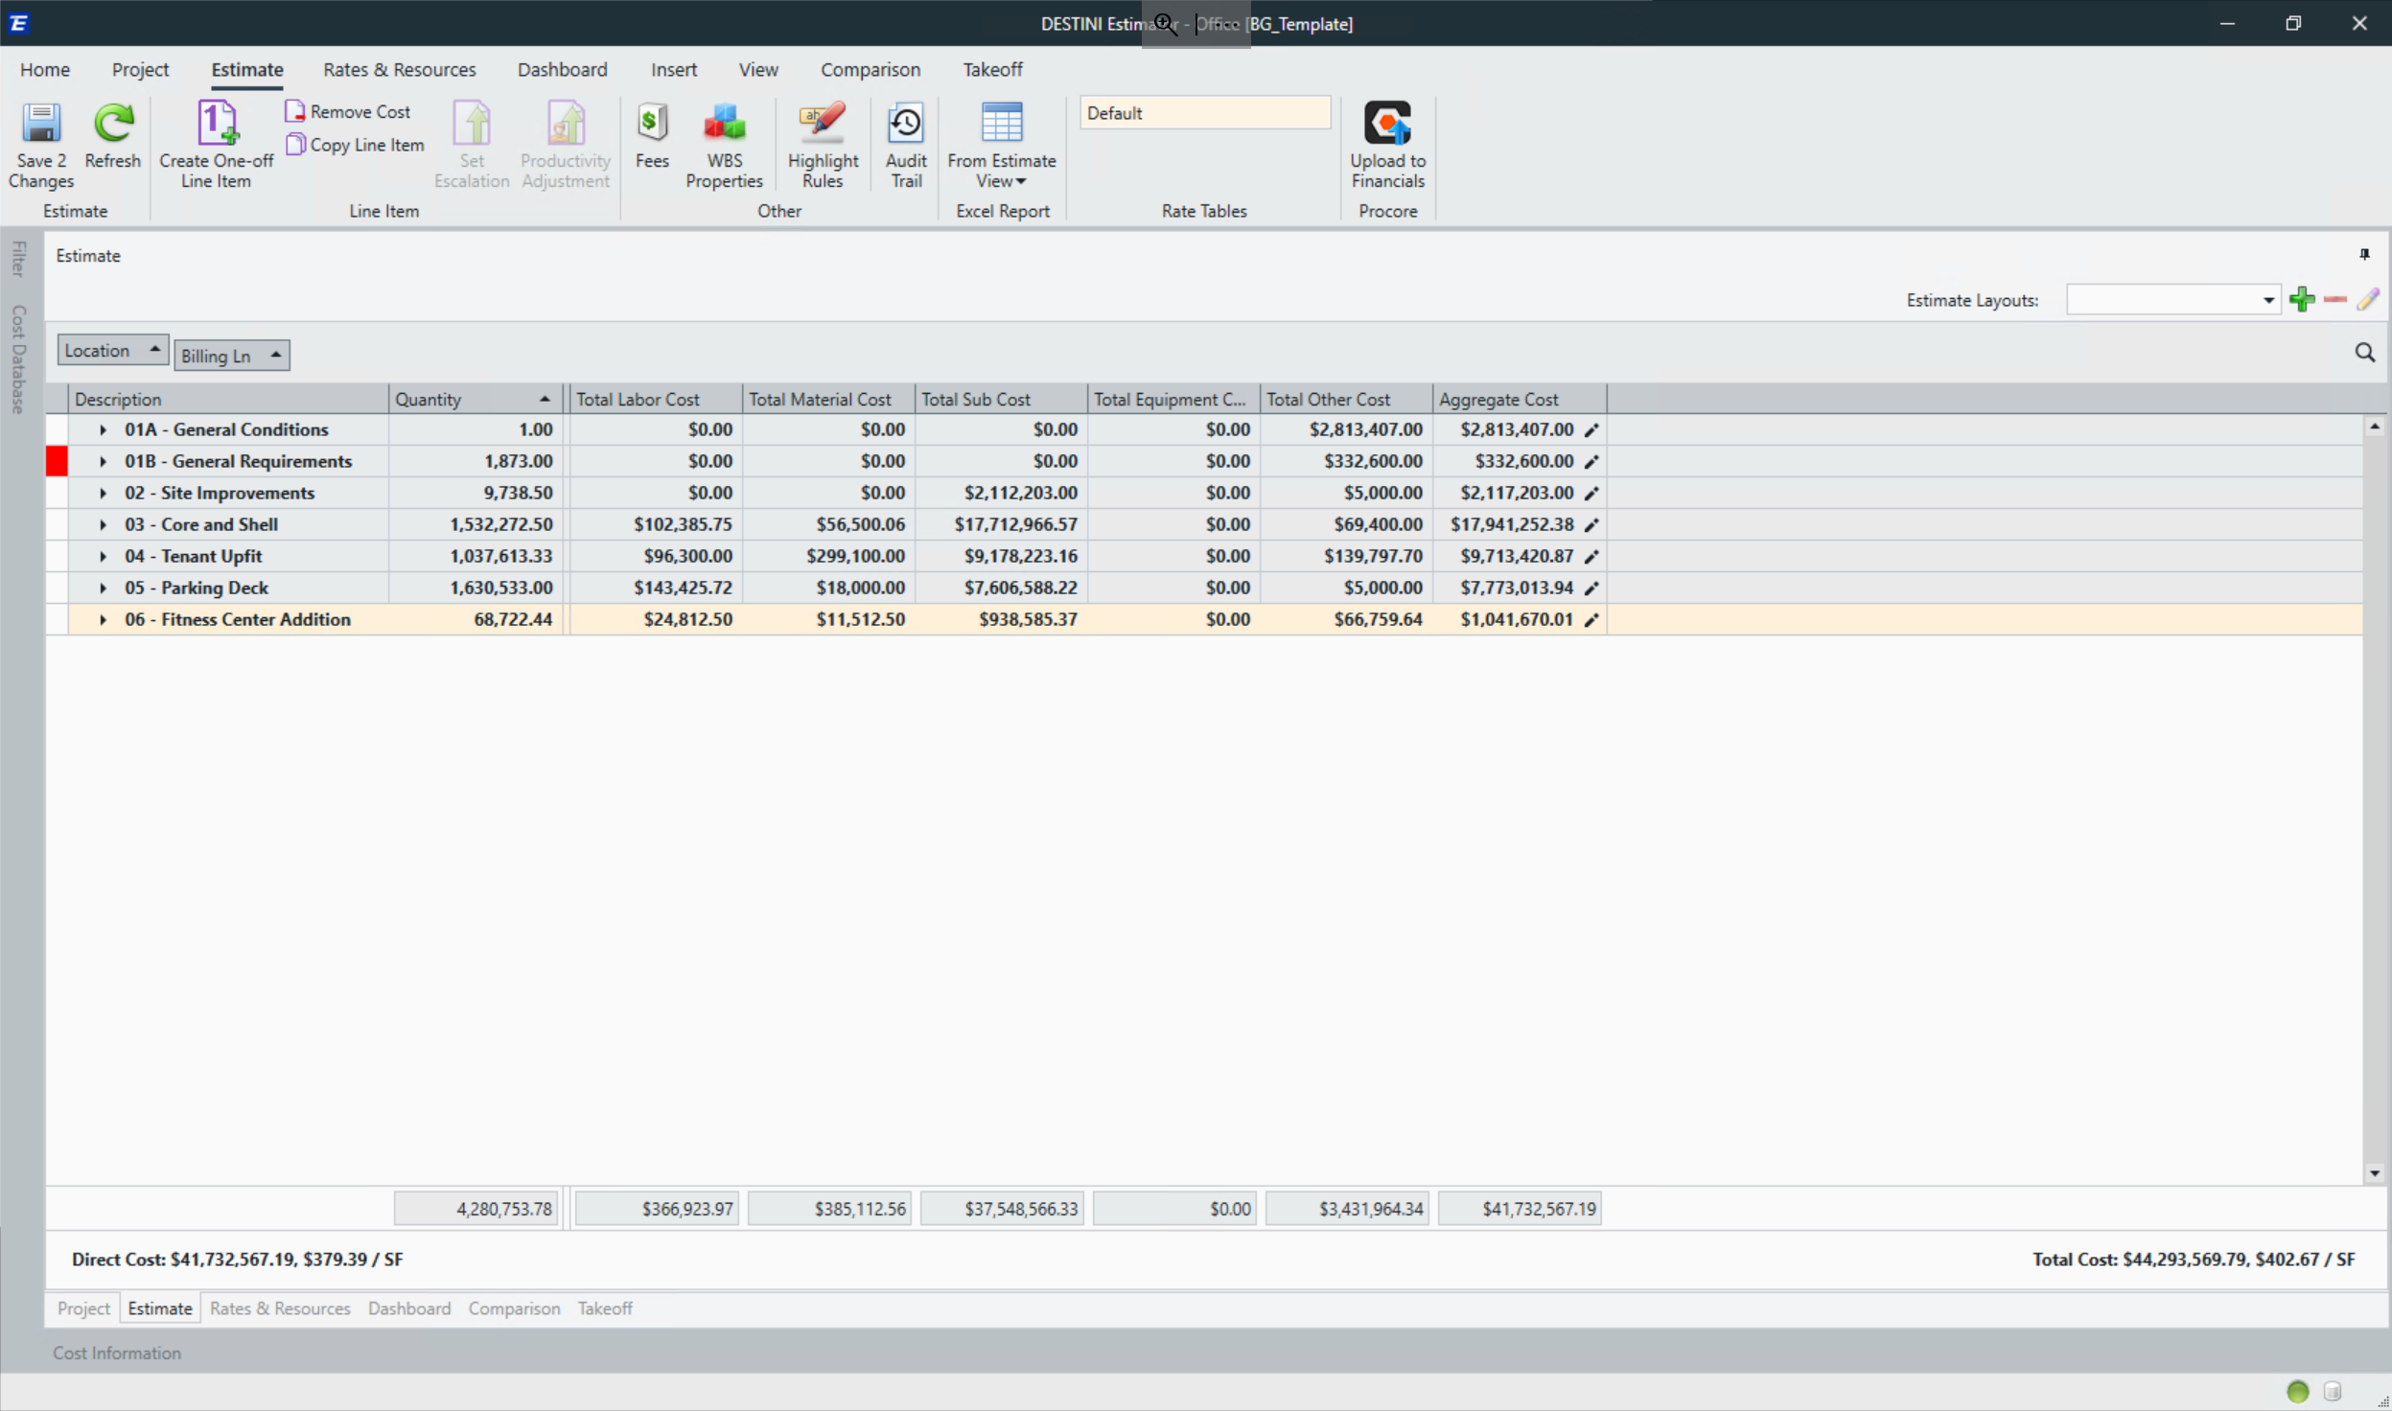
Single Source of Truth to Automated Spreadsheets
DESTINI Estimator to Excel

Slide 29
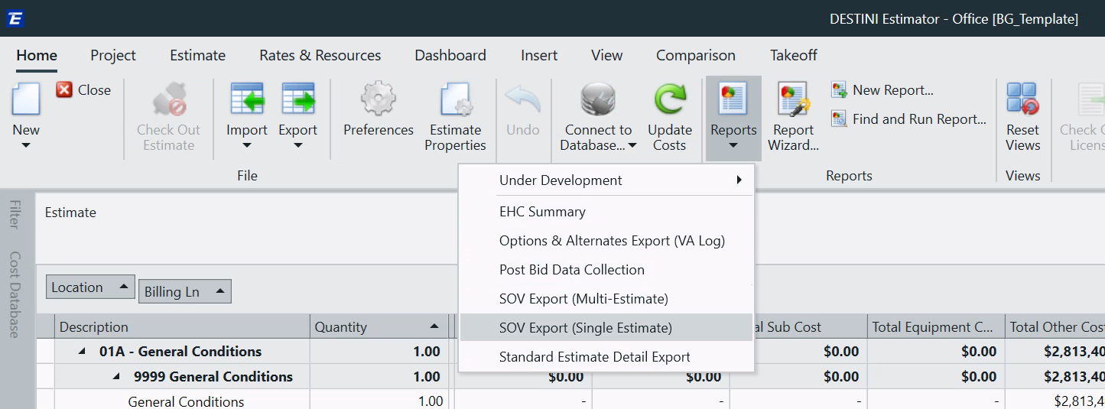
Single Source of Truth to Automated Spreadsheets
DESTINI Estimator to Excel
Sample text

Slide 30
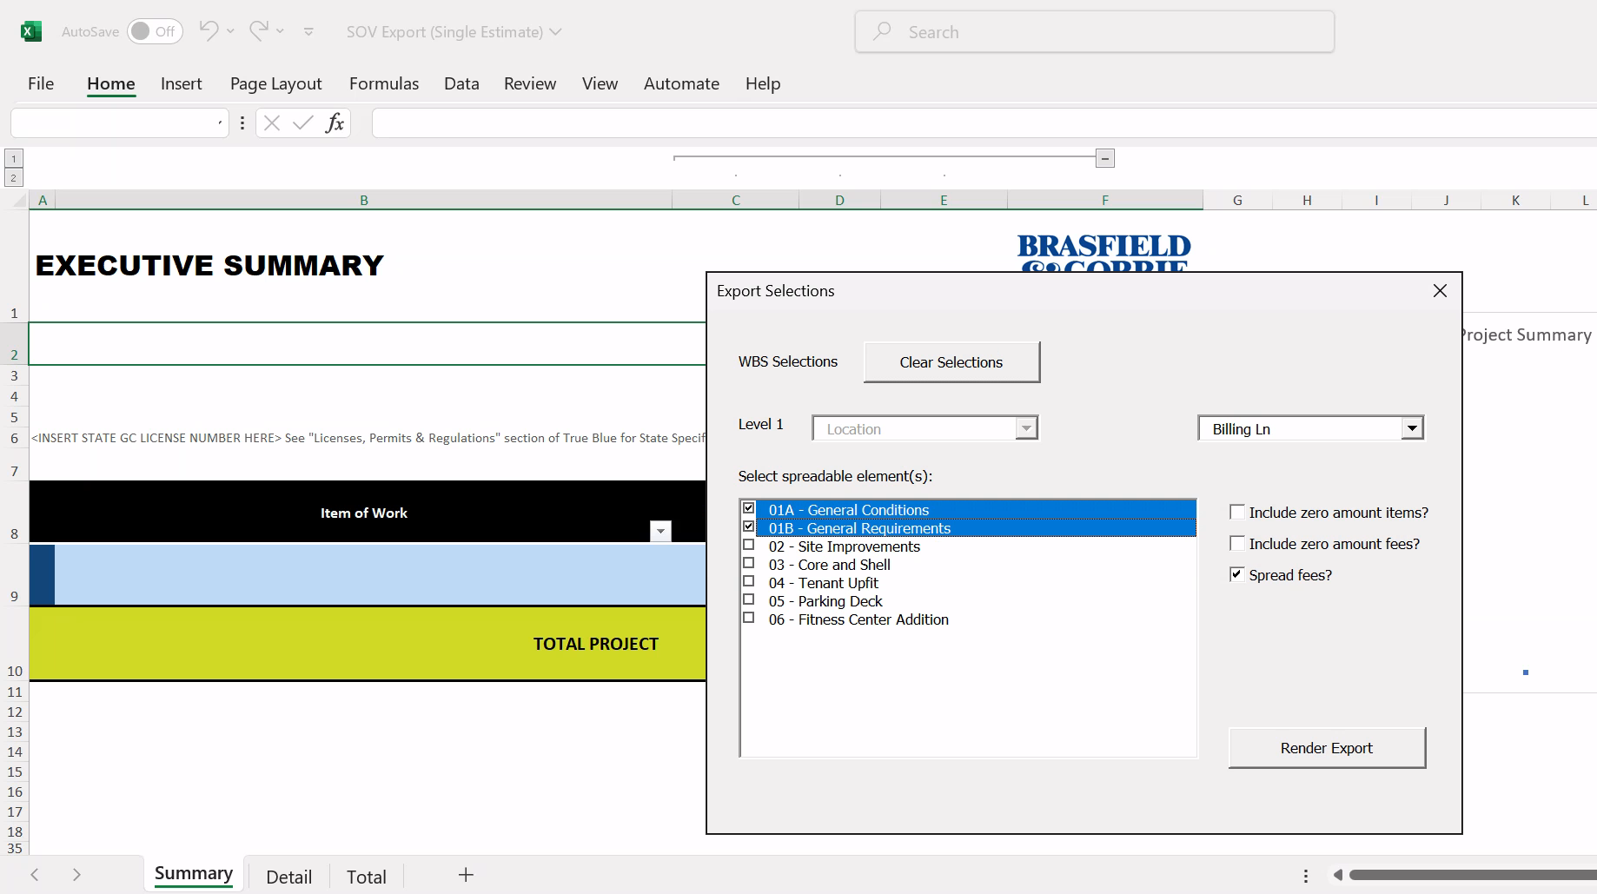
Single Source of Truth to Automated Spreadsheets
DESTINI Estimator to Excel
Sample text

Slide 31
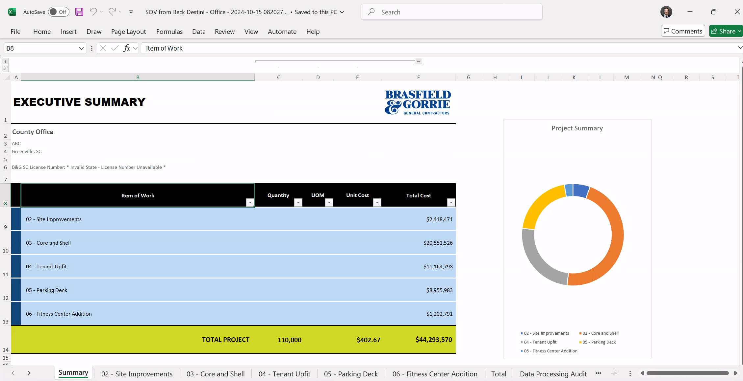
Single Source of Truth to Automated Spreadsheets
DESTINI Estimator to Excel
Sample text

Slide 32
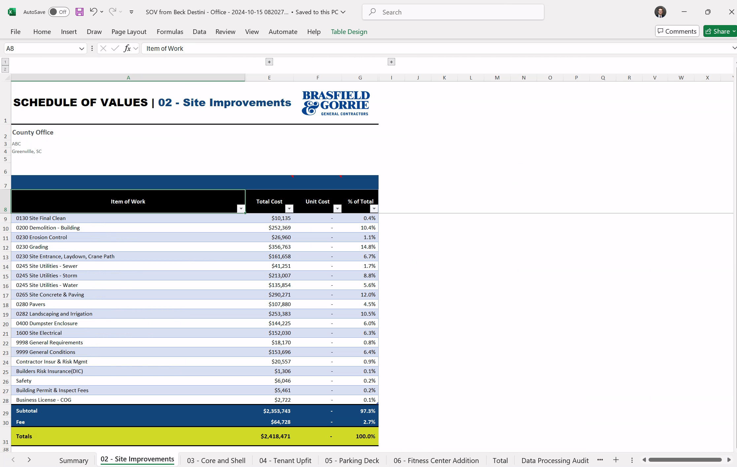
Single Source of Truth to Automated Spreadsheets
DESTINI Estimator to Excel
Sample text

Slide 33
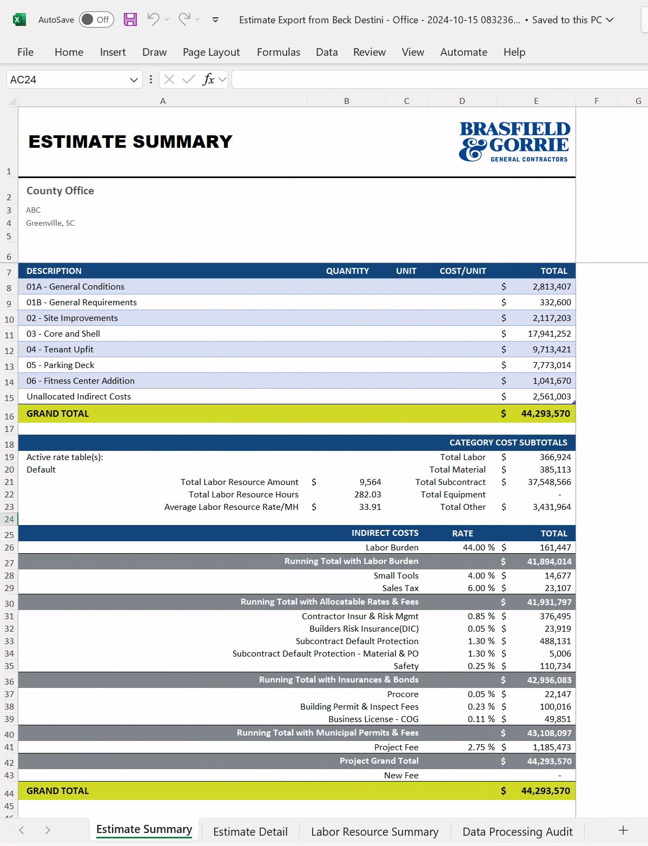
Single Source of Truth to Automated Spreadsheets
DESTINI Estimator to Excel

Slide 34
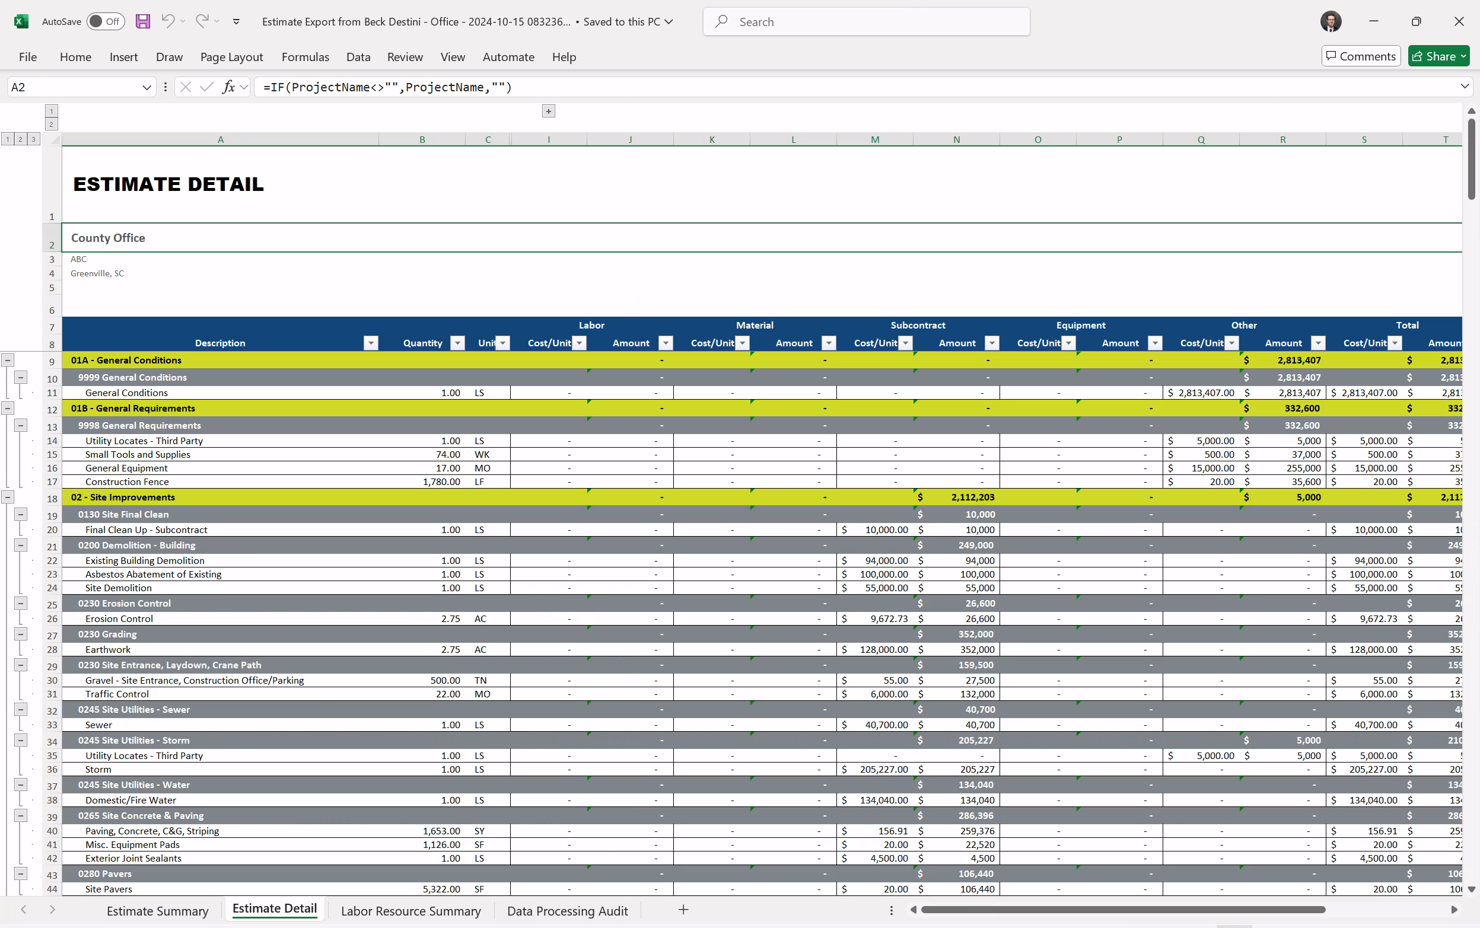
Single Source of Truth to Automated Spreadsheets
DESTINI Estimator to Excel
Sample text

Slide 35

Save Your Spreadsheets
Keep tried and true spreadsheets
Lock down the calculations governing the Source of Truth
Leverage DESTINI Estimator to produce consistent branded and accurate outputs in Excel

Slide 36
Single Source of Truth to Automated Spreadsheets
DESTINI Estimator to Excel
Keep tried and true spreadsheets
Lock down the calculations governing the Source of Truth
Leverage DESTINI Estimator to produce consistent branded and accurate outputs in Excel
  Project Tab / Project Properties
  From Estimate View
  Dashboards
  Custom Multi Tab Spreadsheets

Slide 37
Questions?
Chris Reeder, Brasfield & Gorrie
Beck-Technology.com

Slide 38
THANK YOU
Chris Reeder, Brasfield & Gorrie
Beck-Technology.com

