Slide 1

Retrospective:
A Look Back at DESTINI Estimator Innovations
Beck-Technology.com

Slide 2

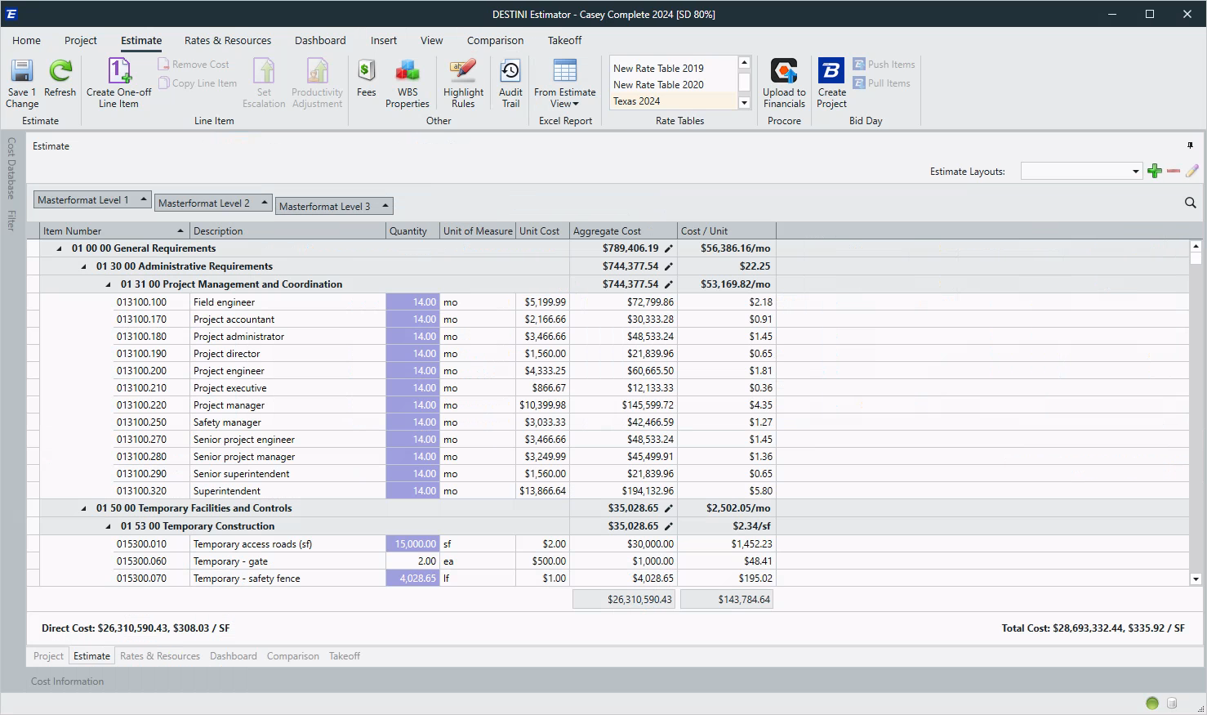
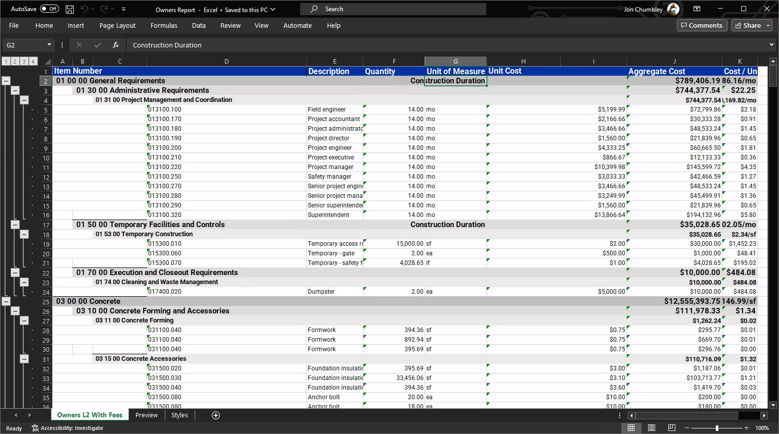
Estimate View Excel Report

Slide 3
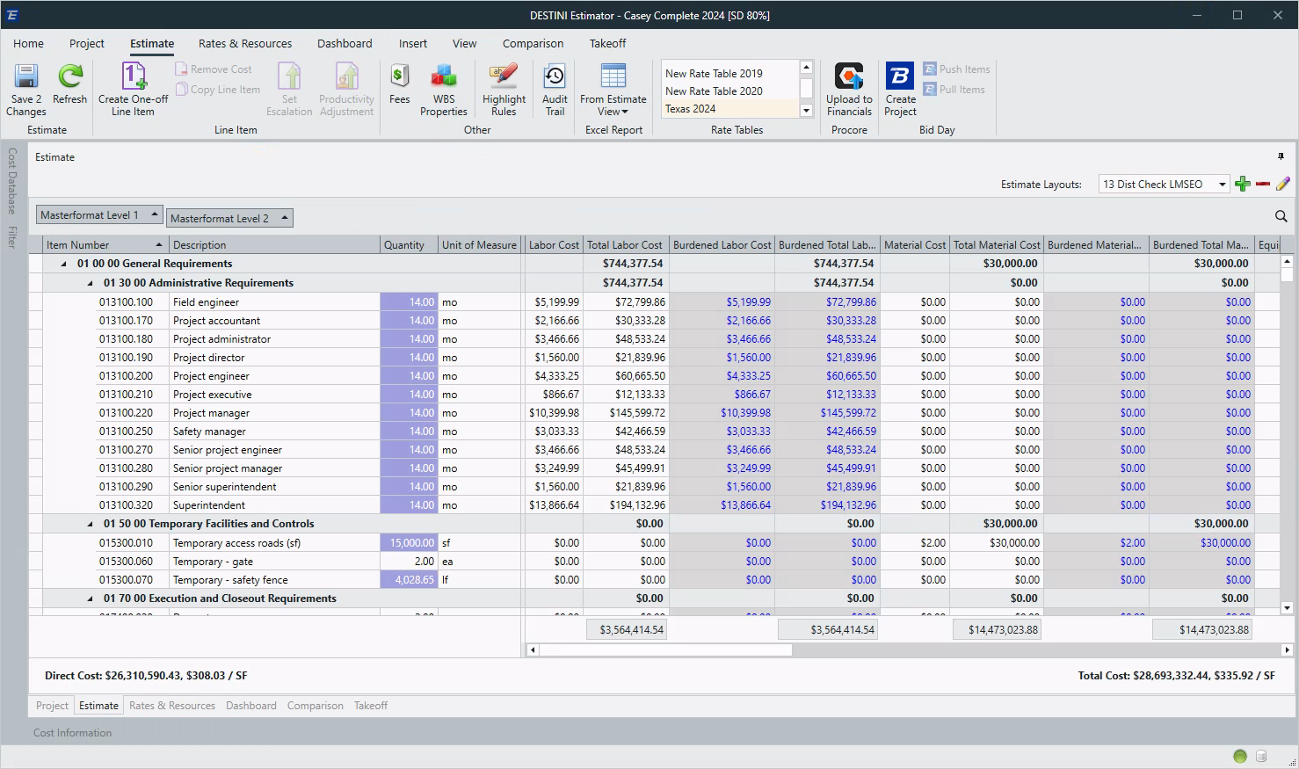
Burdened Cost Columns

Slide 4
2D Enhancements
Making Takeoff Quicker
Beck-Technology.com

Slide 5
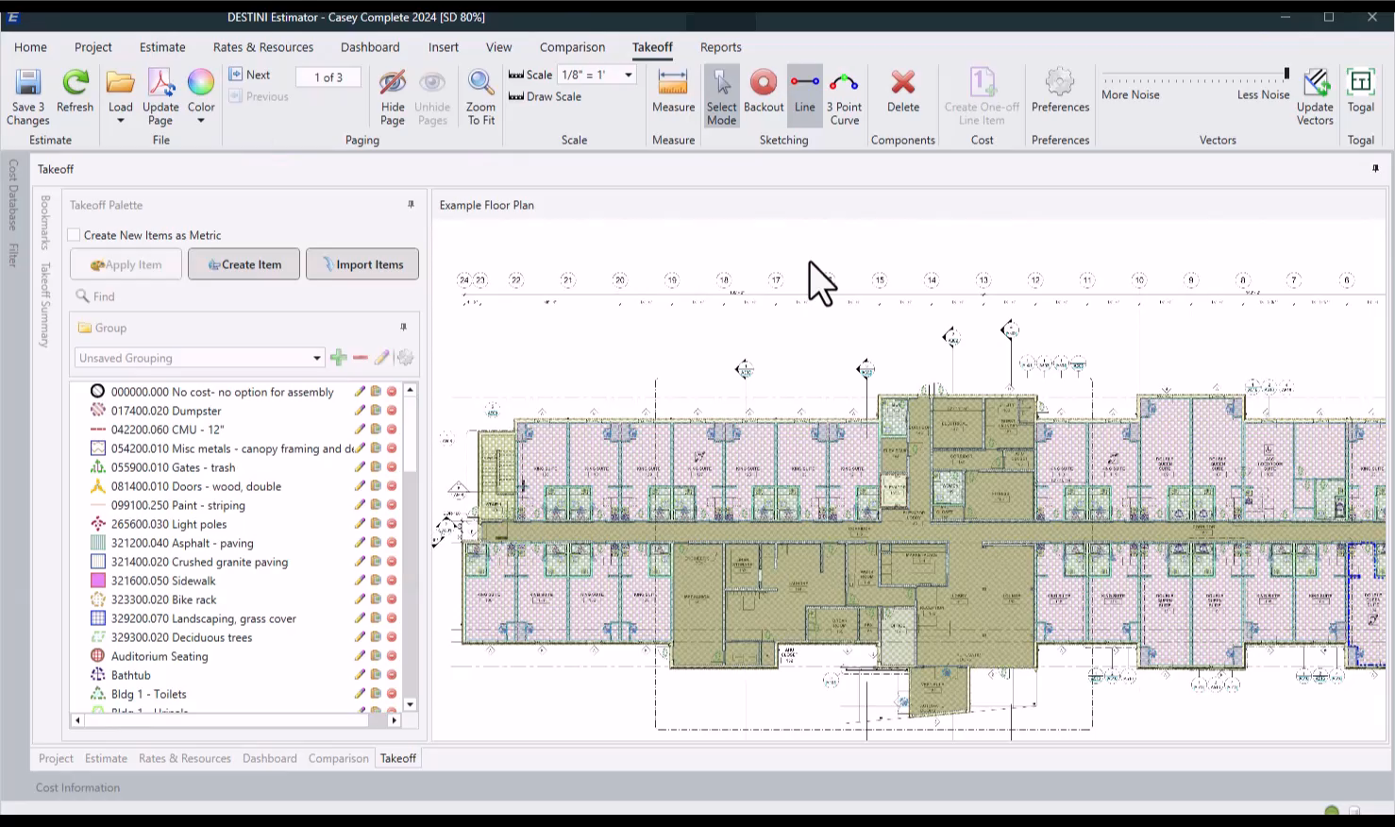
2D Measure
Tool

Slide 6
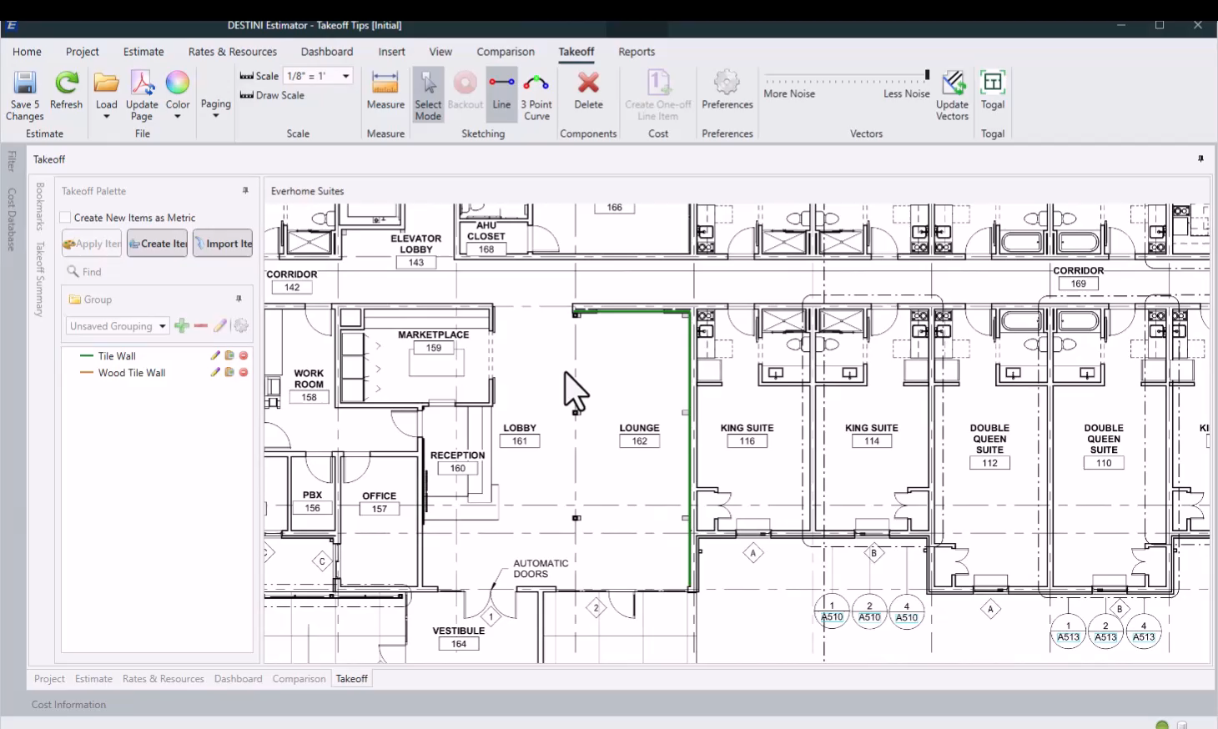
2D Add Point
Split Polyline

Slide 7
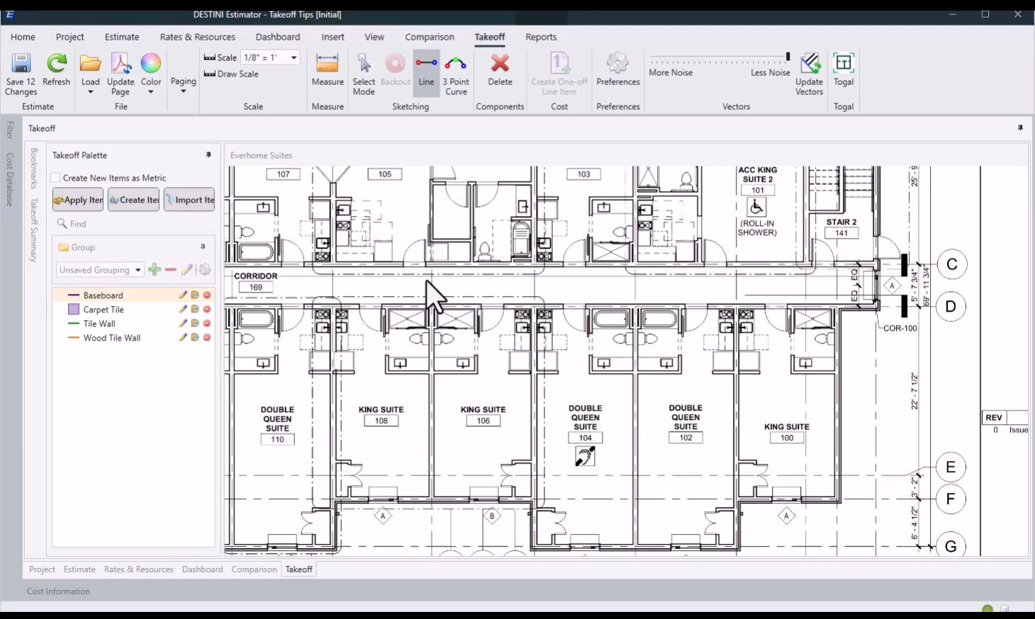
2D Double Click
End Sketching

Slide 8
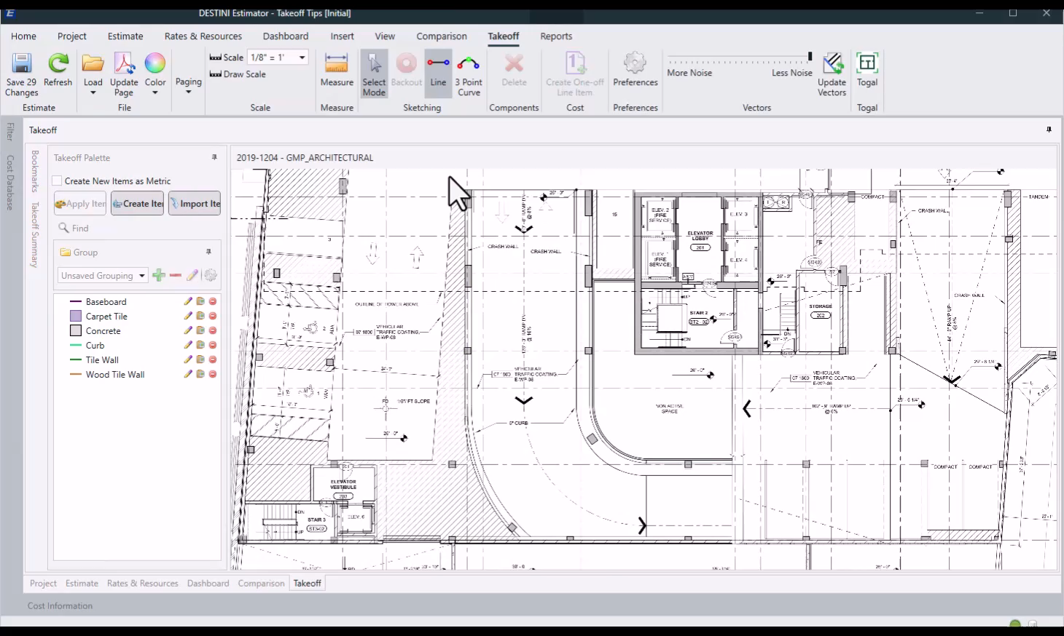
2D Convert
To Arc

Slide 9
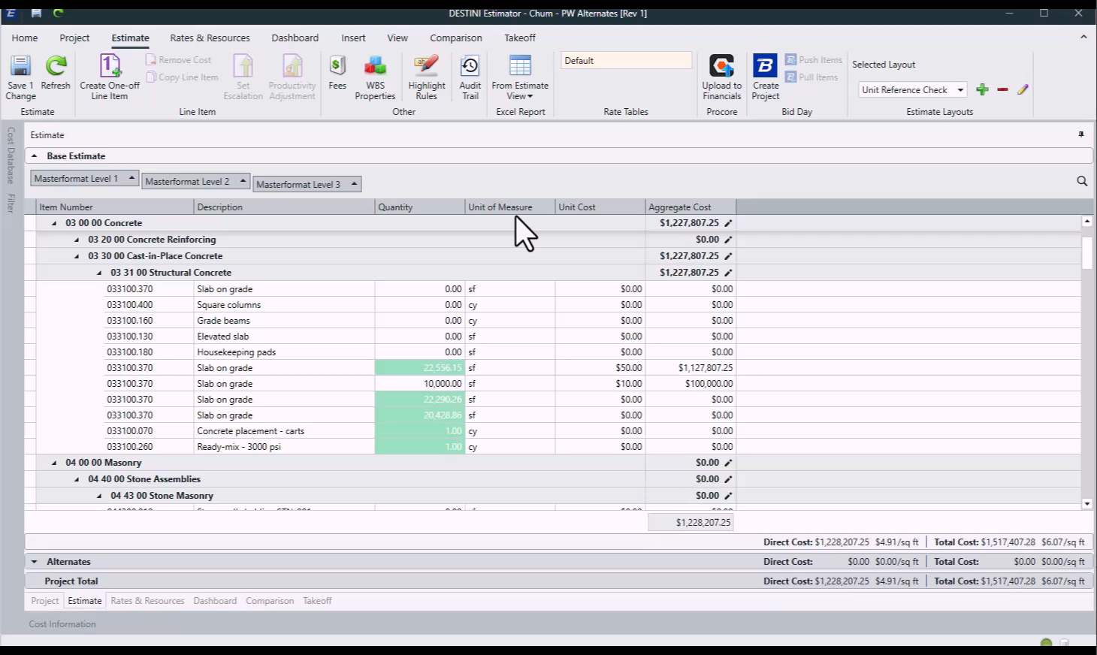

Alternates
Released!

Slide 10
Performance & Stability
Pencils Down
Beck-Technology.com

Slide 11

Performance & Stability
Pencils Down
Open estimates up to 70% faster
Launching Estimator up to 60% faster
Data Entry up to 80% faster
Critical issues reported down 75%

Slide 12
Next-Generation Estimator
The Future
Beck-Technology.com

Slide 13
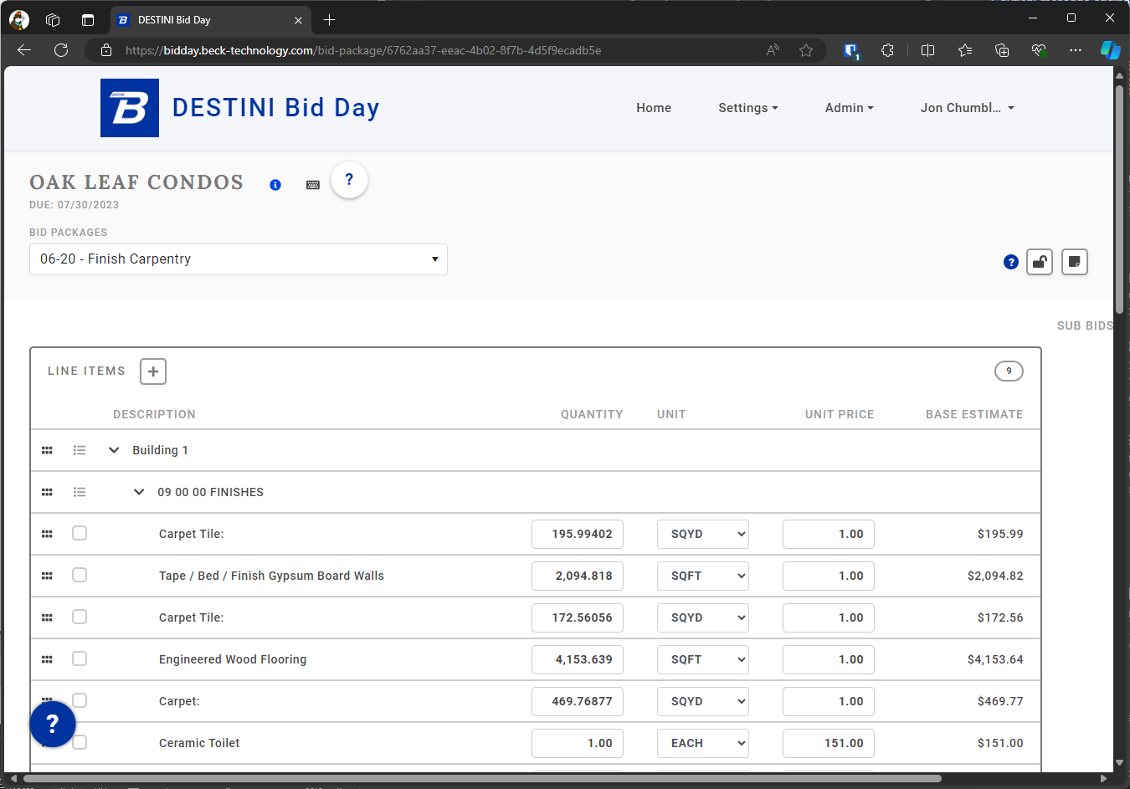
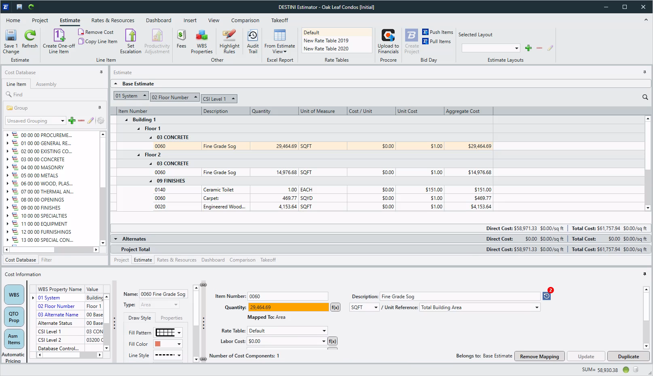
Browser vs
Thick Client

Slide 14
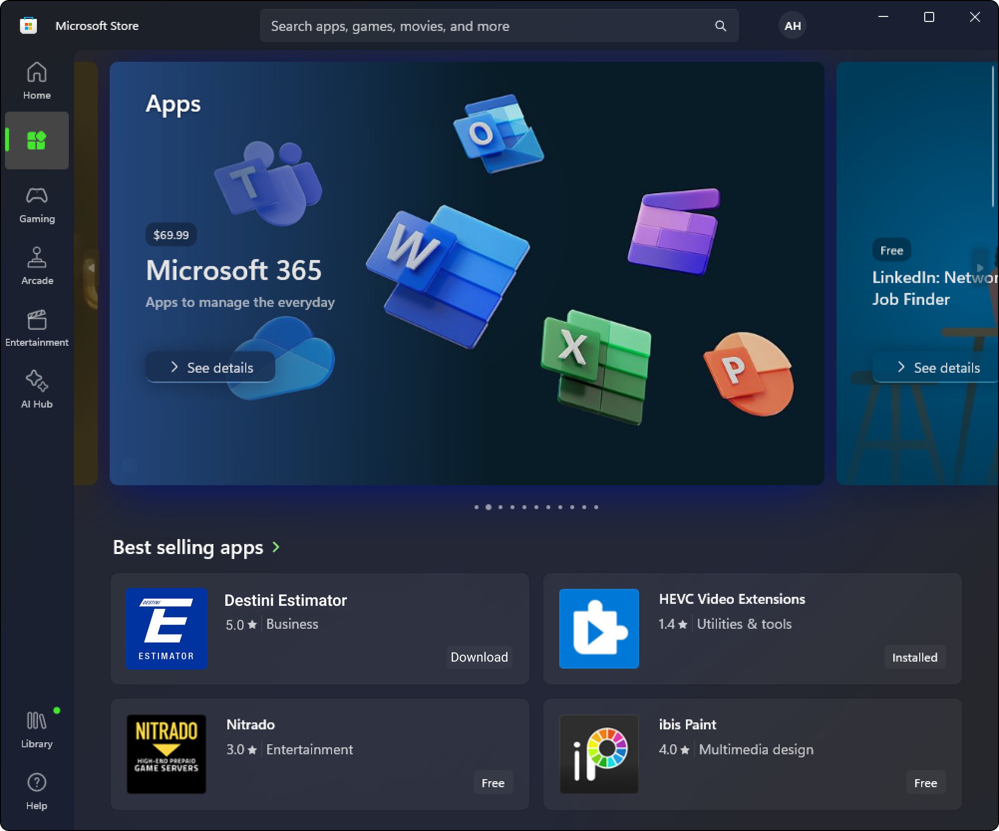


Deployment
Options

Slide 15


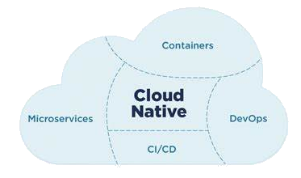



Next-Gen
Estimator

Slide 16
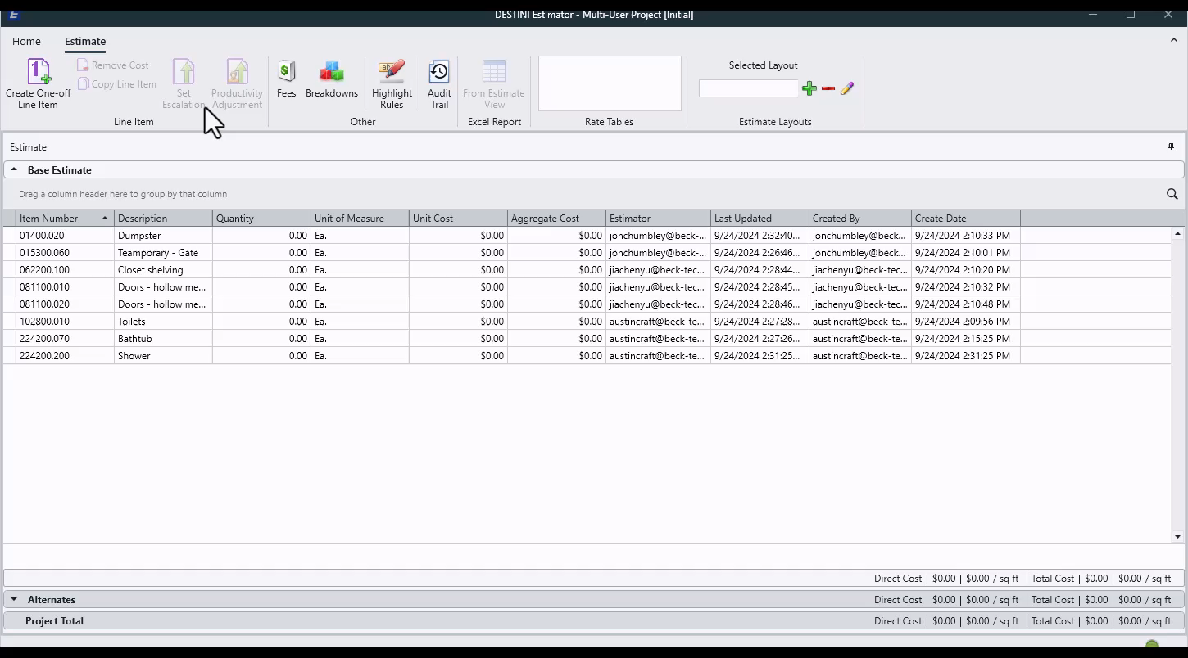
Next-Gen
Estimator

Slide 17

No Save/Refresh
What does that mean?

