Slide 1



Pitching Collaborative Project Delivery to Owners
Leading the Horse to Water:
Andrew Zukoski
CEO
Jason Brenner
Head of Industry Strategy

Slide 2
Agenda
Introductions
Barriers to Collaboration
What can you do about it
Q&A
Closing

Slide 3









Join connects the right people to the right information at the right time to advance decisions
Teams must align expertise & information to reach a decision … and repeat the process

Slide 4

More than 1,000 companies are using Join

Slide 5


How can we define
collaborative project delivery?
Is NOT:
Is:
“Traditional”
Hard Bid, Design - Bid - Build, Hard Bid GMP, Line Item GMP
GC’s & Key Trades brought on late in design (such as IFP or Construction Documents sets)
Design Firms work exclusively independent of the builder’s input to design
Siloed and independent working
“Collaborative”
Contract types that could include: CM at Risk, GMP, Cost Plus, IFOA
When GC’s & Key Trades are brought on early in design (ideally before design development)
When Design Firms are selected (at least partially) for their willingness / experience with harnessing the builder’s input on design
Coordinated & integrated working

Slide 6




Collaborative project delivery barriers
Cost Premium
Lack of trust
GC opportunity cost
Other barriers
Extra Precon Cost (longer duration)
Competitive Price
    GC Pricing
    Sub Pricing

Slide 7
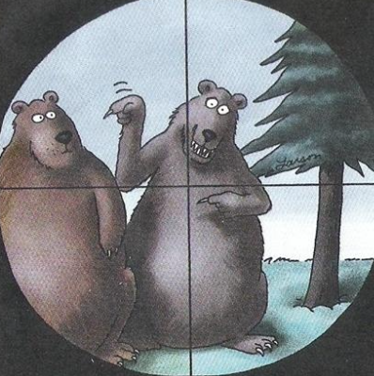
Collaborative project delivery barriers
Cost Premium
Lack of trust
GC opportunity cost
Other barriers
Industry has “Trust Issues”
Traditional practices
    Built for “Trust Issues”
    Unfortunately, reinforce behavior
v

Slide 8
Collaborative project delivery barriers
Cost Premium
Lack of trust
GC opportunity cost
Other barriers
Must balance limited resources
Collaborative Projects more demanding
    Longer Precon time
    Senior Estimators & Builders
Tough Business Choice
    Commit Senior Team to 1x project
    Leverage Senior Team to many projects

Slide 9
Collaborative project delivery barriers
Cost Premium
Lack of trust
GC opportunity cost
Other barriers
Owner’s prior project history
Inadequate internal resources
(skill / availability)
Contractual misalignment
Budget constraints
Schedule constraints
Too late in design
Notes:
Cost Premium
Lack of Trust
GC Opportunity Cost
Other Barriers
Owners Prior Project History
Inadequate Internal Resources (Skill / Availability)
Contractual Misalignment
Budget Constraints
Schedule Constraints
Too late in Design

Slide 10
Mitigating these barriers
Cost Premium
Lack of trust
GC opportunity cost
Cost of preconstruction
    Reframe as project investment
    Transparency of precon services
      Resource Loader
      Deliverable List
Competitive pricing
  GC cost
    Separate out Cost of Work from Fee, Mark ups
    Fixed Labor Rates
Trade partner cost
  Part A / Part B Concept
  Separate out COW from Fee, Mark Ups
  Detailed Baseline Estimate with productivity assumptions

Slide 11
Mitigating these barriers
Cost Premium
Lack of trust
GC opportunity cost
Demonstrate the 3x C’s
  Competency
  Character
  Care
Build Allies
Leverage Transparency

Slide 12
Mitigating these barriers
Cost Premium
Lack of trust
GC opportunity cost
Seek Alignment Internally
  Ensure commitment internally
Build Matrix Team
  Leverage Jr Staff
  Plan for rotation

Slide 13
Q&A

Slide 14
Closing

Slide 15

Thank you!
© 2024 Join, Inc. All Rights Reserved.

